Slide 1
8085 Microprocessor
JOSEPH SENGOL
ASSISTANT LECTURER

Slide 2
UNIT I
8085 MICROPROCESSOR

Slide 3
Microprocessor
Microprocessor (µP) is the “brain” of a computer that has been implemented on one semiconductor chip.
The word comes from the combination micro and processor.
Processor means a device that processes whatever(binary numbers, 0’s and 1’s)
To process means to manipulate. It describes all manipulation.
Micro - > extremely small

Slide 4
Definition of a Microprocessor.
The microprocessor is a programmable device that takes in numbers, performs on them arithmetic or logical operations according to the program stored in memory and then produces other numbers as a result.

Slide 5
Basic Microprocessors System
Central Processing Unit
Processing
Data into
Information
Control
Unit
Arithmetic-
Logic
Unit
Input
Devices
Output
Devices
Primary Storage
Unit
Keyboard,
Mouse
etc
Monitor
Printer
Disks, Tapes, Optical Disks
Secondary Storage Devices

Slide 6
8085 Microprocessor Architecture

Slide 7
1 1. 8085 Microprocessor Architecture
8-bit general purpose μp
Capable of addressing 64 k of memory
Has 40 pins
Requires +5 v power supply
Can operate with 3 MHz clock

Slide 8
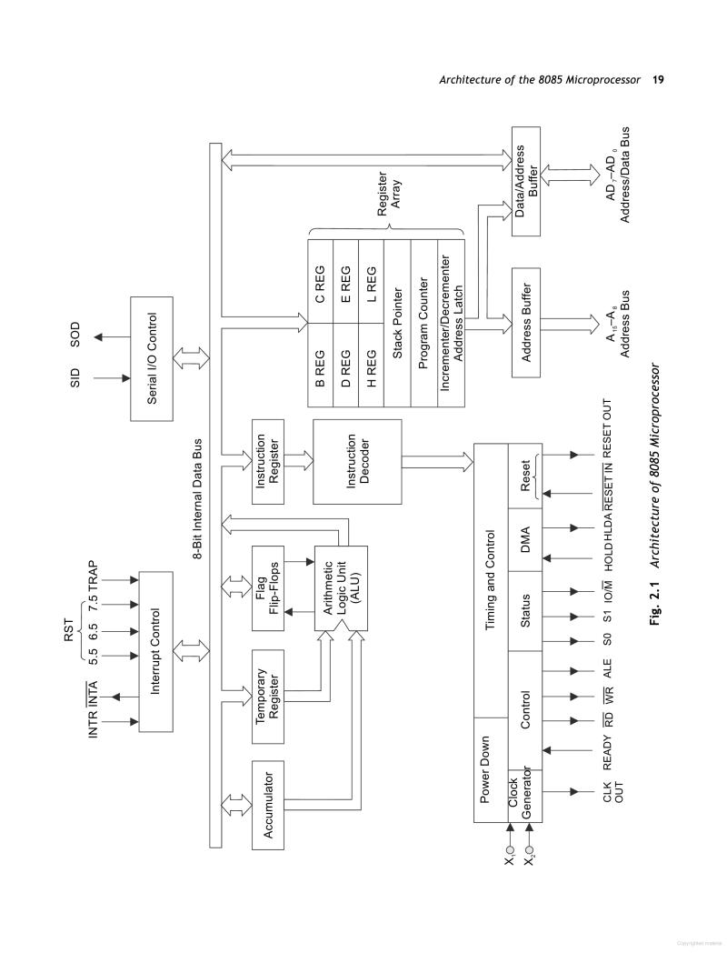

Slide 9
Accumulator
8 bit register
It is part of arithmetic and logic unit
Identified as A or ACC
Used stored 8 bit data and perform arithmetic and logic operations
The final results will be stored in this register after Arithmetic and logic operation

Slide 10
Temporary register (TR)
8 bit register
Associated with ALU
This register hold data during arithmetic and logical operation
This register used by the microprocessor but is not accessible to the programmer

Slide 11
TEMPORARY REGISTER
The temporary register is not accessible by the user.
So, it cannot read by the user.
The ALU always operate with one or two operand.
Operands are available in general purpose register or memory.
Final results will stored in the accumulator.

Slide 12
General purpose registers
B, C, D, E, H and L
Register used to store 8 bit operand
To hold 16 bit data or 16 bit memory address, two 8 bit registers can be combined. It is known as register pair (BC, DE and HL).
HL pair is used as the address of memory location
BC and DE are used to store the 16 bit data.
It can be accessed by programmer during execution

Slide 13
Special purpose register
Program counter (PC)
Stack pointer (SP)
Flag/ status register (FR or SR)
Instruction register (IR)
Memory address register (MAR)
Temporary register

Slide 14
Program counter (PC)
16 bit special purpose register
It is hold the memory address of the next instruction which will be executed.
This register keep track of memory location of the instruction during execution of program.
Microprocessor increment the program counter after execution of each instruction

Slide 15
Stack pointer (SP)
16 bit special purpose register
The stack is a sequence of memory location in the R/W memory.
Starting of the stack is defined by 16 bit address into the stack pointer.
Programmers use this register to store or retrieve the contents of the accumulator, flag register, program counter during execution of program

Slide 16
Instruction register (IR)
The instruction registers holds the operation code (opcode) of the current instruction of a program during arithmetic and logical operation.
The instruction is fetched from the memory prior to execution.
The decoder takes the instruction and decodes.
After that, decoded instruction pass to the next stage for execution

Slide 17
Timing and control unit
Control unit control the operations of different units while the CPU generates timing sequence signals for executions of instruction.
This unit control the data flow between CPU to memory and CPU to peripherals devices.
It controls the entire operations of microprocessors.
Timing and control unit act as the brain of the microprocessor

Slide 18
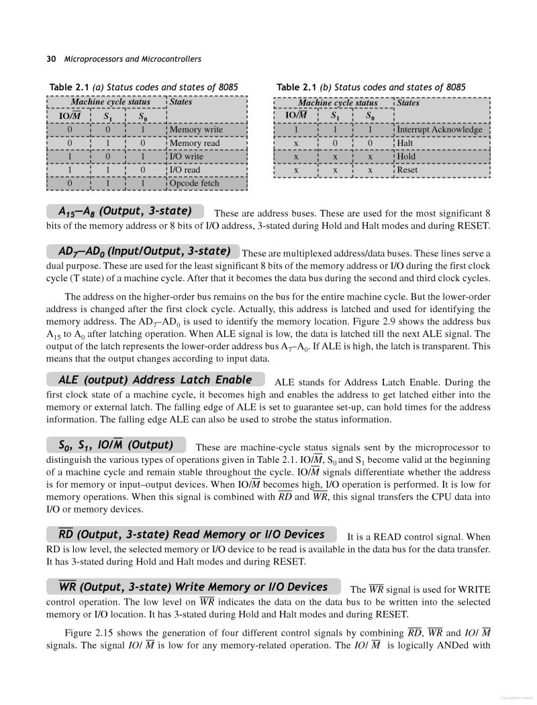

Slide 19
Interrupt
Interrupt:
It means interrupting the normal execution of the
microprocessor.
When microprocessor receives interrupt signal, it discontinues whatever it was executing.
It starts executing new program indicated by the interrupt signal.
Interrupt signals are generated by external peripheral
devices.
After execution of the new program, microprocessor goes back to the previous program.

Slide 20
Flags/ status register
ALU includes five flips, which are set or reset after an ALU operation according to content of accumulator and other general purpose register.
Status of each flip flops known as flag
Five flags
Carry flag (CY), Parity flag (PY), Auxiliary Carry flag (AC), Zero flag (Z) and Sign flag (S)

Slide 21
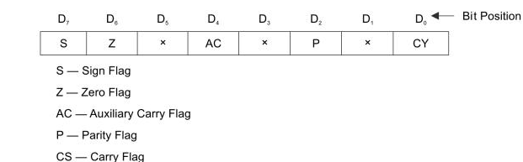

Slide 22
2.ALU performs the following operations
Addition
Subtraction
Logical AND
Logical OR
Logical Ex-OR
Complement
Increment by 1
Decrement by 1
Rotate left, rotate right
Clear

Slide 23
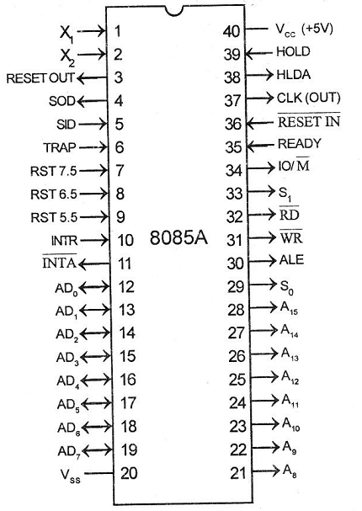
3.PIN DIAGRAM
Pin 1 and Pin 2 (Input)
These are also called
Crystal Input Pins.
8085 can generate clock signals internally.
To generate clock signals internally, 8085 requires external inputs from X1 and X2.
Clk generator provides an output on CLK OUT (pin 37)

Slide 24
RESET IN AND RESET OUT
Pin 36 (Input) and Pin 3 (Output)
RESET IN:
It is used to reset the Microprocessor.
It is active low signal.
When the signal on this pin is low for at least 3 clocking cycles, it forces the microprocessor to reset itself.

Slide 25


Resetting the microprocessor means:
Clearing the PC and IR.
Disabling all interrupts
(except TRAP).
Disabling the SOD pin.
All the buses (data, address, control) are tri- stated.
Gives HIGH output to RESET OUT pin.

Slide 26
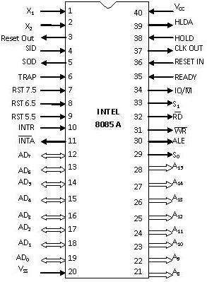
RESET IN and RESET OUT
Pin 36 (Input) and Pin 3 (Output)
RESET OUT:
It is used to reset the peripheral devices and other ICs on the circuit.
It is an output signal.
It is an active high signal.
The output on this pin goes high whenever RESET IN is given low signal.
The output remains high as long as RESET IN is kept low.

Slide 27
SID and SOD
Pin 4 (Input) and Pin 5 (Output)
SID (Serial Input
Data):
It takes 1 bit input from serial port of 8085.
Stores the bit at the 8th position (MSB) of the Accumulator.
RIM (Read Interrupt Mask) instruction is used to transfer the bit.

Slide 28
SID and SOD
Pin 4 (Input) and Pin 5 (Output)
SOD (Serial Output Data):
It takes 1 bit from Accumulator to serial port of 8085.
Takes the bit from the 8th position (MSB) of the Accumulator.
SIM (Set Interrupt Mask) instruction is used to transfer the bit.

Slide 29
INTERRUPT PIN

Slide 30
TRAP
Pin 6 (Input)
It is an non-maskable interrupt.
It has the highest priority.
cannot be disabled.
TRAP is usually used for power failure and emergency shutoff.
Microprocessor starts execution from 0024H Vector address

Slide 31


RST 7.5
Pin 7 (Input)
It is a maskable interrupt.
It has the second highest priority.
Microprocessor starts execution from 003CH Vector address

Slide 32


RST 6.5
Pin 8 (Input)
It is a maskable interrupt.
It has the third highest
priority.
RST 6.5 can be enabled by EI instruction.
It can be disabled by DI Instruction.
Microprocessor starts execution from 0034H Vector address

Slide 33


RST 5.5
Pin 9 (Input)
It is a maskable
interrupt.
It has the fourth highest priority.
It is also level
triggered.
This interrupt is very similar to RST 6.5.
Microprocessor starts execution from 002CH Vector address

Slide 34


INTR
Pin 10 (Input)
It is a maskable interrupt.
It has the lowest priority.
It is a general purpose interrupt.
By general purpose we mean that it can be used to vector microprocessor to any specific subroutine having any address.

Slide 35


Pin 11 (Output)It stands for interrupt
acknowledge.
It is an out going signal.
It is an active low
signal.
Low output on this pin indicates that microprocessor has acknowledged the INTR request.

Slide 36

Address and Data Pins

Slide 37
Address and Data Pins
Address Bus:
The address bus is used to send address to memory.
It selects one of the many locations in memory.
Its size is 16-bit.

Slide 38
Address and Data Pins
Data Bus:
It is used to transfer data between microprocessor and memory.
Data bus is of 8-bit.

Slide 39







AD₀ – AD₇
Pin 19-12 (Bidirectional)
These pins serve the dual purpose of transmitting lower order address and data byte.
During 1st clock cycle, these pins act as lower half of address.
In remaining clock cycles, these pins act as data bus.
The separation of lower order address and data is done by address latch.

Slide 40





A₈ – A₁₅
Pin 21-28 (Unidirectional)
These pins carry the higher order of address bus.
The address is sent from microprocessor to memory.

Slide 41


Pin 30 (Output)
ALE
It is used to enable Address Latch.
It indicates whether bus functions as address bus or data bus.
If ALE = 1 then
Bus functions as address bus.
If ALE = 0 then
Bus functions as data bus.

Slide 42



S₀ and S₁
Pin 29 (Output) and Pin 33 (Output)
S₀ and S₁ are called Status Pins.
They tell the current operation which is in progress in 8085.
S₀ | S₁ | Operation
0 | 0 | Halt
0 | 1 | Write
1 | 0 | Read
1 | 1 | Opcode Fetch

Slide 43


IO/M
Pin 34 (Output)
This pin tells whether I/O or memory operation is being performed.
If IO/M = 1 then
I/O operation is being
performed.
If IO/M = 0 then
Memory operation is being performed.

Slide 44
IO/M
Pin 34 (Output)
The operation being performed is indicated by S₀ and S₁.
If S₀ = 0 and S₁ = 1 then
It indicates WRITE operation.
If IO/M = 0 then
It indicates Memory operation.
Combining these two we get Memory Write
Operation.

Slide 45
Table Showing IO/M, S₀, S₁ and
Corresponding Operations
Operations | IO/M | S₀ | S₁
Opcode Fetch | 0 | 1 | 1
Memory Read | 0 | 1 | 0
Memory Write | 0 | 0 | 1
I/O Read | 1 | 1 | 0
I/O Write | 1 | 0 | 1
Interrupt Ack. | 1 | 1 | 1
Halt | 1/0 | 0 | 0

Slide 46


Pin 32 (Output)
RD
RD stands for Read.
It is an active low signal.
It is a control signal used for Read operation either from memory or from Input device.
A low signal indicates that data on the data bus must be placed either from selected memory location or from input device.

Slide 47


Pin 31 (Output)
WR
WR stands for Write.
It is also active low signal.
It is a control signal used for Write operation either into memory or into output device.
A low signal indicates that data on the data bus must be written into selected memory location or into output device.

Slide 48


READY
Pin 35 (Input)
This pin is used to synchronize slower peripheral devices with fast microprocessor.
A low value causes the microprocessor to enter into wait state.
The microprocessor remains in wait state until the input at this pin goes high.

Slide 49


HOLD
Pin 38 (Input)
HOLD pin is used to request the microprocessor for DMA transfer.
A high signal on this pin is a request to microprocessor to release the hold on buses.
This request is sent by DMA controller.
Intel 8257 and Intel 8237 are two DMA controllers.

Slide 50


HLDA
Pin 39 (Output)
HLDA stands for Hold Acknowledge.
The microprocessor uses this pin to acknowledge the receipt of HOLD signal.
When HLDA signal goes high, address bus, data bus, RD, WR, IO/M pins are tri-stated.
This means they are cut-off from external environment.

Slide 51
HLDA
Pin 39 (Output)
When HOLD goes low, HLDA also goes low and the microprocessor takes control of the buses.

Slide 52





V_{SS} and V_{CC}
Pin 20 (Input) and Pin 40 (Input)
 +5V power supply is
connected to V_{CC}.
 Ground signal is connected to V_{SS}.

Slide 53
4.Addressing Modes of 8085

Slide 54
Addressing Modes of 8085
Addressing Modes : is the technique used to fetch the desired operand during the execution of an instruction.
Instructions can be categorized according to their method of addressing the hardware registers and/or memory.

Slide 55
Addressing Modes of 8085
• The 8085 MPU uses five addressing Modes:
Immediate Addressing Modes
Register Addressing Modes
Direct Addressing Modes
Register Indirect Addressing Modes
Implied Addressing Modes

Slide 56
Addressing Modes of 8085
Immediate Addressing Mode:
Data immediately follow the opcode in program memory
The operand comes from next byte in program memory
Example: MVI E,08h
ADI 7Ah
LXI B,0001h

Slide 57
Addressing Modes of 8085
Register Addressing Mode:
• Many 8085 MPU instructions use register addressing
• Specify one of the registers A through E, H or L as well as the operation code.
• The operand is retrieved from internal CPU Register
Example: MOV A,B
ANA E
SUB H

Slide 58
Addressing Modes of 8085
Direct Addressing Mode:
• Address is given directly in the instruction
The operand is accessed from the given address of memory / IO device
Example: STA 2005h
LHLD 8200h
IN 96h
OUT 01h

Slide 59
Addressing Modes of 8085
Register Indirect Addressing Mode:
• Address is given indirectly by specifying register pair
The content of register pair will be taken address of memory
The content of memory location is the original operand
Example: MOV A,M
SUB M
LDAX B

Slide 60
Addressing Modes of 8085
Implied / Implicit / Inherent Addressing Mode:
• Some Instructions specify the operand within the opcode itself
Example: STC, CMA, RAL
Some other instructions do not deal with operands
Example: HLT

Slide 61
5. Detailed Review of the
8085 Instruction Set

Slide 62
8085 Instruction Set
The 8085 instructions can be classified as follows:
Data transfer Instructions
Arithmetic Instructions (ADD, SUB, INR, DCR)
Logical Instructions (NOT, AND, OR, EXOR)
Branching Instructions (JMP, CALL, RET)
Between registers
Between memory location and a register
Direct write to a register / memory
Between I/O device and accumulator

Slide 63
8085 Instruction Types
One Byte Instructions:
Includes both opcode and operand in the same byte
Example
Opcode | Operand | Hex Code
MOV | C,A | 4F
ADD | B | 80
CMA |  | 2F

Slide 64
8085 Instruction Types
Two Byte Instructions:
First byte specifies opcode and second byte specifies operand
Example
Opcode | Operand | Hex Code
MVI | A, 07 | 3E, 07

Slide 65
8085 Instruction Types
Three Byte Instructions:
First byte specifies opcode and the following two bytes specifies address
Example
Note: Second byte is lower order address
Third byte is higher order address
Opcode | Operand | Hex Code
JMP | 2085 | C3, 85, 20

Slide 66
Data Transfer Instructions
MOV
MOV r1, r2
MOV r, M
MOV M, r
MVI
MVI r, 8 bit data
MVI M, 8 bit data
LDA address
STA address
LDAX rp
STAX rp
LHLD address
SHLD address
LXI rp, 16 bit data
XCHG

Slide 67
Example
Instruction:
MOV A, B
Register contents before Execution
Register contents after Execution
A
9A _{h}
A
89 _{h}
B
89 _{h}
B
89 _{h}
Note: No flags are modified during the execution of data transfer instruction.

Slide 68
Example
Instruction:
MOV C, M
Register contents before Execution
Register contents after Execution
C
9A _{h}
C
C2 _{h}
HL
8500_{h}
HL
8500_{h}
MEMORY
MEMORY
84FF
7Ah
84FF
7Ah
8500
C2h
8500
C2h
8501
45_{h}
8501
45_{h}
8502
F4_{h}
8502
F4_{h}

Slide 69
Example
Instruction:
MVI B, 18h
Register contents before Execution
Register contents after Execution
B
9A _{h}
B
18 _{h}

Slide 70
Example
Instruction:
LDA 2005h
Register contents before Execution
Register contents after Execution
A
87 _{h}
A
45 _{h}
MEMORY
MEMORY
2003
7Ah
2003
7Ah
2004
C2h
2004
C2h
2005
45_{h}
2005
45_{h}
2006
F4_{h}
2006
F4_{h}

Slide 71
Example
Instruction:
STA 2005h
Register contents before Execution
Register contents after Execution
A
87 _{h}
A
87 _{h}
MEMORY
MEMORY
2003
7Ah
2003
7Ah
2004
C2h
2004
C2h
2005
45_{h}
2005
87_{h}
2006
F4_{h}
2006
F4_{h}

Slide 72
Example
Instruction:
LDAX D
Register contents before Execution
Register contents after Execution
A
2Bh
A
C2 _{h}
DE
4020h
DE
4020h
MEMORY
MEMORY
401F
7Ah
401F
7Ah
4020
C2h
4020
C2h
4021
45_{h}
4021
45_{h}
4022
F4_{h}
4022
F4_{h}

Slide 73
Example
Instruction:
STAX B
Register contents before Execution
Register contents after Execution
A
A4h
A
A4 _{h}
BC
4020h
BC
4020h
MEMORY
MEMORY
401F
7Ah
401F
7Ah
4020
C2h
4020
A4h
4021
45_{h}
4021
45_{h}
4022
F4_{h}
4022
F4_{h}

Slide 74
Example
Instruction:
LHLD 2005h
Register contents before Execution
Register contents after Execution
HL
74F1h
HL
45C2h
MEMORY
MEMORY
2004
7Ah
2004
7Ah
2005
C2h
2005
C2h
2006
45_{h}
2006
45_{h}
2007
F4_{h}
2007
F4_{h}

Slide 75
Example
Instruction:
SHLD 2005h
Register contents before Execution
Register contents after Execution
HL
74F1h
HL
74F1h
MEMORY
MEMORY
2004
7Ah
2004
7Ah
2005
A4h
2005
F1h
2006
45_{h}
2006
74_{h}
2007
F4_{h}
2007
F4_{h}

Slide 76
Example
Instruction:
LXI B, 1122h
Register contents before Execution
Register contents after Execution
BC
76DA _{h}
BC
1122 _{h}

Slide 77
Example
Instruction:
XCHG
Register contents before Execution
Register contents after Execution
HL
1234 _{h}
HL
5678 _{h}
DE
5678 _{h}
DE
1234 _{h}

Slide 78
Arithmetic Instructions
ADD
ADD r or M
ADC r or M
ADI 8 bit data
ACI 8 bit data
DAD rp
SUB
SUB r or M
SBB r or M
SUI 8 bit data
SBI 8 bit data
INR r or M
DCR r or M
INX rp
DCX rp
DAA

Slide 79
Example
Instruction:
ADD B
Register contents before Execution
Register contents after Execution
A
9A _{h}
A
23 _{h}
B
89 _{h}
B
89 _{h}
1 0 0 1 1 0 1 0
1 0 0 0 1 0 0 1
0 0 1 0 0 0 1 1
Flag: S=0, Z=0, AC=1 , P=0 and CY=1
Note: All flags are affected during the execution of arithmetic instruction.

Slide 80
Example
Instruction:
ADC B
Register contents before Execution
Register contents after Execution
A
9A _{h}
A
24 _{h}
B
89 _{h}
B
89 _{h}
Flag: S=0, Z=0, AC=0 , P=0 and C=1
Flag: S=0, Z=0, AC=1 , P=1 and CY=1
1 0 0 1 1 0 1 0
1 0 0 0 1 0 0 1
1
0 0 1 0 0 1 0 0

Slide 81
Example
Instruction:
ADI B2h
Register contents before Execution
Register contents after Execution
A
C4 _{h}
A
76 _{h}
Flag: S=0, Z=0, AC=0, P=0 and CY=0
Flag: S=0, Z=0, AC=0 , P=0 and CY=1
1 1 0 0 0 1 0 0
1 0 1 1 0 0 1 0
0 1 1 1 0 1 1 0

Slide 82
Example
Instruction:
ACI 15h
Register contents before Execution
Register contents after Execution
A
38 _{h}
A
4E _{h}
Flag: S=0, Z=0, AC=0 , P=1 and CY=0
Flag: S=0, Z=0, AC=0 , P=0 and C=1
0 0 1 1 1 0 0 0
0 0 0 1 0 1 0 1
1
0 1 0 0 1 1 1 0

Slide 83
Example
Instruction:
DAD B
Register contents before Execution
Register contents after Execution
HL
2233 _{h}
HL
3355 _{h}
BC
1122 _{h}
BC
1122 _{h}
Note: No flags are affected except Carry Flag.

Slide 84
Example
Instruction:
SUB M
Register contents before Execution
Register contents after Execution
A
20 _{h}
A
18 _{h}
HL
8500_{h}
HL
8500_{h}
MEMORY
MEMORY
84FF
7Ah
84FF
7Ah
8500
08h
0 0 1 0 0 0 0 0
8500
08h
8501
45_{h}
0 0 0 0 1 0 0 0
8501
45_{h}
8502
F4_{h}
0 0 0 1 1 0 0 0
8502
F4_{h}
Flag: S=0, Z=0, AC=0 , P=0 and CY=1
Flag: S=0, Z=0, AC=1 , P=1 and CY=0

Slide 85
Example
Instruction:
SBB B
Register contents before instruction
Register contents after Execution
A
40 _{h}
A
1F _{h}
B
20 _{h}
B
20 _{h}
Flag: S=0, Z=0, AC=0 , P=0 and C=1
Flag: S=0, Z=0, AC=1, P=0 and CY=0
0 1 0 0 0 0 0 0
0 0 1 0 0 0 0 0
1
0 0 0 1 1 1 1 1

Slide 86
Example
Instruction:
SUI 13h
Register contents before Execution
Register contents after Execution
A
05 _{h}
A
F2 _{h}
Flag: S=0, Z=0, AC=0 , P=0 and CY=0
Flag: S=1, Z=0, AC=0, P=0 and CY=1
0 0 0 0 0 1 0 1
0 0 0 1 0 0 1 1
1 1 1 1 0 0 1 0

Slide 87
Example
Instruction:
SBI 13h
Register contents before Execution
Register contents after Execution
A
18 _{h}
A
04 _{h}
Flag: S=0, Z=0, AC=0, P=0 and CY=0
Flag: S=0, Z=0, AC=0 , P=0 and C=1
0 0 0 1 1 0 0 0
0 0 0 1 0 0 1 1
1
0 0 0 0 0 1 0 0

Slide 88
Example
Instruction:
INR E
Register contents before Execution
Register contents after Execution
E
1C _{h}
E
1D _{h}
Note: Except Carry Flag, all flags are affected depend upon the result.

Slide 89
Example
Instruction:
DCR M
Register contents before Execution
Register contents after Execution
HL
8500_{h}
HL
8500_{h}
MEMORY
MEMORY
84FF
7Ah
84FF
7Ah
8500
08h
8500
07h
8501
45_{h}
8501
45_{h}
8502
F4_{h}
8502
F4_{h}
Note: Except Carry Flag, all flags are affected depend upon the result.

Slide 90
Example
Instruction:
INX D
Register contents before Execution
Register contents after Execution
DE
A103 _{h}
DE
A104 _{h}
Note: No Flags are affected.

Slide 91
Example
Instruction:
DCX H
Register contents before Execution
Register contents after Execution
HL
FFFF _{h}
HL
FFFE _{h}
Note: No Flags are affected.

Slide 92
Example
Instruction:
DAA
Register contents before Execution
Register contents after Execution
A
6C _{h}
A
72 _{h}
Flag: S=0, Z=0, AC=0 , P=0 and CY=0
0 1 1 0 1 1 0 0
Flag: S=0, Z=0, AC=1 , P=1 and CY=0
0 0 0 0 0 1 1 0
0 1 1 1 0 0 1 0

Slide 93
Logical Instructions
ANA
ANA r or M
ANI 8 bit data
ORA
ORA r or M
ORI 8 bit data
XRA
XRA r or M
XRI 8 bit data
CMA
CMC
CMP
CMP r or M
CPI 8 bit data
STC
RLC
RRC
RAL
RAR

Slide 94
Example
Instruction:
ANA C
Register contents before Execution
Register contents after Execution
A
62 _{h}
A
42 _{h}
C
4A _{h}
C
4A _{h}
Flag: S=0, Z=0, AC=0 , P=0 and CY=0
0 1 1 0 0 0 1 0
Flag: S=0, Z=0, AC=1 , P=1 and CY=0
0 1 0 0 1 0 1 0
0 1 0 0 0 0 1 0
Note: S, Z, P flags are affected during the execution of AND instruction. CY=0 AC = 1

Slide 95
Example
Instruction:
ANI 15h
Register contents before Execution
Register contents after Execution
A
62 _{h}
A
00 _{h}
Flag: S=0, Z=0, AC=0 , P=0 and CY=0
Flag: S=0, Z=1, AC=1 , P=1 and CY=0
0 1 1 0 0 0 1 0
0 0 0 1 0 1 0 1
0 0 0 0 0 0 0 0

Slide 96
Example
Instruction:
ORA C
Register contents before Execution
Register contents after Execution
A
62 _{h}
A
6A _{h}
C
4A _{h}
C
4A _{h}
0 1 1 0 0 0 1 0
Flag: S=0, Z=0, AC=0 , P=1 and CY=0
Flag: S=0, Z=0, AC=0 , P=0 and CY=0
0 1 0 0 1 0 1 0
0 1 1 0 1 0 1 0
Note: S, Z, P flags are affected during the execution of OR instruction. CY=0 AC = 0

Slide 97
Example
Instruction:
ORI 15h
Register contents before Execution
Register contents after Execution
A
62 _{h}
A
77 _{h}
Flag: S=0, Z=0, AC=0 , P=0 and CY=0
Flag: S=0, Z=0, AC=0 , P=1 and CY=0
0 1 1 0 0 0 1 0
0 0 0 1 0 1 0 1
0 1 1 1 0 1 1 1

Slide 98
Example
Instruction:
XRA E
Register contents before Execution
Register contents after Execution
A
EE _{h}
A
B4 _{h}
E
5A _{h}
E
5A _{h}
1 1 1 0 1 1 1 0
Flag: S=0, Z=0, AC=0 , P=0 and CY=0
0 1 0 1 1 0 1 0
Flag: S=0, Z=0, AC=0 , P=1 and CY=0
1 0 1 1 0 1 0 0
Note: S, Z, P flags are affected during the execution of XOR instruction. CY=0 AC = 0

Slide 99
Example
Instruction:
XRI 18h
Register contents before Execution
Register contents after Execution
A
C3 _{h}
A
DB _{h}
Flag: S=0, Z=0, AC=0 , P=0 and CY=0
Flag: S=0, Z=0, AC=0 , P=1 and CY=0
1 1 0 0 0 0 1 1
0 0 0 1 1 0 0 0
1 1 0 1 1 0 1 1

Slide 100
Example
Instruction:
CMA
Register contents before Execution
Register contents after Execution
A
9A _{h}
A
65 _{h}
1 0 0 1 1 0 1 0
0 1 1 0 0 1 0 1
Note: No Flags are affected.

Slide 101
Example
Instruction:
CMP L
Register contents before Execution
Register contents after Execution
A
45 _{h}
A
45 _{h}
L
75 _{h}
C
75 _{h}
0 1 0 0 0 1 0 1
Flag: Z=0 and CY=1
Flag: Z=0 and CY=0
0 1 1 1 0 1 0 1
1 1 0 1 0 0 0 0
Note: Besides Z and CY, All other Flags are also affected.

Slide 102
Example
Instruction:
CPI 45h
Register contents before Execution
Register contents after Execution
A
62 _{h}
A
62 _{h}
Flag: Z=0 and CY=0
Flag: Z=0 and CY=0
0 1 1 0 0 0 1 0
0 1 0 0 0 1 0 1
0 0 0 1 1 1 0 1

Slide 103
Example
Instruction:
RLC
Register contents before Execution
CY
A
1
0
1
1
0
1
0
1
1
Register contents after Execution
CY
A
0
 |  |  |  |  |  |  | 0
1 | 1 | 0 | 1 | 0 | 1 | 1 | 0

Slide 104
Example
Instruction:
RRC
Register contents before Execution
CY
A
1
0 | 1 | 1 | 0 | 1 | 0 | 1 | 1
Register contents after Execution
CY
A
1
 | 0 | 1 | 1 | 0 | 1 | 0 | 1
1 | 0 | 1 | 1 | 0 | 1 | 0 | 1

Slide 105
Example
Instruction:
RAL
Register contents before Execution
CY
A
0
1 | 1 | 1 | 0 | 0 | 0 | 0 | 1
Register contents after Execution
CY
A
1
 |  |  |  |  |  |  | 0
1 | 1 | 0 | 0 | 0 | 0 | 1 | 0

Slide 106
Example
Instruction:
RAR
Register contents before Execution
CY
A
0
1 | 1 | 1 | 0 | 0 | 0 | 0 | 1
Register contents after Execution
CY
A
1
0
0 | 1 | 1 | 1 | 0 | 0 | 0 | 0

Slide 107
Branching Instructions
Jump Unconditionally
Jump Conditionally
JC, JNC
JP, JM
JPE, JPO
JZ, JNZ
Call Unconditionally
Call Conditionally
CC, CNC
CP, CM
CPE, CPO
CZ, CNZ
Return Unconditionally
Return Conditionally
RST
PCHL
Notes:
107

Slide 108
Example
Instruction:
JMP 8500h
Register contents before Execution
Register contents after Execution
PC
8000_{h}
PC
8500 _{h}
Note: No Flags are affected.

Slide 109
Example
Instruction:
CALL 8500h
Register contents before Execution
Register contents after Execution
PC
8000_{h}
PC
8500 _{h}
SP
1001 _{h}
STACK
1000
SP
1001
_{00h}
SP
1002
_{80h}
SP
1003
_{9Ch}
Note: No Flags are affected.

Slide 110
Example
Instruction:
RET
Register contents before Execution
Register contents after Execution
PC
8000_{h}
PC
9000 _{h}
SP
1001 _{h}
SP
1003 _{h}
STACK
STACK
1000
1001
₀₀
1000
1002
_{90h}
1001
_{9Ch}
1002
1003
1003
_{9Ch}
Note: No Flags are affected.

Slide 111
6.Flags/ status register

Slide 112
2.Flags/ status register
ALU includes five flips, which are set or reset after an ALU operation according to content of accumulator and other general purpose register.
Status of each flip flops known as flag
Five flags
Carry flag (CY), Parity flag (PY), Auxiliary Carry flag (AC), Zero flag (Z) and Sign flag (S)

Slide 114
Carry flag
Arithmetic operation generates carry in case of addition or a borrow in case of subtraction.
After execution, carry flag is set to 1.
position of the carry flag is D₀

Slide 115
Parity flag
After arithmetic or logical operation,
If number of 1s in the results is even then it is even parity, then parity flag set to 1.
If number of 1s in the results is odd then it is odd parity, then parity flag set to 0.
Position of the parity flag is D₂

Slide 116
Auxiliary carry flag
In arithmetic operation, if carry generated by bit D₃ and passed on D₄, then auxiliary carry flag is set.
This flag is used to internal binary coded decimal operations (BCD).
The position of this flag is D₄

Slide 117
Zero flag
When 8 bit ALU operation results is zero, then zero flag is set.
This flag affected by accumulator and general purpose register
Position of the flag is D₆

Slide 118
Sign flag
Sign flag has importance only on signed arithmetic operation
MSB of the 8 bit data is the sign bit.
When a number is negative, it is 1
When a number is positive, it is 0
For signed operation, remaining 7 bits are used for represent the magnitude of a number
After execution of signed arithmetic, MSB of the results also used represents the sign.
Position of sign flag is D₇

Slide 119
7.Sequence of operations of ALU
One operand is in the A register
The other operand may be in general purpose register or memory location, which will be transferred to the temporary register.
Contents of the accumulator and temporary registers are considered as inputs of ALU.
The results of ALU operation is transferred in the A register through internal data bus.
The content of the FLAG registers change depending on the result.

Slide 120
8. INTERRUPT

Slide 121
8. Interrupt:
Interrupt:
It means interrupting the normal execution of the microprocessor.
When microprocessor receives interrupt signal, it discontinues whatever it was executing.
It starts executing new program indicated by the interrupt signal.
Interrupt signals are generated by external peripheral devices.
After execution of the new program, microprocessor goes back to the previous program.

Slide 122
Sequence of Steps Whenever There is an Interrupt
Microprocessor completes execution of current instruction of the program.
PC contents are stored in stack.
PC is loaded with address of the new program.
After executing the new program, the microprocessor returns back to the previous program.
It goes to the previous program by reading the top value of stack.

Slide 123
Interrupts
Hardware
Interrupts
Software Interrupts
Maskable Interrupts
Nonmaskable Interrupts
The programmer can choose to mask specific interrupts and re-enable them later
The programmer cannot control when a non maskable interrupt is served
The processor has to stop the main program to execute the Service Routine.

Slide 124
Maskable Interrupts
Maskable interrupts are those interrupts which can be enabled or disabled.
Enabling and Disabling is done by software instructions.
List of Maskable Interrupts:
RST 7.5, RST 6.5, RST 5.5, INTR

Slide 125
Non-Maskable Interrupts
The interrupts which are always in enabled mode are called non- maskable interrupts.
These interrupts can never be disabled by any software instruction.
TRAP is a non-maskable interrupt.

Slide 126
Five Hardware Interrupts in 8085
TRAP
RST 7.5
RST 6.5
RST 5.5
INTR

Slide 127
09.MEMORY MAPPING

Slide 128
MEMORY MAPPING
In the 8085 microprocessor, memory mapping refers to the process of assigning specific memory addresses to different memory devices like RAM, ROM, and I/O devices in the system.
🔹 Key Points:
8085 has a 16-bit address bus: So, it can access 2¹⁶ = 65,536 = 64KB of memory locations.
Memory mapping means placing different types of memory (like ROM, RAM) in different address ranges within this 64KB space.
Each memory chip is connected to the microprocessor using address lines and control signals like RD̅, WR̅, and CS̅ (chip select).
Memory is divided based on address ranges. Example:
0000H to 1FFFH → ROM (for program storage)
2000H to 3FFFH → RAM (for data storage)
This mapping is done using address decoding logic, which activates a particular chip when its address range is accessed.

Slide 129
Memory read operation
Microprocessor place 16 bit address in to the address bus
Decoding the address bus for identifying the memory address of data
Microprocessor sends MEMR controls signal enable the memory IC
Data of memory location is placed in data bus and microprocessor

Slide 130
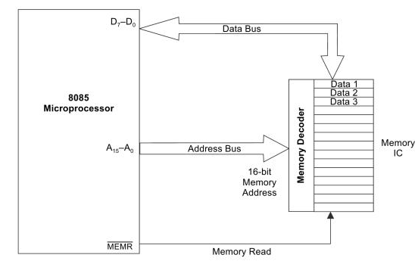

Slide 131
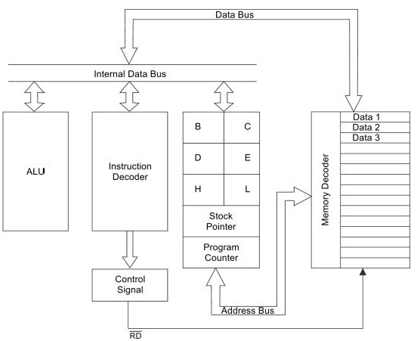

Slide 132
Memory Mapping
8085 has 16-bit Address Bus
The complete address space is thus given by the range of addresses 0000H – FFFFH
The range of addresses allocated to a memory device is known as its memory map

Slide 133
Memory map: 64K memory device
Address lines required: 16 (A0 – A15)
Memory map: 0000H - FFFFH
Memory map: 32K memory device
Address lines required: 15 (A0 – A14)
Memory map: depends on how address line A15 is connected

Slide 134
Memory device is selected only if IO/M = 0 & A15 = 0

Slide 135
10. TIMING DIAGRAM

Slide 136
TIMING DIAGRAM
The graphical representation of the instruction execution in steps with respect to the time is called timing diagram.

Slide 137
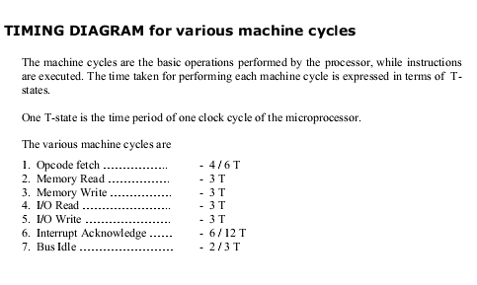

Slide 138
Instruction cycle
Instruction: A command given to the microprocessor to perform an operation
Program : A set of instructions given in a sequential manner to perform a particular task
The CPU fetches one instruction from memory at a time & executes it.
Instruction cycle = Fetch cycle + Execute cycle

Slide 139
Fetch Cycle : The steps taken by CPU to fetch the opcode from the memory
The time taken for fetch cycle is fixed.
Execute Cycle : The steps taken by CPU to fetch data & to perform the operation specified in the instruction
The time taken for execute cycle is variable which depends on the type of instruction ,i.e. 3 –byte , 2-byte & 1-byte instruction.

Slide 140
Machine cycle
The time required by the micro processor to complete the operation of accessing memory or I/O device .
Operations like :
Opcode fetch
Memory read
Memory write
I/O read
I/O write

Slide 141
T - states
Microprocessor performs an operation in specific clock cycles.
Each clock cycle is called as T –States.
The number of T – states required to perform an operation is called Machine Cycle .

Slide 142
Table Showing IO/M, S₀, S₁ and Corresponding Operations
Operations | IO/M | S₁ | S₀
Opcode Fetch | 0 | 1 | 1
Memory Read | 0 | 1 | 0
Memory Write | 0 | 0 | 1
I/O Read | 1 | 1 | 0
I/O Write | 1 | 0 | 1
Interrupt Ack. | 1 | 1 | 1
Halt | High Impedance | 0 | 0

Slide 143
Table Showing RD, WR, INTA and Corresponding Operations
Machine cycle | Control
 | RD | WR | INTA
Opcode fetch | 0 | 1 | 1
Memory read | 0 | 1 | 1
Memory write | 1 | 0 | 1
I/O read | 0 | 1 | 1
I/O wrte | 1 | 0 | 1
Intr ack | 1 | 1 | 1
Bus idle | 1 | 1 | 1

Slide 144
1. Instruction Cycle (IC)
It is the total time required by the microprocessor to fetch, decode, and execute an instruction.
It includes one or more machine cycles.
Instruction Cycle = Fetch Cycle + (Execute Cycle + any additional cycles like memory read/write, etc.)
2. Machine Cycle (MC)
A machine cycle is a basic operation performed by the microprocessor, such as:
Fetching instruction
Reading from memory
Writing to memory
Reading from I/O
Writing to I/O
Each machine cycle consists of multiple T-states (timing states or clock cycles).

Slide 145
Difference at a glance
Feature | Instruction Cycle | Machine Cycle
Definition | Total process of executing an instruction | One operation like memory read/write
Contains | Multiple machine cycles | Multiple T-states
Example | MVI A, 32H takes multiple machine cycles | Instruction Fetch, Memory Read

Slide 146
Example (8085):
Instruction: MVI A, 32H
This instruction cycle involves:
Instruction Fetch (Machine Cycle)
Memory Read (Machine Cycle)
So, this Instruction Cycle = 2 Machine Cycles

Slide 147
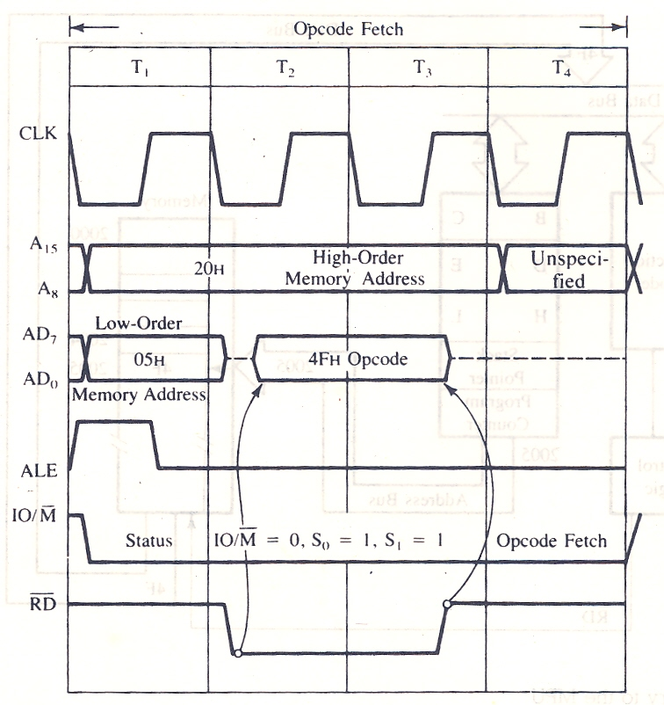
Timing Diagram

Slide 148
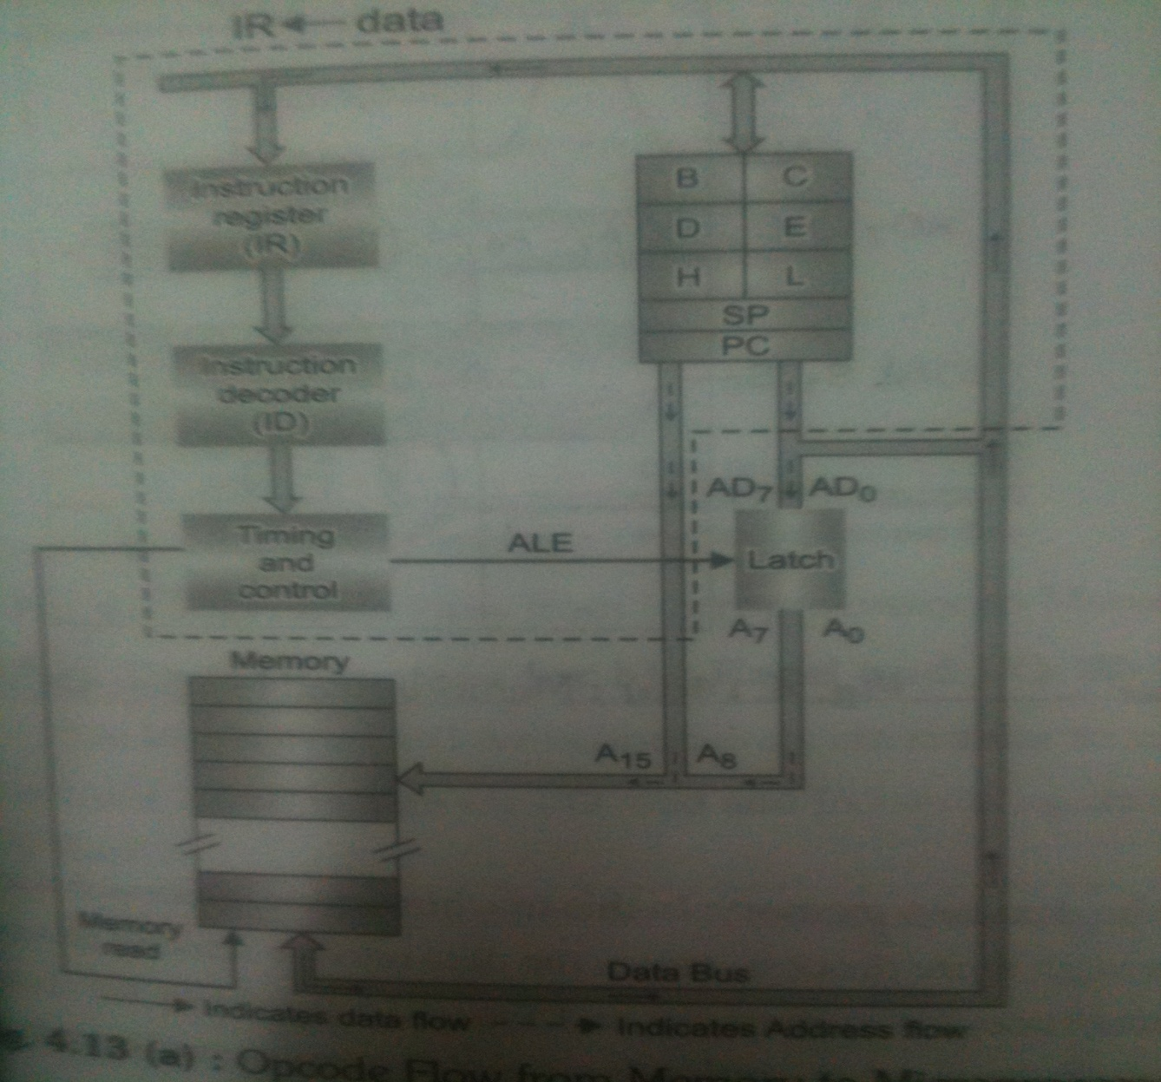
OPCODE FETCH

Slide 149
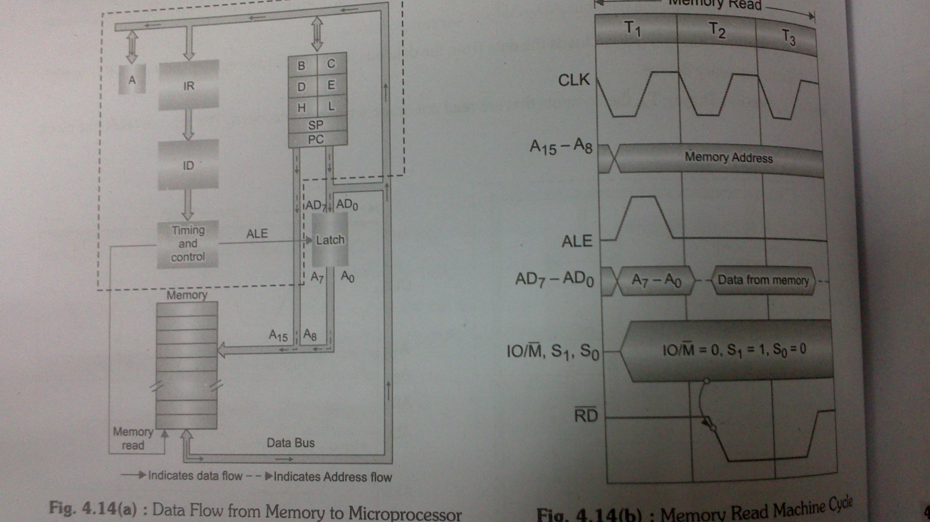
MEMORY READ MACHINE CYCLE

Slide 150
Memory Read: The flow of data from the memory to the microprocessor.
Step 1(T1) : microprocessor places the address on the address lines from program counter & activates ALE signal to multiplex the low order address.
It also sends status signals IO/M = 0, S₁=1, S₀ =0 for memory read operation.
Step 2 (T2) : SE

Slide 151
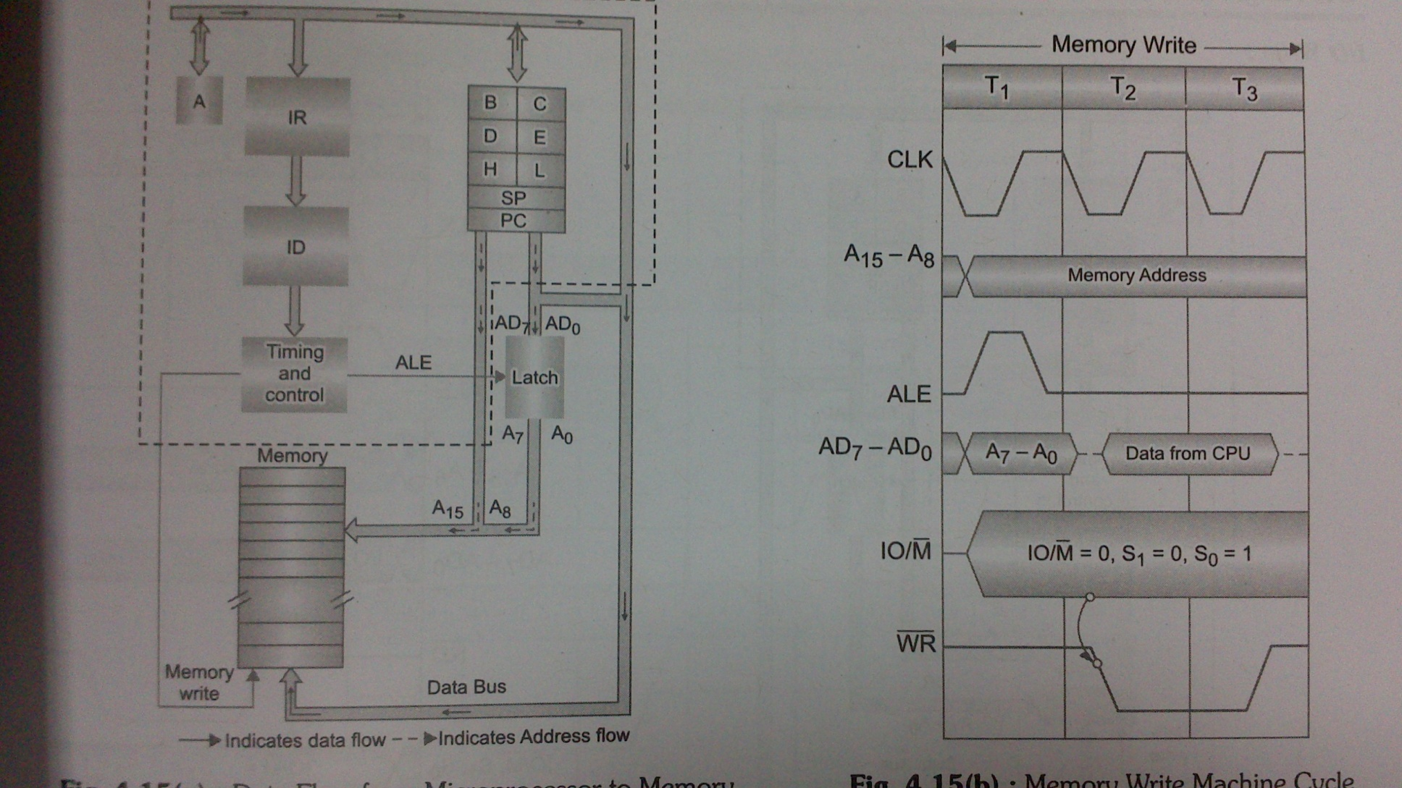
MEMORY WRITE MACHINE CYCLE

Slide 152
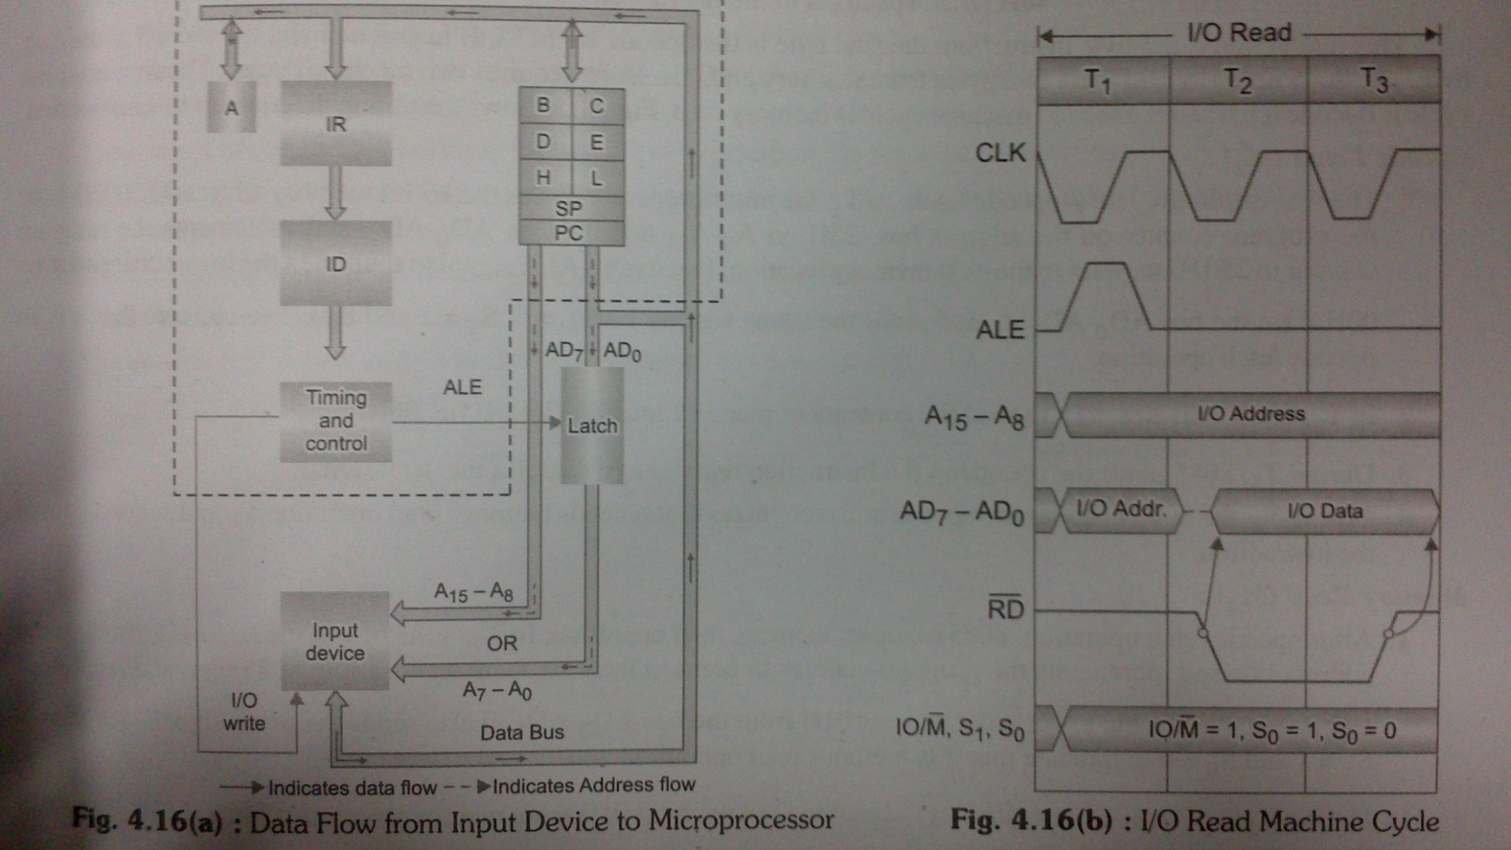
I/O READ MACHINE CYCLE

Slide 153
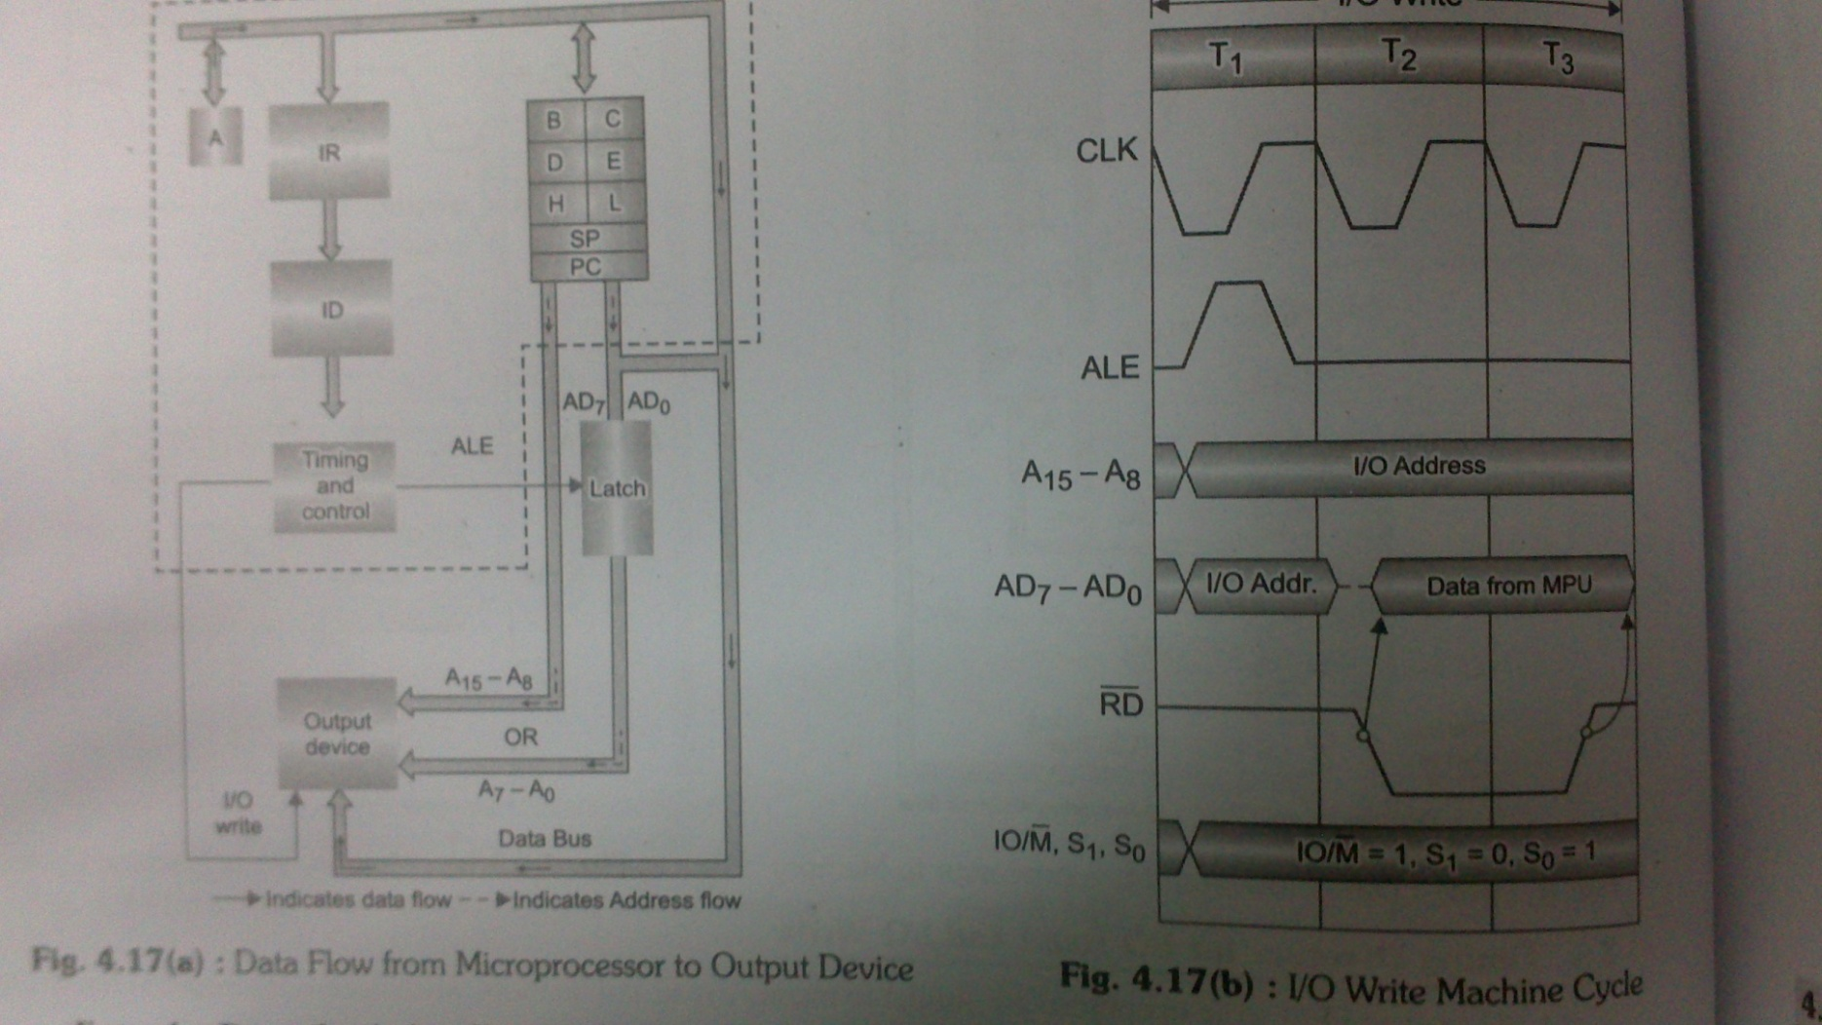
I/O WRITE MACHINE CYCLE

Slide 154
UNIT II

Slide 156
8086 MICROPROCESSOR

Slide 157
Microprocessor
Fifth Generation Pentium
Fourth Generation
During 1980s
Low power version of HMOS technology (HCMOS)
32 bit processors
Physical memory space 2²⁴ bytes = 16 Mb
Virtual memory space 2⁴⁰ bytes = 1 Tb
Floating point hardware
Supports increased number of addressing modes
Intel 80386
Third Generation
During 1978
HMOS technology ⇒ Faster speed, Higher packing density
16 bit processors ⇒ 40/ 48/ 64 pins
Easier to program
Dynamically relatable programs
Processor has multiply/ divide arithmetic hardware
More powerful interrupt handling capabilities
Flexible I/O port addressing
Intel 8086 (16 bit processor)
Second Generation
During 1973
NMOS technology ⇒ Faster speed, Higher density, Compatible with TTL
4 / 8/ 16 bit processors ⇒ 40 pins
Ability to address large memory spaces and I/O ports
Greater number of levels of subroutine nesting
Better interrupt handling capabilities
Intel 8085 (8 bit processor)
First Generation
Between 1971 – 1973
PMOS technology, non compatible with TTL
4 bit processors ⇒ 16 pins
8 and 16 bit processors ⇒ 40 pins
Due to limitations of pins, signals are multiplexed

Slide 159
1. Architecture

Slide 160
Functional blocks
Microprocessor
Computational Unit; performs arithmetic and logic operations
Various conditions of the results are stored as status bits called flags in flag register
Internal storage of data
Register array or internal memory
Data Bus
ALU
Generates the address of the instructions to be fetched from the memory and send through address bus to the memory
Flag Register
Instruction decoding unit
Timing and control unit
PC/ IP
Control Bus
Address Bus
Generates control signals for internal and external operations of the microprocessor
Decodes instructions; sends information to the timing and control unit

Slide 161
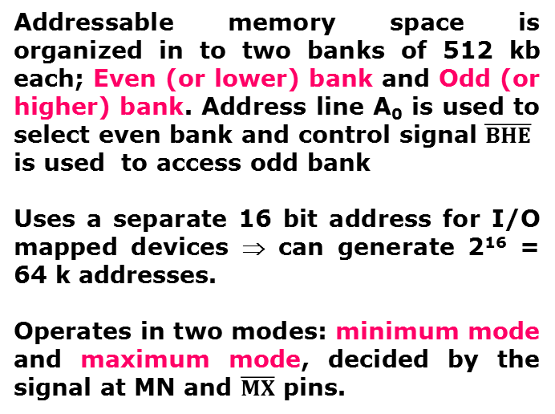
Overview
8086 Microprocessor
First 16- bit processor released by INTEL in the year 1978
Originally HMOS, now manufactured using HMOS III technique
Approximately 29, 000 transistors, 40 pin DIP, 5V supply
Does not have internal clock; external asymmetric clock source with 33% duty cycle
20-bit address to access memory ⇒ can address up to 2²⁰ = 1 megabytes of memory space.
Addressable memory space is organized in to two banks of 512 kb each; Even (or lower) bank and Odd (or higher) bank. Address line A₀ is used to select even bank and control signal $\overline{BHE}$
is used to access odd bank
Uses a separate 16 bit address for I/O mapped devices ⇒ can generate 2¹⁶ = 64 k addresses.
Operates in two modes: minimum mode and maximum mode, decided by the signal at MN and $\overline{MX}$ pins.
Notes:
DIP- Dual Inline Package

Slide 162
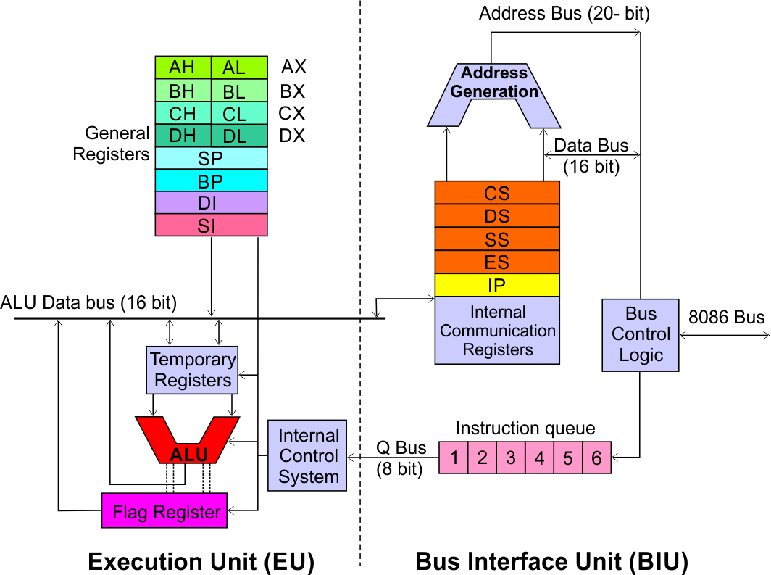
Architecture
8086 Microprocessor
Execution Unit (EU)
EU executes instructions that have already been fetched by the BIU.
BIU and EU functions separately.
Bus Interface Unit (BIU)
BIU fetches instructions, reads data from memory and I/O ports, writes data to memory and I/ O ports.

Slide 163
Architecture
8086 Microprocessor
Bus Interface Unit (BIU)
Dedicated Adder to generate 20 bit address
Four 16-bit segment registers
Code Segment (CS)
Data Segment (DS)
Stack Segment (SS)
Extra Segment (ES)
Segment Registers >>

Slide 164
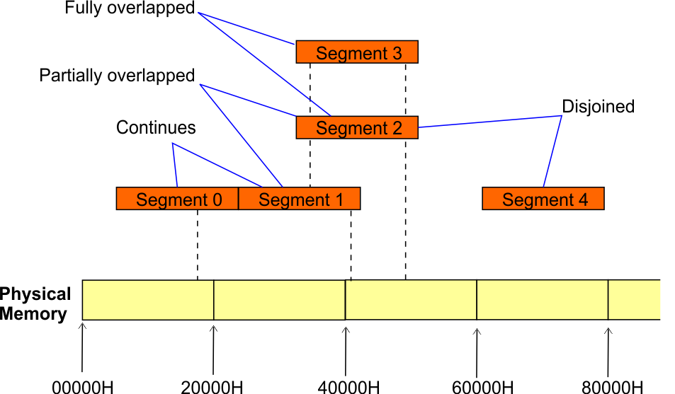
Architecture
8086 Microprocessor
Bus Interface Unit (BIU)
Segment
Registers
8086’s 1-megabyte memory is divided into segments of up to 64K bytes each.
The 8086 can directly address four segments (256 K bytes within the 1 M byte of memory) at a particular time.
Programs obtain access to code and data in the segments by changing the segment register content to point to the desired segments.

Slide 165
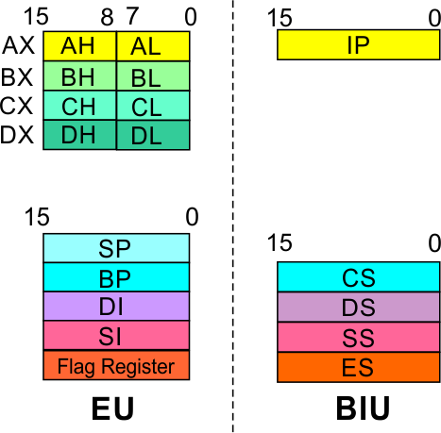
Architecture
8086 Microprocessor
Bus Interface Unit (BIU)
Segment
Registers
Code Segment Register
16-bit
CS contains the base or start of the current code segment; IP contains the distance or offset from this address to the next instruction byte to be fetched.
BIU computes the 20-bit physical address by logically shifting the contents of CS 4-bits to the left and then adding the 16-bit contents of IP.
That is, all instructions of a program are relative to the contents of the CS register multiplied by 16 and then offset is added provided by the IP.

Slide 166
Architecture
8086 Microprocessor
Bus Interface Unit (BIU)
Segment
Registers
Data Segment Register
16-bit
Points to the current data segment; operands for most instructions are fetched from this segment.
The 16-bit contents of the Source Index (SI) or Destination Index (DI) or a 16-bit displacement are used as offset for computing the 20-bit physical address.

Slide 167
Architecture
8086 Microprocessor
Bus Interface Unit (BIU)
Segment
Registers
Stack Segment Register
16-bit
Points to the current stack.
The 20-bit physical stack address is calculated from the Stack Segment (SS) and the Stack Pointer (SP) for stack instructions such as PUSH and POP.
In based addressing mode, the 20-bit physical stack address is calculated from the Stack segment (SS) and the Base Pointer (BP).

Slide 168
Architecture
8086 Microprocessor
Bus Interface Unit (BIU)
Segment
Registers
Extra Segment Register
16-bit
Points to the extra segment in which data (in excess of 64K pointed to by the DS) is stored.
String instructions use the ES and DI to determine the 20-bit physical address for the destination.

Slide 169
Architecture
8086 Microprocessor
Bus Interface Unit (BIU)
Segment
Registers
Instruction Pointer
16-bit
Always points to the next instruction to be executed within the currently executing code segment.
So, this register contains the 16-bit offset address pointing to the next instruction code within the 64Kb of the code segment area.
Its content is automatically incremented as the execution of the next instruction takes place.

Slide 170
Architecture
8086 Microprocessor
Bus Interface Unit (BIU)
Instruction queue
A group of First-In-First-Out (FIFO) in which up to 6 bytes of instruction code are pre fetched from the memory ahead of time.
This is done in order to speed up the execution by overlapping instruction fetch with execution.
This mechanism is known as pipelining.

Slide 171
Architecture
8086 Microprocessor
Execution Unit (EU)
EU decodes and executes instructions.
A decoder in the EU control system translates instructions.
16-bit ALU for performing arithmetic and logic operation
Four general purpose registers(AX, BX, CX, DX);
Pointer registers (Stack Pointer, Base Pointer);
and
Index registers (Source Index, Destination Index) each of 16-bits
Some of the 16 bit registers can be used as two 8 bit registers as :
AX can be used as AH and AL
BX can be used as BH and BL
CX can be used as CH and CL
DX can be used as DH and DL

Slide 172
Architecture
8086 Microprocessor
Execution Unit (EU)
EU
Registers
Accumulator Register (AX)
Consists of two 8-bit registers AL and AH, which can be combined together and used as a 16-bit register AX.
AL in this case contains the low order byte of the word, and AH contains the high-order byte.
The I/O instructions use the AX or AL for inputting / outputting 16 or 8 bit data to or from an I/O port.
Multiplication and Division instructions also use the AX or AL.

Slide 173
Architecture
8086 Microprocessor
Execution Unit (EU)
EU
Registers
Base Register (BX)
Consists of two 8-bit registers BL and BH, which can be combined together and used as a 16-bit register BX.
BL in this case contains the low-order byte of the word, and BH contains the high-order byte.
This is the only general purpose register whose contents can be used for addressing the 8086 memory.
All memory references utilizing this register content for addressing use DS as the default segment register.

Slide 174
Architecture
8086 Microprocessor
Execution Unit (EU)
EU
Registers
Counter Register (CX)
Consists of two 8-bit registers CL and CH, which can be combined together and used as a 16-bit register CX.
When combined, CL register contains the low order byte of the word, and CH contains the high-order byte.
Instructions such as SHIFT, ROTATE and LOOP use the contents of CX as a counter.
Example:
The instruction LOOP START automatically decrements CX by 1 without affecting flags and will check if [CX] = 0.
If it is zero, 8086 executes the next instruction; otherwise the 8086 branches to the label START.

Slide 175
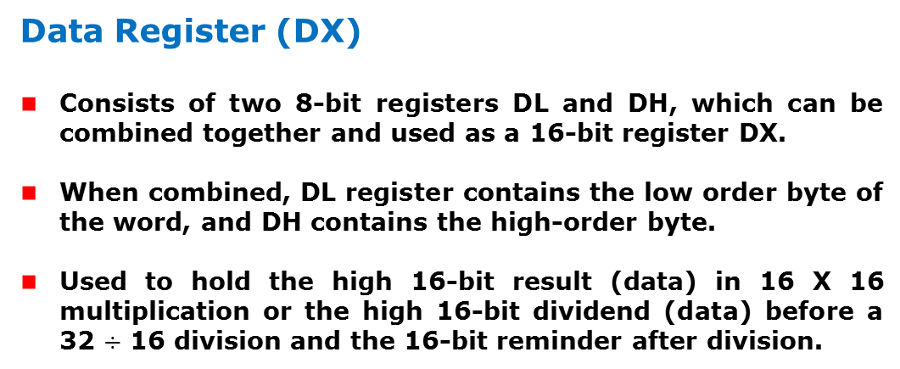
Architecture
8086 Microprocessor
Execution Unit (EU)
EU
Registers
Data Register (DX)
Consists of two 8-bit registers DL and DH, which can be combined together and used as a 16-bit register DX.
When combined, DL register contains the low order byte of the word, and DH contains the high-order byte.
Used to hold the high 16-bit result (data) in 16 X 16 multiplication or the high 16-bit dividend (data) before a 32 $÷$ 16 division and the 16-bit reminder after division.

Slide 176
Architecture
8086 Microprocessor
Execution Unit (EU)
EU
Registers
Stack Pointer (SP) and Base Pointer (BP)
SP and BP are used to access data in the stack segment.
SP is used as an offset from the current SS during execution of instructions that involve the stack segment in the external memory.
SP contents are automatically updated (incremented/ decremented) due to execution of a POP or PUSH instruction.
BP contains an offset address in the current SS, which is used by instructions utilizing the based addressing mode.

Slide 177
Architecture
8086 Microprocessor
Execution Unit (EU)
EU
Registers
Source Index (SI) and Destination Index (DI)
Used in indexed addressing.
Instructions that process data strings use the SI and DI registers together with DS and ES respectively in order to distinguish between the source and destination addresses.

Slide 178
Architecture
8086 Microprocessor
Execution Unit (EU)
EU
Registers
Source Index (SI) and Destination Index (DI)
Used in indexed addressing.
Instructions that process data strings use the SI and DI registers together with DS and ES respectively in order to distinguish between the source and destination addresses.

Slide 179
Architecture
8086 Microprocessor
Execution Unit (EU)
Auxiliary Carry Flag
This is set, if there is a carry from the lowest nibble, i.e, bit three during addition, or borrow for the lowest nibble, i.e, bit three, during subtraction.
Carry Flag
This flag is set, when there is a carry out of MSB in case of addition or a borrow in case of subtraction.
Flag Register
Sign Flag
This flag is set, when the result of any computation is negative
Zero Flag
This flag is set, if the result of the computation or comparison performed by an instruction is zero
Parity Flag
This flag is set to 1, if the lower byte of the result contains even number of 1’s ; for odd number of 1’s set to zero.
15 | 14 | 13 | 12 | 11 | 10 | 9 | 8 | 7 | 6 | 5 | 4 | 3 | 2 | 1 | 0
 |  |  |  | OF | DF | IF | TF | SF | ZF |  | AF |  | PF |  | CF
Over flow Flag
This flag is set, if an overflow occurs, i.e, if the result of a signed operation is large enough to accommodate in a destination register. The result is of more than 7-bits in size in case of 8-bit signed operation and more than 15-bits in size in case of 16-bit sign operations, then the overflow will be set.
Tarp Flag
If this flag is set, the processor enters the single step execution mode by generating internal interrupts after the execution of each instruction
Direction Flag
This is used by string manipulation instructions. If this flag bit is ‘0’, the string is processed beginning from the lowest address to the highest address, i.e., auto incrementing mode. Otherwise, the string is processed from the highest address towards the lowest address, i.e., auto incrementing mode.
Interrupt Flag
Causes the 8086 to recognize external mask interrupts; clearing IF disables these interrupts.

Slide 180
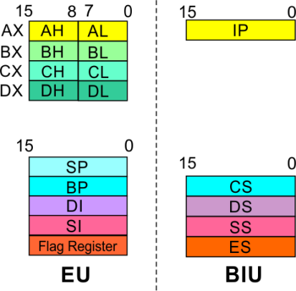
8086 Microprocessor
Architecture
8086 registers categorized into 4 groups
15 | 14 | 13 | 12 | 11 | 10 | 9 | 8 | 7 | 6 | 5 | 4 | 3 | 2 | 1 | 0
 |  |  |  | OF | DF | IF | TF | SF | ZF |  | AF |  | PF |  | CF
Sl.No. | Type | Register width | Name of register
1 | General purpose register | 16 bit | AX, BX, CX, DX
 |  | 8 bit | AL, AH, BL, BH, CL, CH, DL, DH
2 | Pointer register | 16 bit | SP, BP
3 | Index register | 16 bit | SI, DI
4 | Instruction Pointer | 16 bit | IP
5 | Segment register | 16 bit | CS, DS, SS, ES
6 | Flag (PSW) | 16 bit | Flag register

Slide 181
8086 Microprocessor
Architecture
Registers and Special Functions
Register | Name of the Register | Special Function
AX | 16-bit Accumulator | Stores the 16-bit results of arithmetic and logic operations
AL | 8-bit Accumulator | Stores the 8-bit results of arithmetic and logic operations
BX | Base register | Used to hold base value in base addressing mode to access memory data
CX | Count Register | Used to hold the count value in SHIFT, ROTATE and LOOP instructions
DX | Data Register | Used to hold data for multiplication and division operations
SP | Stack Pointer | Used to hold the offset address of top stack memory
BP | Base Pointer | Used to hold the base value in base addressing using SS register to access data from stack memory
SI | Source Index | Used to hold index value of source operand (data) for string instructions
DI | Data Index | Used to hold the index value of destination operand (data) for string operations

Slide 182
2.Pins and signals

Slide 183
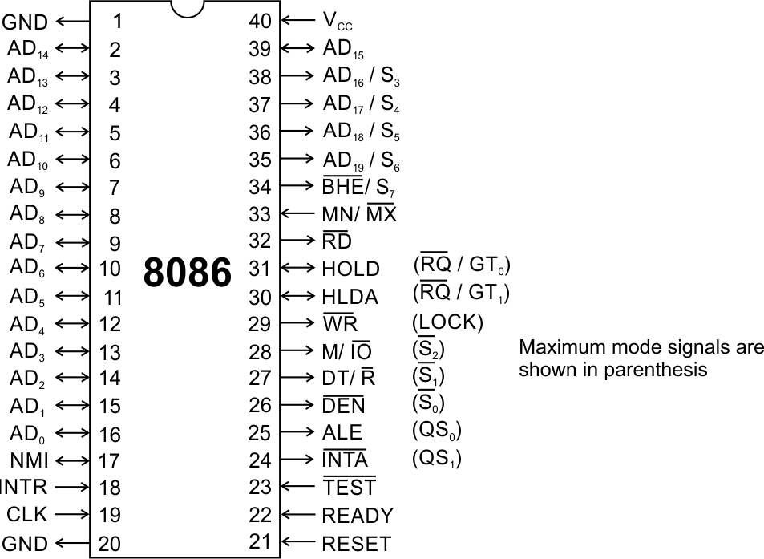
Pins and Signals
8086 Microprocessor
Common signals
AD₀-AD₁₅ (Bidirectional)
Address/Data bus
Low order address bus; these are multiplexed with data.
When AD lines are used to transmit memory address the symbol A is used instead of AD, for example A₀-A₁₅.
When data are transmitted over AD lines the symbol D is used in place of AD, for example D₀-D₇, D₈-D₁₅ or D₀-D₁₅.
A₁₆/S₃, A₁₇/S₄, A₁₈/S₅, A₁₉/S₆
High order address bus. These are multiplexed with status signals

Slide 184
Pins and Signals
8086 Microprocessor
Common signals
BHE (Active Low)/S₇ (Output)
Bus High Enable/Status
It is used to enable data onto the most significant half of data bus, D₈-D₁₅. 8-bit device connected to upper half of the data bus use BHE (Active Low) signal. It is multiplexed with status signal S₇.
MN/ MX
MINIMUM / MAXIMUM
This pin signal indicates what mode the processor is to operate in.
RD (Read) (Active Low)
The signal is used for read operation.
It is an output signal.
It is active when low.

Slide 185
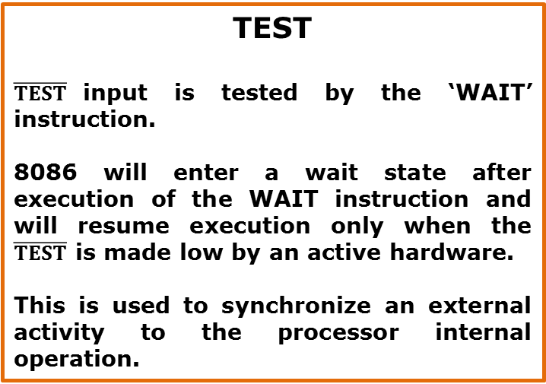
Pins and Signals
8086 Microprocessor
Common signals
TEST
$\overline{TEST}$input is tested by the ‘WAIT’ instruction.
8086 will enter a wait state after execution of the WAIT instruction and will resume execution only when the $\overline{TEST}$ is made low by an active hardware.
This is used to synchronize an external activity to the processor internal operation.
READY
This is the acknowledgement from the slow device or memory that they have completed the data transfer.
The signal made available by the devices is synchronized by the 8284A clock generator to provide ready input to the 8086.
The signal is active high.

Slide 186
Pins and Signals
8086 Microprocessor
Common signals
RESET (Input)
Causes the processor to immediately terminate its present activity.
The signal must be active HIGH for at least four clock cycles.
CLK
The clock input provides the basic timing for processor operation and bus control activity. Its an asymmetric square wave with 33% duty cycle.
INTR Interrupt Request
This is a triggered input. This is sampled during the last clock cycles of each instruction to determine the availability of the request. If any interrupt request is pending, the processor enters the interrupt acknowledge cycle.
This signal is active high and internally synchronized.

Slide 187
Pins and Signals
8086 Microprocessor
Min/ Max Pins
The 8086 microprocessor can work in two modes of operations : Minimum mode and Maximum mode.
In the minimum mode of operation the microprocessor do not associate with any co-processors and can not be used for multiprocessor systems.
In the maximum mode the 8086 can work in multi-processor or co-processor configuration.
Minimum or maximum mode operations are decided by the pin MN/ MX(Active low).
When this pin is high 8086 operates in minimum mode otherwise it operates in Maximum mode.

Slide 188


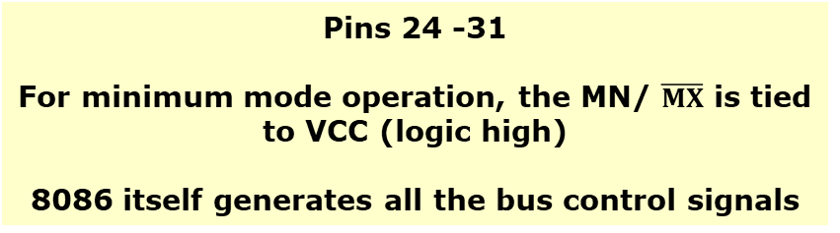

Pins and Signals
8086 Microprocessor
Minimum mode signals
Pins 24 -31
For minimum mode operation, the MN/ $\overline{MX}$ is tied to VCC (logic high)
8086 itself generates all the bus control signals
DT/$\overline{R}$ | (Data Transmit/ Receive) Output signal from the processor to control the direction of data flow through the data transceivers
$$\overline{DEN}$$ | (Data Enable) Output signal from the processor used as out put enable for the transceivers
ALE | (Address Latch Enable) Used to demultiplex the address and data lines using external latches
M/$\overline{IO}$ | Used to differentiate memory access and I/O access. For memory reference instructions, it is high. For IN and OUT instructions, it is low.
$$\overline{WR}$$ | Write control signal; asserted low Whenever processor writes data to memory or I/O port
$$\overline{INTA}$$ | (Interrupt Acknowledge) When the interrupt request is accepted by the processor, the output is low on this line.

Slide 189
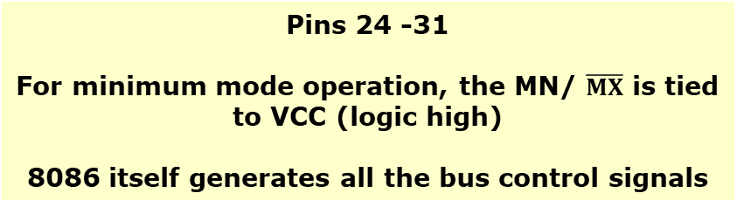
Pins and Signals
8086 Microprocessor
Minimum mode signals
Pins 24 -31
For minimum mode operation, the MN/ $\overline{MX}$ is tied to VCC (logic high)
8086 itself generates all the bus control signals
HOLD | Input signal to the processor form the bus masters as a request to grant the control of the bus. Usually used by the DMA controller to get the control of the bus.
HLDA | (Hold Acknowledge) Acknowledge signal by the processor to the bus master requesting the control of the bus through HOLD. The acknowledge is asserted high, when the processor accepts HOLD.

Slide 190
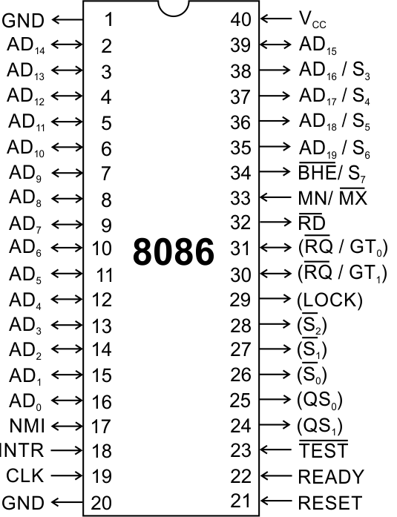
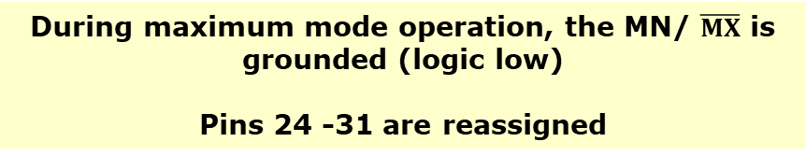
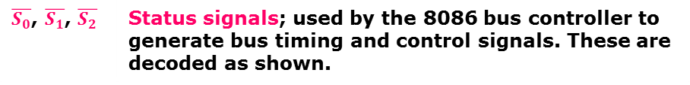
Pins and Signals
8086 Microprocessor
Maximum mode signals
During maximum mode operation, the MN/ $\overline{MX}$ is grounded (logic low)
Pins 24 -31 are reassigned
$\overline{S_{0}}$, $\overline{S_{1}}$, $\overline{S_{2}}$ | Status signals; used by the 8086 bus controller to generate bus timing and control signals. These are decoded as shown.

Slide 191
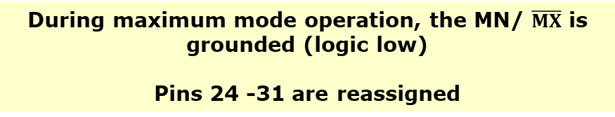
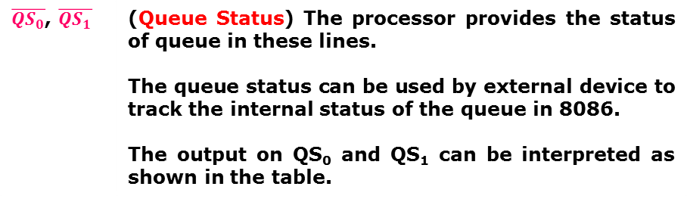
Pins and Signals
8086 Microprocessor
Maximum mode signals
During maximum mode operation, the MN/ $\overline{MX}$ is grounded (logic low)
Pins 24 -31 are reassigned
$\overline{{QS}_{0}}$, $\overline{QS_{1}}$ | (Queue Status) The processor provides the status of queue in these lines. The queue status can be used by external device to track the internal status of the queue in 8086. The output on QS₀ and QS₁ can be interpreted as shown in the table.

Slide 192
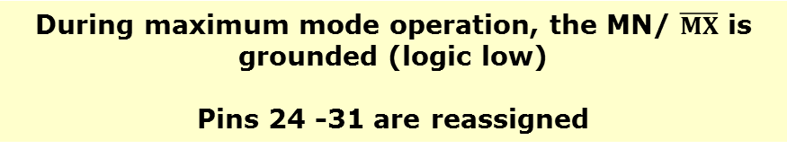
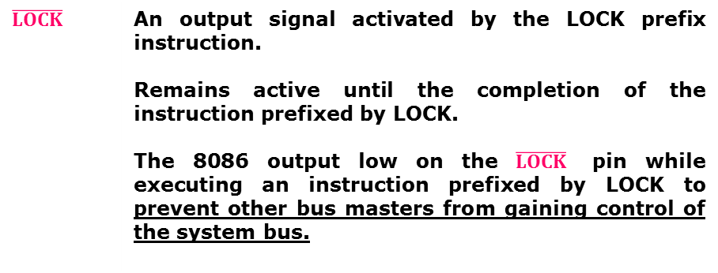
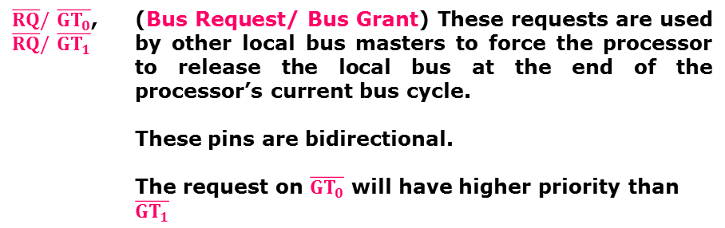
Pins and Signals
8086 Microprocessor
Maximum mode signals
During maximum mode operation, the MN/ $\overline{MX}$ is grounded (logic low)
Pins 24 -31 are reassigned
$\overline{RQ}/\overline{GT_{0}}$, $\overline{RQ}/\overline{GT_{1}}$ | (Bus Request/ Bus Grant) These requests are used by other local bus masters to force the processor to release the local bus at the end of the processor’s current bus cycle. These pins are bidirectional. The request on$\overline{GT_{0}}$ will have higher priority than$\overline{GT_{1}}$
$$\overline{LOCK}$$ | An output signal activated by the LOCK prefix instruction. Remains active until the completion of the instruction prefixed by LOCK. The 8086 output low on the $\overline{LOCK}$ pin while executing an instruction prefixed by LOCK to prevent other bus masters from gaining control of the system bus.

Slide 193
ADDRESSING MODES & Instruction set

Slide 194
Introduction
8086 Microprocessor
Program
A set of instructions written to solve a problem.
Instruction
Directions which a microprocessor follows to execute a task or part of a task.
Computer language
High Level
Low Level
Machine Language
Assembly Language
 Binary bits
English Alphabets
‘Mnemonics’
Assembler Mnemonics → Machine Language

Slide 195
Introduction
8086 Microprocessor
Program is a set of instructions written to solve a problem. Instructions are the directions which a microprocessor follows to execute a task or part of a task. Broadly, computer language can be divided into two parts as high-level language and low level language. Low level language are machine specific. Low level language can be further divided into machine language and assembly language.
Machine language is the only language which a machine can understand. Instructions in this language are written in binary bits as a specific bit pattern. The computer interprets this bit pattern as an instruction to perform a particular task. The entire program is a sequence of binary numbers. This is a machine-friendly language but not user friendly. Debugging is another problem associated with machine language.
To overcome these problems, programmers develop another way in which instructions are written in English alphabets. This new language is known as Assembly language. The instructions in this language are termed mnemonics. As microprocessor can only understand the machine language so mnemonics are translated into machine language either manually or by a program known as assembler.
Efficient software development for the microprocessor requires a complete familiarity with the instruction set, their format and addressing modes. Here in this chapter, we will focus on the addressing modes and instructions formats of microprocessor 8086.

Slide 196
3.ADDRESSING MODES

Slide 197
Addressing Modes
8086 Microprocessor
Every instruction of a program has to operate on a data.
The different ways in which a source operand is denoted in an instruction are known as addressing modes.
Register Addressing
Immediate Addressing
Direct Addressing
Register Indirect Addressing
Based Addressing
Indexed Addressing
Based Index Addressing
String Addressing
Direct I/O port Addressing
10. Indirect I/O port Addressing
11. Relative Addressing
12. Implied Addressing
Group I : Addressing modes for register and immediate data
Group II : Addressing modes for memory data
Group III : Addressing modes for I/O ports
Group IV : Relative Addressing mode
Group V : Implied Addressing mode

Slide 198
Addressing Modes
8086 Microprocessor
Group I : Addressing modes for register and immediate data
Register Addressing
Immediate Addressing
Direct Addressing
Register Indirect Addressing
Based Addressing
Indexed Addressing
Based Index Addressing
String Addressing
Direct I/O port Addressing
10. Indirect I/O port Addressing
11. Relative Addressing
12. Implied Addressing
The instruction will specify the name of the register which holds the data to be operated by the instruction.
Example:
MOV CL, DH
The content of 8-bit register DH is moved to another 8-bit register CL
(CL) ← (DH)

Slide 199

Addressing Modes
8086 Microprocessor
Group I : Addressing modes for register and immediate data
Register Addressing
Immediate Addressing
Direct Addressing
Register Indirect Addressing
Based Addressing
Indexed Addressing
Based Index Addressing
String Addressing
Direct I/O port Addressing
10. Indirect I/O port Addressing
11. Relative Addressing
12. Implied Addressing
In immediate addressing mode, an 8-bit or 16-bit data is specified as part of the instruction
Example:
MOV DL, 08H
The 8-bit data (08_{H}) given in the instruction is moved to DL
(DL) ← 08_{H}
MOV AX, 0A9FH
The 16-bit data (0A9F_{H}) given in the instruction is moved to AX register
(AX) ← 0A9F_{H}

Slide 200
Addressing Modes : Memory Access
8086 Microprocessor
Offset Value (16 bits)
Segment Register (16 bits)
0 0 0 0
Adder
Physical Address (20 Bits)

Slide 201
Addressing Modes : Memory Access
8086 Microprocessor
20 Address lines ⇒ 8086 can address up to 2²⁰ = 1M bytes of memory
However, the largest register is only 16 bits
Physical Address will have to be calculated Physical Address : Actual address of a byte in memory. i.e. the value which goes out onto the address bus.
Memory Address represented in the form – Seg : Offset (Eg - 89AB:F012)
Each time the processor wants to access memory, it takes the contents of a segment register, shifts it one hexadecimal place to the left (same as multiplying by 16₁₀), then add the required offset to form the 20- bit address
16 bytes of contiguous memory
89AB : F012 → 89AB → 89AB0 (Paragraph to byte → 89AB x 10 = 89AB0)
F012 → 0F012 (Offset is already in byte unit)
+ -------
98AC2 (The absolute address)

Slide 202
Addressing Modes : Memory Access
8086 Microprocessor
To access memory we use these four registers: BX, SI, DI, BP
Combining these registers inside [ ] symbols, we can get different memory locations (Effective Address, EA)
Supported combinations:
[BX + SI] [BX + DI] [BP + SI] [BP + DI] | [SI] [DI] d16 (variable offset only) [BX] | [BX + SI + d8] [BX + DI + d8] [BP + SI + d8] [BP + DI + d8]
[SI + d8] [DI + d8] [BP + d8] [BX + d8] | [BX + SI + d16] [BX + DI + d16] [BP + SI + d16] [BP + DI + d16] | [SI + d16] [DI + d16] [BP + d16] [BX + d16]
BX BP | SI DI | + disp

Slide 203
Addressing Modes
8086 Microprocessor
Group II : Addressing modes for memory data
Register Addressing
Immediate Addressing
Direct Addressing
Register Indirect Addressing
Based Addressing
Indexed Addressing
Based Index Addressing
String Addressing
Direct I/O port Addressing
10. Indirect I/O port Addressing
11. Relative Addressing
12. Implied Addressing
Here, the effective address of the memory location at which the data operand is stored is given in the instruction.
The effective address is just a 16-bit number written directly in the instruction.
Example:
MOV BX, [1354H]
MOV BL, [0400H]
The square brackets around the 1354_{H} denotes the contents of the memory location. When executed, this instruction will copy the contents of the memory location into BX register.
This addressing mode is called direct because the displacement of the operand from the segment base is specified directly in the instruction.

Slide 204
Addressing Modes
8086 Microprocessor
Group II : Addressing modes for memory data
Register Addressing
Immediate Addressing
Direct Addressing
Register Indirect Addressing
Based Addressing
Indexed Addressing
Based Index Addressing
String Addressing
Direct I/O port Addressing
10. Indirect I/O port Addressing
11. Relative Addressing
12. Implied Addressing
In Register indirect addressing, name of the register which holds the effective address (EA) will be specified in the instruction.
Registers used to hold EA are any of the following registers:
BX, BP, DI and SI.
Content of the DS register is used for base address calculation.
Example:
MOV CX, [BX]
Operations:
EA = (BX)
BA = (DS) x 16₁₀
MA = BA + EA
(CX) ← (MA) or,
(CL) ← (MA)
(CH) ← (MA +1)
Note : Register/ memory enclosed in brackets refer to content of register/ memory

Slide 205
Addressing Modes
8086 Microprocessor
Group II : Addressing modes for memory data
Register Addressing
Immediate Addressing
Direct Addressing
Register Indirect Addressing
Based Addressing
Indexed Addressing
Based Index Addressing
String Addressing
Direct I/O port Addressing
10. Indirect I/O port Addressing
11. Relative Addressing
12. Implied Addressing
In Based Addressing, BX or BP is used to hold the base value for effective address and a signed 8-bit or unsigned 16-bit displacement will be specified in the instruction.
In case of 8-bit displacement, it is sign extended to 16-bit before adding to the base value.
When BX holds the base value of EA, 20-bit physical address is calculated from BX and DS.
When BP holds the base value of EA, BP and SS is used.
Example:
MOV AX, [BX + 08H]
Operations:
0008_{H} ← 08_{H} (Sign extended)
EA = (BX) + 0008_{H}
BA = (DS) x 16₁₀
MA = BA + EA
(AX) ← (MA) or,
(AL) ← (MA)
(AH) ← (MA + 1)

Slide 206
Addressing Modes
8086 Microprocessor
Group II : Addressing modes for memory data
Register Addressing
Immediate Addressing
Direct Addressing
Register Indirect Addressing
Based Addressing
Indexed Addressing
Based Index Addressing
String Addressing
Direct I/O port Addressing
10. Indirect I/O port Addressing
11. Relative Addressing
12. Implied Addressing
SI or DI register is used to hold an index value for memory data and a signed 8-bit or unsigned 16-bit displacement will be specified in the instruction.
Displacement is added to the index value in SI or DI register to obtain the EA.
In case of 8-bit displacement, it is sign extended to 16-bit before adding to the base value.
Example:
MOV CX, [SI + 0A2H]
Operations:
FFA2_{H} ← A2_{H} (Sign extended)
EA = (SI) + FFA2_{H}
BA = (DS) x 16₁₀
MA = BA + EA
(CX) ← (MA) or,
(CL) ← (MA)
(CH) ← (MA + 1)

Slide 207
Addressing Modes
8086 Microprocessor
Group II : Addressing modes for memory data
Register Addressing
Immediate Addressing
Direct Addressing
Register Indirect Addressing
Based Addressing
Indexed Addressing
Based Index Addressing
String Addressing
Direct I/O port Addressing
10. Indirect I/O port Addressing
11. Relative Addressing
12. Implied Addressing
In Based Index Addressing, the effective address is computed from the sum of a base register (BX or BP), an index register (SI or DI) and a displacement.
Example:
MOV DX, [BX + SI + 0AH]
Operations:
000A_{H} ← 0A_{H} (Sign extended)
EA = (BX) + (SI) + 000A_{H}
BA = (DS) x 16₁₀
MA = BA + EA
(DX) ← (MA) or,
(DL) ← (MA)
(DH) ← (MA + 1)

Slide 208
Addressing Modes
8086 Microprocessor
Group II : Addressing modes for memory data
Register Addressing
Immediate Addressing
Direct Addressing
Register Indirect Addressing
Based Addressing
Indexed Addressing
Based Index Addressing
String Addressing
Direct I/O port Addressing
10. Indirect I/O port Addressing
11. Relative Addressing
12. Implied Addressing
Employed in string operations to operate on string data.
The effective address (EA) of source data is stored in SI register and the EA of destination is stored in DI register.
Segment register for calculating base address of
source data is DS and that of the destination data is ES
Example: MOVS BYTE
Operations:
Calculation of source memory location:
EA = (SI) BA = (DS) x 16₁₀ MA = BA + EA
Calculation of destination memory location:
EA_{E} = (DI) BA_{E} = (ES) x 16₁₀ MA_{E} = BA_{E} + EA_{E}
(MAE) ← (MA)
If DF = 1, then (SI) ← (SI) – 1 and (DI) = (DI) - 1
If DF = 0, then (SI) ← (SI) +1 and (DI) = (DI) + 1
Note : Effective address of the Extra segment register

Slide 209
Addressing Modes
8086 Microprocessor
Group III : Addressing modes for I/O ports
Register Addressing
Immediate Addressing
Direct Addressing
Register Indirect Addressing
Based Addressing
Indexed Addressing
Based Index Addressing
String Addressing
Direct I/O port Addressing
10. Indirect I/O port Addressing
11. Relative Addressing
12. Implied Addressing
These addressing modes are used to access data from standard I/O mapped devices or ports.
In direct port addressing mode, an 8-bit port address is directly specified in the instruction.
Example: IN AL, [09H]
Operations: PORT_{addr} = 09_{H}
(AL) ← (PORT)
Content of port with address 09_{H} is moved to AL register
In indirect port addressing mode, the instruction will specify the name of the register which holds the port address. In 8086, the 16-bit port address is stored in the DX register.
Example: OUT [DX], AX
Operations: PORT_{addr} = (DX)
(PORT) ← (AX)
Content of AX is moved to port whose address is specified by DX register.

Slide 210
Addressing Modes
8086 Microprocessor
Group IV : Relative Addressing mode
Register Addressing
Immediate Addressing
Direct Addressing
Register Indirect Addressing
Based Addressing
Indexed Addressing
Based Index Addressing
String Addressing
Direct I/O port Addressing
10. Indirect I/O port Addressing
11. Relative Addressing
12. Implied Addressing
In this addressing mode, the effective address of a program instruction is specified relative to Instruction Pointer (IP) by an 8-bit signed displacement.
Example: JZ 0AH
Operations:
000A_{H} ← 0A_{H} (sign extend)
If ZF = 1, then
EA = (IP) + 000A_{H}
BA = (CS) x 16₁₀
MA = BA + EA
If ZF = 1, then the program control jumps to new address calculated above.
If ZF = 0, then next instruction of the program is executed.

Slide 211
Addressing Modes
8086 Microprocessor
Group IV : Implied Addressing mode
Register Addressing
Immediate Addressing
Direct Addressing
Register Indirect Addressing
Based Addressing
Indexed Addressing
Based Index Addressing
String Addressing
Direct I/O port Addressing
10. Indirect I/O port Addressing
11. Relative Addressing
12. Implied Addressing
Instructions using this mode have no operands. The instruction itself will specify the data to be operated by the instruction.
Example: CLC
This clears the carry flag to zero.

Slide 212
4.INSTRUCTION SET

Slide 213
Instruction Set
8086 Microprocessor
8086 supports 6 types of instructions.
Data Transfer Instructions
Arithmetic Instructions
Logical Instructions
String manipulation Instructions
Process Control Instructions
Control Transfer Instructions

Slide 214
Instruction Set
8086 Microprocessor
1. Data Transfer Instructions
Instructions that are used to transfer data/ address in to registers, memory locations and I/O ports.
Generally involve two operands: Source operand and Destination operand of the same size.
Source: Register or a memory location or an immediate data
Destination : Register or a memory location.
The size should be a either a byte or a word.
A 8-bit data can only be moved to 8-bit register/ memory and a 16-bit data can be moved to 16-bit register/ memory.

Slide 215
Instruction Set
8086 Microprocessor
1. Data Transfer Instructions
Mnemonics: MOV, XCHG, PUSH, POP, IN, OUT …
MOV reg2/ mem, reg1/ mem MOV reg2, reg1 MOV mem, reg1 MOV reg2, mem | (reg2) ← (reg1) (mem) ← (reg1) (reg2) ← (mem)
MOV reg/ mem, data MOV reg, data MOV mem, data | (reg) ← data (mem) ← data
XCHG reg2/ mem, reg1 XCHG reg2, reg1 XCHG mem, reg1 | (reg2) ↔ (reg1) (mem) ↔ (reg1)

Slide 216
Instruction Set
8086 Microprocessor
1. Data Transfer Instructions
Mnemonics: MOV, XCHG, PUSH, POP, IN, OUT …
PUSH reg16/ mem PUSH reg16 PUSH mem | (SP) ← (SP) – 2 MA _{S} = (SS) x 16₁₀ + SP (MA _{S} ; MA _{S} + 1) ← (reg16) (SP) ← (SP) – 2 MA _{S} = (SS) x 16₁₀ + SP (MA _{S} ; MA _{S} + 1) ← (mem)
POP reg16/ mem POP reg16 POP mem | MA _{S} = (SS) x 16₁₀ + SP (reg16) ← (MA _{S} ; MA _{S} + 1) (SP) ← (SP) + 2 MA _{S} = (SS) x 16₁₀ + SP (mem) ← (MA _{S} ; MA _{S} + 1) (SP) ← (SP) + 2

Slide 217
Instruction Set
8086 Microprocessor
1. Data Transfer Instructions
Mnemonics: MOV, XCHG, PUSH, POP, IN, OUT …
IN A, [DX] IN AL, [DX] IN AX, [DX] | PORT_{addr} = (DX) (AL) ← (PORT) PORT_{addr} = (DX) (AX) ← (PORT)
IN A, addr8 IN AL, addr8 IN AX, addr8 | (AL) ← (addr8) (AX) ← (addr8)
OUT [DX], A OUT [DX], AL OUT [DX], AX | PORT_{addr} = (DX) (PORT) ← (AL) PORT_{addr} = (DX) (PORT) ← (AX)
OUT addr8, A OUT addr8, AL OUT addr8, AX | (addr8) ← (AL) (addr8) ← (AX)

Slide 218
Instruction Set
8086 Microprocessor
2. Arithmetic Instructions
Mnemonics: ADD, ADC, SUB, SBB, INC, DEC, MUL, DIV, CMP…
ADD reg2/ mem, reg1/mem ADC reg2, reg1 ADC reg2, mem ADC mem, reg1 | (reg2) ← (reg1) + (reg2) (reg2) ← (reg2) + (mem) (mem) ← (mem)+(reg1)
ADD reg/mem, data ADD reg, data ADD mem, data | (reg) ← (reg)+ data (mem) ← (mem)+data
ADD A, data ADD AL, data8 ADD AX, data16 | (AL) ← (AL) + data8 (AX) ← (AX) +data16

Slide 219
Instruction Set
8086 Microprocessor
2. Arithmetic Instructions
Mnemonics: ADD, ADC, SUB, SBB, INC, DEC, MUL, DIV, CMP…
ADC reg2/ mem, reg1/mem ADC reg2, reg1 ADC reg2, mem ADC mem, reg1 | (reg2) ← (reg1) + (reg2)+CF (reg2) ← (reg2) + (mem)+CF (mem) ← (mem)+(reg1)+CF
ADC reg/mem, data ADC reg, data ADC mem, data | (reg) ← (reg)+ data+CF (mem) ← (mem)+data+CF
ADDC A, data ADD AL, data8 ADD AX, data16 | (AL) ← (AL) + data8+CF (AX) ← (AX) +data16+CF

Slide 220
Instruction Set
8086 Microprocessor
2. Arithmetic Instructions
Mnemonics: ADD, ADC, SUB, SBB, INC, DEC, MUL, DIV, CMP…
SUB reg2/ mem, reg1/mem SUB reg2, reg1 SUB reg2, mem SUB mem, reg1 | (reg2) ← (reg1) - (reg2) (reg2) ← (reg2) - (mem) (mem) ← (mem) - (reg1)
SUB reg/mem, data SUB reg, data SUB mem, data | (reg) ← (reg) - data (mem) ← (mem) - data
SUB A, data SUB AL, data8 SUB AX, data16 | (AL) ← (AL) - data8 (AX) ← (AX) - data16

Slide 221
Instruction Set
8086 Microprocessor
2. Arithmetic Instructions
Mnemonics: ADD, ADC, SUB, SBB, INC, DEC, MUL, DIV, CMP…
SBB reg2/ mem, reg1/mem SBB reg2, reg1 SBB reg2, mem SBB mem, reg1 | (reg2) ← (reg1) - (reg2) - CF (reg2) ← (reg2) - (mem)- CF (mem) ← (mem) - (reg1) –CF
SBB reg/mem, data SBB reg, data SBB mem, data | (reg) ← (reg) – data - CF (mem) ← (mem) - data - CF
SBB A, data SBB AL, data8 SBB AX, data16 | (AL) ← (AL) - data8 - CF (AX) ← (AX) - data16 - CF

Slide 222
Instruction Set
8086 Microprocessor
2. Arithmetic Instructions
Mnemonics: ADD, ADC, SUB, SBB, INC, DEC, MUL, DIV, CMP…
INC reg/ mem INC reg8 INC reg16 INC mem | (reg8) ← (reg8) + 1 (reg16) ← (reg16) + 1 (mem) ← (mem) + 1
DEC reg/ mem DEC reg8 DEC reg16 DEC mem | (reg8) ← (reg8) - 1 (reg16) ← (reg16) - 1 (mem) ← (mem) - 1

Slide 223
Instruction Set
8086 Microprocessor
2. Arithmetic Instructions
Mnemonics: ADD, ADC, SUB, SBB, INC, DEC, MUL, DIV, CMP…
MUL reg/ mem MUL reg MUL mem | For byte : (AX) ← (AL) x (reg8) For word : (DX)(AX) ← (AX) x (reg16) For byte : (AX) ← (AL) x (mem8) For word : (DX)(AX) ← (AX) x (mem16)
IMUL reg/ mem IMUL reg IMUL mem | For byte : (AX) ← (AL) x (reg8) For word : (DX)(AX) ← (AX) x (reg16) For byte : (AX) ← (AX) x (mem8) For word : (DX)(AX) ← (AX) x (mem16)

Slide 224
Instruction Set
8086 Microprocessor
2. Arithmetic Instructions
Mnemonics: ADD, ADC, SUB, SBB, INC, DEC, MUL, DIV, CMP…
DIV reg/ mem DIV reg DIV mem | For 16-bit :- 8-bit : (AL) ← (AX) :- (reg8) Quotient (AH) ← (AX) MOD(reg8) Remainder For 32-bit :- 16-bit : (AX) ← (DX)(AX) :- (reg16) Quotient (DX) ← (DX)(AX) MOD(reg16) Remainder For 16-bit :- 8-bit : (AL) ← (AX) :- (mem8) Quotient (AH) ← (AX) MOD(mem8) Remainder For 32-bit :- 16-bit : (AX) ← (DX)(AX) :- (mem16) Quotient (DX) ← (DX)(AX) MOD(mem16) Remainder

Slide 225
Instruction Set
8086 Microprocessor
2. Arithmetic Instructions
Mnemonics: ADD, ADC, SUB, SBB, INC, DEC, MUL, DIV, CMP…
IDIV reg/ mem IDIV reg IDIV mem | For 16-bit :- 8-bit : (AL) ← (AX) :- (reg8) Quotient (AH) ← (AX) MOD(reg8) Remainder For 32-bit :- 16-bit : (AX) ← (DX)(AX) :- (reg16) Quotient (DX) ← (DX)(AX) MOD(reg16) Remainder For 16-bit :- 8-bit : (AL) ← (AX) :- (mem8) Quotient (AH) ← (AX) MOD(mem8) Remainder For 32-bit :- 16-bit : (AX) ← (DX)(AX) :- (mem16) Quotient (DX) ← (DX)(AX) MOD(mem16) Remainder

Slide 226
Instruction Set
8086 Microprocessor
2. Arithmetic Instructions
Mnemonics: ADD, ADC, SUB, SBB, INC, DEC, MUL, DIV, CMP…
CMP reg2/mem, reg1/ mem CMP reg2, reg1 CMP reg2, mem CMP mem, reg1 | Modify flags ← (reg2) – (reg1) If (reg2) > (reg1) then CF=0, ZF=0, SF=0 If (reg2) < (reg1) then CF=1, ZF=0, SF=1 If (reg2) = (reg1) then CF=0, ZF=1, SF=0 Modify flags ← (reg2) – (mem) If (reg2) > (mem) then CF=0, ZF=0, SF=0 If (reg2) < (mem) then CF=1, ZF=0, SF=1 If (reg2) = (mem) then CF=0, ZF=1, SF=0 Modify flags ← (mem) – (reg1) If (mem) > (reg1) then CF=0, ZF=0, SF=0 If (mem) < (reg1) then CF=1, ZF=0, SF=1 If (mem) = (reg1) then CF=0, ZF=1, SF=0

Slide 227
Instruction Set
8086 Microprocessor
2. Arithmetic Instructions
Mnemonics: ADD, ADC, SUB, SBB, INC, DEC, MUL, DIV, CMP…
CMP reg/mem, data CMP reg, data CMP mem, data | Modify flags ← (reg) – (data) If (reg) > data then CF=0, ZF=0, SF=0 If (reg) < data then CF=1, ZF=0, SF=1 If (reg) = data then CF=0, ZF=1, SF=0 Modify flags ← (mem) – (mem) If (mem) > data then CF=0, ZF=0, SF=0 If (mem) < data then CF=1, ZF=0, SF=1 If (mem) = data then CF=0, ZF=1, SF=0

Slide 228
Instruction Set
8086 Microprocessor
2. Arithmetic Instructions
Mnemonics: ADD, ADC, SUB, SBB, INC, DEC, MUL, DIV, CMP…
CMP A, data CMP AL, data8 CMP AX, data16 | Modify flags ← (AL) – data8 If (AL) > data8 then CF=0, ZF=0, SF=0 If (AL) < data8 then CF=1, ZF=0, SF=1 If (AL) = data8 then CF=0, ZF=1, SF=0 Modify flags ← (AX) – data16 If (AX) > data16 then CF=0, ZF=0, SF=0 If (mem) < data16 then CF=1, ZF=0, SF=1 If (mem) = data16 then CF=0, ZF=1, SF=0

Slide 229
Instruction Set
8086 Microprocessor
3. Logical Instructions
Mnemonics: AND, OR, XOR, TEST, SHR, SHL, RCR, RCL …

Slide 230
Instruction Set
8086 Microprocessor
3. Logical Instructions
Mnemonics: AND, OR, XOR, TEST, SHR, SHL, RCR, RCL …

Slide 231
Instruction Set
8086 Microprocessor
3. Logical Instructions
Mnemonics: AND, OR, XOR, TEST, SHR, SHL, RCR, RCL …

Slide 232
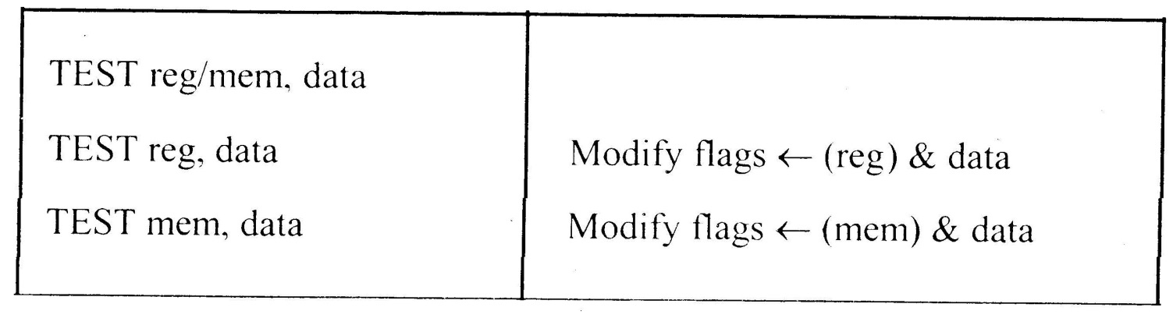
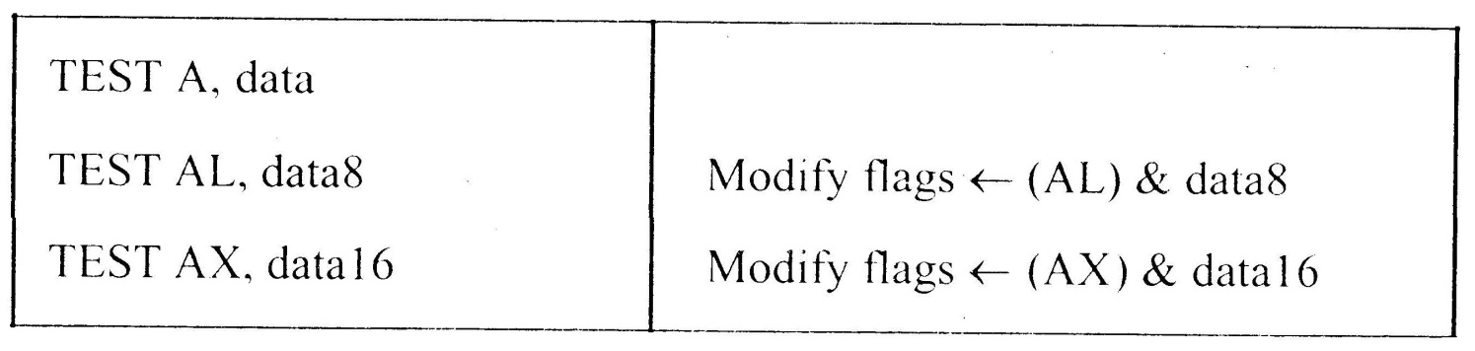
Instruction Set
8086 Microprocessor
3. Logical Instructions
Mnemonics: AND, OR, XOR, TEST, SHR, SHL, RCR, RCL …

Slide 233
Instruction Set
8086 Microprocessor
3. Logical Instructions
Mnemonics: AND, OR, XOR, TEST, SHR, SHL, RCR, RCL …

Slide 234
Instruction Set
8086 Microprocessor
3. Logical Instructions
Mnemonics: AND, OR, XOR, TEST, SHR, SHL, RCR, RCL …

Slide 235
Instruction Set
8086 Microprocessor
3. Logical Instructions
Mnemonics: AND, OR, XOR, TEST, SHR, SHL, RCR, RCL …

Slide 236
Instruction Set
8086 Microprocessor
3. Logical Instructions
Mnemonics: AND, OR, XOR, TEST, SHR, SHL, RCR, RCL …

Slide 237
Instruction Set
8086 Microprocessor
4. String Manipulation Instructions
String : Sequence of bytes or words
8086 instruction set includes instruction for string movement, comparison, scan, load and store.
REP instruction prefix : used to repeat execution of string instructions
String instructions end with S or SB or SW. S represents string, SB string byte and SW string word.
Offset or effective address of the source operand is stored in SI register and that of the destination operand is stored in DI register.
Depending on the status of DF, SI and DI registers are automatically updated.
DF = 0 ⇒ SI and DI are incremented by 1 for byte and 2 for word.
DF = 1 ⇒ SI and DI are decremented by 1 for byte and 2 for word.

Slide 238
Instruction Set
8086 Microprocessor
4. String Manipulation Instructions
Mnemonics: REP, MOVS, CMPS, SCAS, LODS, STOS
REP REPZ/ REPE (Repeat CMPS or SCAS until ZF = 0) REPNZ/ REPNE (Repeat CMPS or SCAS until ZF = 1) | While CX ≠ 0 and ZF = 1, repeat execution of string instruction and (CX) ← (CX) – 1 While CX ≠ 0 and ZF = 0, repeat execution of string instruction and (CX) ← (CX) - 1

Slide 239
Instruction Set
8086 Microprocessor
4. String Manipulation Instructions
Mnemonics: REP, MOVS, CMPS, SCAS, LODS, STOS
MOVS MOVSB MOVSW | MA = (DS) x 16₁₀ + (SI) MA_{E} = (ES) x 16₁₀ + (DI) (MA_{E}) ← (MA) If DF = 0, then (DI) ← (DI) + 1; (SI) ← (SI) + 1 If DF = 1, then (DI) ← (DI) - 1; (SI) ← (SI) - 1 MA = (DS) x 16₁₀ + (SI) MA_{E} = (ES) x 16₁₀ + (DI) (MA_{E} ; MA_{E} + 1) ← (MA; MA + 1) If DF = 0, then (DI) ← (DI) + 2; (SI) ← (SI) + 2 If DF = 1, then (DI) ← (DI) - 2; (SI) ← (SI) - 2

Slide 240
Instruction Set
8086 Microprocessor
4. String Manipulation Instructions
Mnemonics: REP, MOVS, CMPS, SCAS, LODS, STOS
Compare two string byte or string word
CMPS CMPSB CMPSW | MA = (DS) x 16₁₀ + (SI) MA_{E} = (ES) x 16₁₀ + (DI) Modify flags ← (MA) - (MA_{E}) If (MA) > (MA_{E}), then CF = 0; ZF = 0; SF = 0 If (MA) < (MA_{E}), then CF = 1; ZF = 0; SF = 1 If (MA) = (MA_{E}), then CF = 0; ZF = 1; SF = 0 For byte operation If DF = 0, then (DI) ← (DI) + 1; (SI) ← (SI) + 1 If DF = 1, then (DI) ← (DI) - 1; (SI) ← (SI) - 1 For word operation If DF = 0, then (DI) ← (DI) + 2; (SI) ← (SI) + 2 If DF = 1, then (DI) ← (DI) - 2; (SI) ← (SI) - 2

Slide 241
Instruction Set
8086 Microprocessor
4. String Manipulation Instructions
Mnemonics: REP, MOVS, CMPS, SCAS, LODS, STOS
Scan (compare) a string byte or word with accumulator
SCAS SCASB SCASW | MA_{E} = (ES) x 16₁₀ + (DI) Modify flags ← (AL) - (MA_{E}) If (AL) > (MA_{E}), then CF = 0; ZF = 0; SF = 0 If (AL) < (MA_{E}), then CF = 1; ZF = 0; SF = 1 If (AL) = (MA_{E}), then CF = 0; ZF = 1; SF = 0 If DF = 0, then (DI) ← (DI) + 1 If DF = 1, then (DI) ← (DI) – 1 MA_{E} = (ES) x 16₁₀ + (DI) Modify flags ← (AL) - (MA_{E}) If (AX) > (MA_{E} ; MA_{E} + 1), then CF = 0; ZF = 0; SF = 0 If (AX) < (MA_{E} ; MA_{E} + 1), then CF = 1; ZF = 0; SF = 1 If (AX) = (MA_{E} ; MA_{E} + 1), then CF = 0; ZF = 1; SF = 0 If DF = 0, then (DI) ← (DI) + 2 If DF = 1, then (DI) ← (DI) – 2

Slide 242
Instruction Set
8086 Microprocessor
4. String Manipulation Instructions
Mnemonics: REP, MOVS, CMPS, SCAS, LODS, STOS
Load string byte in to AL or string word in to AX
LODS LODSB LODSW | MA = (DS) x 16₁₀ + (SI) (AL) ← (MA) If DF = 0, then (SI) ← (SI) + 1 If DF = 1, then (SI) ← (SI) – 1 MA = (DS) x 16₁₀ + (SI) (AX) ← (MA ; MA + 1) If DF = 0, then (SI) ← (SI) + 2 If DF = 1, then (SI) ← (SI) – 2

Slide 243
Instruction Set
8086 Microprocessor
4. String Manipulation Instructions
Mnemonics: REP, MOVS, CMPS, SCAS, LODS, STOS
Store byte from AL or word from AX in to string
STOS STOSB STOSW | MA_{E} = (ES) x 16₁₀ + (DI) (MA_{E}) ← (AL) If DF = 0, then (DI) ← (DI) + 1 If DF = 1, then (DI) ← (DI) – 1 MA_{E} = (ES) x 16₁₀ + (DI) (MA_{E} ; MA_{E} + 1 ) ← (AX) If DF = 0, then (DI) ← (DI) + 2 If DF = 1, then (DI) ← (DI) – 2

Slide 244
Instruction Set
8086 Microprocessor
5. Processor Control Instructions
Mnemonics | Explanation
STC | Set CF ← 1
CLC | Clear CF ← 0
CMC | Complement carry CF ← CF/
STD | Set direction flag DF ← 1
CLD | Clear direction flag DF ← 0
STI | Set interrupt enable flag IF ← 1
CLI | Clear interrupt enable flag IF ← 0
NOP | No operation
HLT | Halt after interrupt is set
WAIT | Wait for TEST pin active
ESC opcode mem/ reg | Used to pass instruction to a coprocessor which shares the address and data bus with the 8086
LOCK | Lock bus during next instruction

Slide 245
Instruction Set
8086 Microprocessor
6. Control Transfer Instructions
Transfer the control to a specific destination or target instruction
Do not affect flags
8086 Unconditional transfers
Mnemonics | Explanation
CALL reg/ mem/ disp16 | Call subroutine
RET | Return from subroutine
JMP reg/ mem/ disp8/ disp16 | Unconditional jump

Slide 246
Instruction Set
8086 Microprocessor
6. Control Transfer Instructions
8086 signed conditional branch instructions
8086 unsigned conditional branch instructions
Checks flags
If conditions are true, the program control is transferred to the new memory location in the same segment by modifying the content of IP

Slide 247
Instruction Set
8086 Microprocessor
6. Control Transfer Instructions
8086 signed conditional branch instructions
8086 unsigned conditional branch instructions
Name | Alternate name
JE disp8 Jump if equal | JZ disp8 Jump if result is 0
JNE disp8 Jump if not equal | JNZ disp8 Jump if not zero
JG disp8 Jump if greater | JNLE disp8 Jump if not less or equal
JGE disp8 Jump if greater than or equal | JNL disp8 Jump if not less
JL disp8 Jump if less than | JNGE disp8 Jump if not greater than or equal
JLE disp8 Jump if less than or equal | JNG disp8 Jump if not greater
Name | Alternate name
JE disp8 Jump if equal | JZ disp8 Jump if result is 0
JNE disp8 Jump if not equal | JNZ disp8 Jump if not zero
JA disp8 Jump if above | JNBE disp8 Jump if not below or equal
JAE disp8 Jump if above or equal | JNB disp8 Jump if not below
JB disp8 Jump if below | JNAE disp8 Jump if not above or equal
JBE disp8 Jump if below or equal | JNA disp8 Jump if not above

Slide 248
Instruction Set
8086 Microprocessor
6. Control Transfer Instructions
8086 conditional branch instructions affecting individual flags
Mnemonics | Explanation
JC disp8 | Jump if CF = 1
JNC disp8 | Jump if CF = 0
JP disp8 | Jump if PF = 1
JNP disp8 | Jump if PF = 0
JO disp8 | Jump if OF = 1
JNO disp8 | Jump if OF = 0
JS disp8 | Jump if SF = 1
JNS disp8 | Jump if SF = 0
JZ disp8 | Jump if result is zero, i.e, Z = 1
JNZ disp8 | Jump if result is not zero, i.e, Z = 1

Slide 249
5.REGISTER ORGANISATION

Slide 250
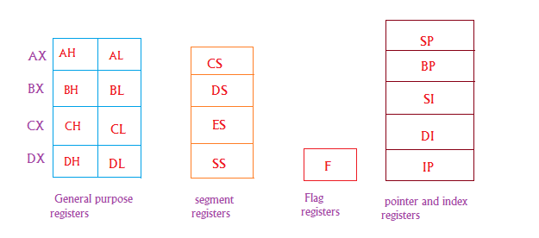

Slide 251
6.Memory Organization in 8086 microprocessor

Slide 252
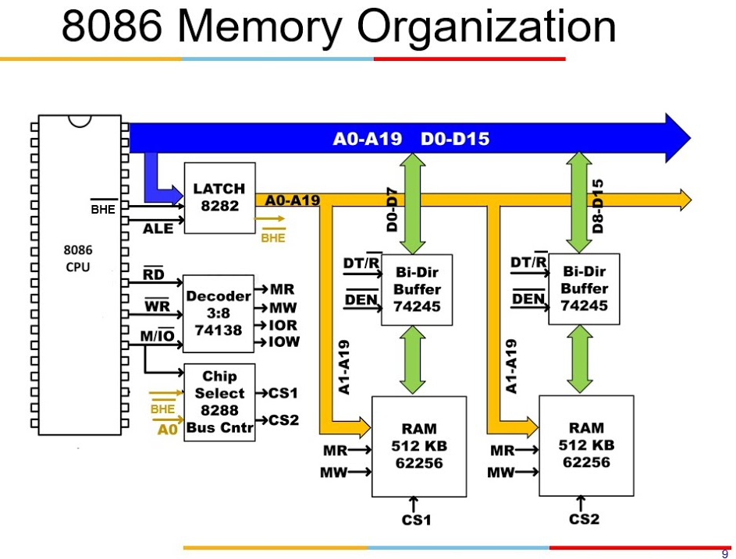

Slide 253
7.Physical Memory Organization in 8086 microprocessor

Slide 254
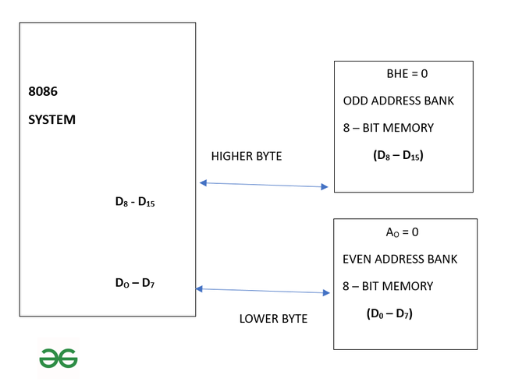

Slide 255
8.Assembler directives

Slide 256
Assemble Directives
8086 Microprocessor
It is a statement that gives direction to the assembler to perform some task.
Instructions to the Assembler regarding the program being executed.
Control the generation of machine codes and organization of the program; but no machine codes are generated for assembler directives.
Also called ‘pseudo instructions’
Used to :
› specify the start and end of a program
› attach value to variables
› allocate storage locations to input/ output data
› define start and end of segments, procedures, macros etc..

Slide 257
Assemble Directives
8086 Microprocessor
DB
DW
SEGMENT
ENDS
ASSUME
ORG
END
EVEN
EQU
PROC
FAR
NEAR
ENDP
SHORT
MACRO
ENDM
Define Byte
Define a byte type (8-bit) variable
Reserves specific amount of memory locations to each variable
Range : 00_{H} – FF_{H} for unsigned value; 00_{H} – 7F_{H} for positive value and 80_{H} – FF_{H} for negative value
General form : variable DB value/ values
Example:
LIST DB 7FH, 42H, 35H
Three consecutive memory locations are reserved for the variable LIST and each data specified in the instruction are stored as initial value in the reserved memory location

Slide 258
Assemble Directives
8086 Microprocessor
DB
DW
SEGMENT
ENDS
ASSUME
ORG
END
EVEN
EQU
PROC
FAR
NEAR
ENDP
SHORT
MACRO
ENDM
Define Word
Define a word type (16-bit) variable
Reserves two consecutive memory locations to each variable
Range : 0000_{H} – FFFF_{H} for unsigned value; 0000_{H} – 7FFF_{H} for positive value and 8000_{H} – FFFF_{H} for negative value
General form : variable DW value/ values
Example:
ALIST DW 6512H, 0F251H, 0CDE2H
Six consecutive memory locations are reserved for the variable ALIST and each 16-bit data specified in the instruction is stored in two consecutive memory location.

Slide 259
Assemble Directives
8086 Microprocessor
DB
DW
SEGMENT
ENDS
ASSUME
ORG
END
EVEN
EQU
PROC
FAR
NEAR
ENDP
SHORT
MACRO
ENDM
SEGMENT : Used to indicate the beginning of a code/ data/ stack segment
ENDS : Used to indicate the end of a code/ data/ stack segment
General form:
Segnam SEGMENT … … … … … … Segnam ENDS | Program code or Data Defining Statements
User defined name of the segment

Slide 260
Assemble Directives
8086 Microprocessor
DB
DW
SEGMENT
ENDS
ASSUME
ORG
END
EVEN
EQU
PROC
FAR
NEAR
ENDP
SHORT
MACRO
ENDM
Informs the assembler the name of the program/ data segment that should be used for a specific segment.
General form:
ASSUME segreg : segnam, .. , segreg : segnam
Segment Register
User defined name of the segment
Example:
ASSUME CS: ACODE, DS:ADATA | Tells the compiler that the instructions of the program are stored in the segment ACODE and data are stored in the segment ADATA

Slide 261
Assemble Directives
8086 Microprocessor
DB
DW
SEGMENT
ENDS
ASSUME
ORG
END
EVEN
EQU
PROC
FAR
NEAR
ENDP
SHORT
MACRO
ENDM
ORG (Origin) is used to assign the starting address (Effective address) for a program/ data segment
END is used to terminate a program; statements after END will be ignored
EVEN : Informs the assembler to store program/ data segment starting from an even address
EQU (Equate) is used to attach a value to a variable
Examples:
ORG 1000H | Informs the assembler that the statements following ORG 1000H should be stored in memory starting with effective address 1000_{H}
LOOP EQU 10FEH | Value of variable LOOP is 10FE_{H}
_SDATA SEGMENT ORG 1200H A DB 4CH EVEN B DW 1052H _SDATA ENDS | In this data segment, effective address of memory location assigned to A will be 1200_{H} and that of B will be 1202_{H} and 1203_{H}.

Slide 262
Assemble Directives
8086 Microprocessor
DB
DW
SEGMENT
ENDS
ASSUME
ORG
END
EVEN
EQU
PROC
ENDP
FAR
NEAR
SHORT
MACRO
ENDM
PROC Indicates the beginning of a procedure
ENDP End of procedure
FAR Intersegment call
NEAR Intrasegment call
General form
procname PROC[NEAR/ FAR] … … … RET procname ENDP | Program statements of the procedure Last statement of the procedure
User defined name of the procedure

Slide 263
Assemble Directives
8086 Microprocessor
DB
DW
SEGMENT
ENDS
ASSUME
ORG
END
EVEN
EQU
PROC
ENDP
FAR
NEAR
SHORT
MACRO
ENDM
Examples:
ADD64 PROC NEAR … … … RET ADD64 ENDP | The subroutine/ procedure named ADD64 is declared as NEAR and so the assembler will code the CALL and RET instructions involved in this procedure as near call and return
CONVERT PROC FAR … … … RET CONVERT ENDP | The subroutine/ procedure named CONVERT is declared as FAR and so the assembler will code the CALL and RET instructions involved in this procedure as far call and return

Slide 264
Assemble Directives
8086 Microprocessor
DB
DW
SEGMENT
ENDS
ASSUME
ORG
END
EVEN
EQU
PROC
ENDP
FAR
NEAR
SHORT
MACRO
ENDM
Reserves one memory location for 8-bit signed displacement in jump instructions
Example:
JMP SHORT AHEAD | The directive will reserve one memory location for 8-bit displacement named AHEAD

Slide 265
Assemble Directives
8086 Microprocessor
DB
DW
SEGMENT
ENDS
ASSUME
ORG
END
EVEN
EQU
PROC
ENDP
FAR
NEAR
SHORT
MACRO
ENDM
MACRO Indicate the beginning of a macro
ENDM End of a macro
General form:
macroname MACRO[Arg1, Arg2 ...] … … … macroname ENDM | Program statements in the macro
User defined name of the macro

Slide 266
9.MACROS

Slide 267
Macros are just like procedures, but not really.
Macros exist only until your code is compiled
After compilation all macros are replaced with real instructions
several macros to make coding easier(Reduce large & complex programs)
Example (Macro definition)
name MACRO [parameters,...]
<instructions>
ENDM

Slide 268
Example1 : Macro Definitions
SAVE MACRO definition of MACRO name SAVE
PUSH AX
PUSH BX
PUSH CX
ENDM
RETREIVE MACRO Another definition of MACRO name RETREIVE
POP CX
POP BX
POP AX
ENDM

Slide 269
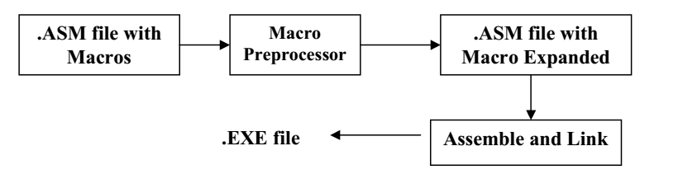

Slide 270
MACROS with Parameters
Example:
COPY MACRO x, y ; macro named COPY with
2 parameters{x, y}
PUSH AX
MOV AX, x
MOV y, AX
POP AX
ENDM

Slide 271
10.INTERRUPTS & INTERRUPT SERVICE ROUTINE(ISR)

Slide 272
INTERRUPT & ISR ?
‘Interrupts’ is to break the sequence of operation.
While the CPU is executing a program, on ‘interrupt’ breaks the normal sequence of execution of instructions, diverts its execution to some other program called Interrupt Service Routine (ISR)

Slide 273
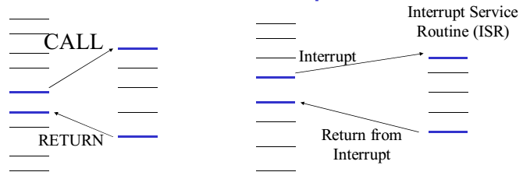

Slide 274
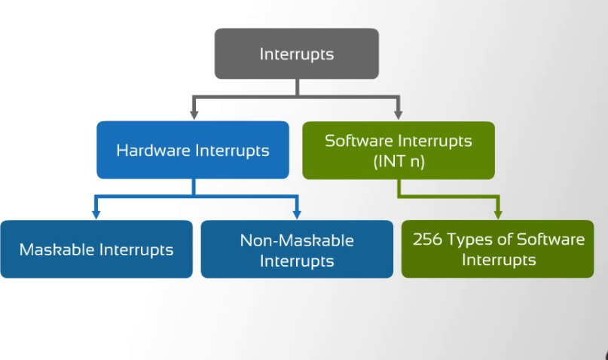

Slide 275
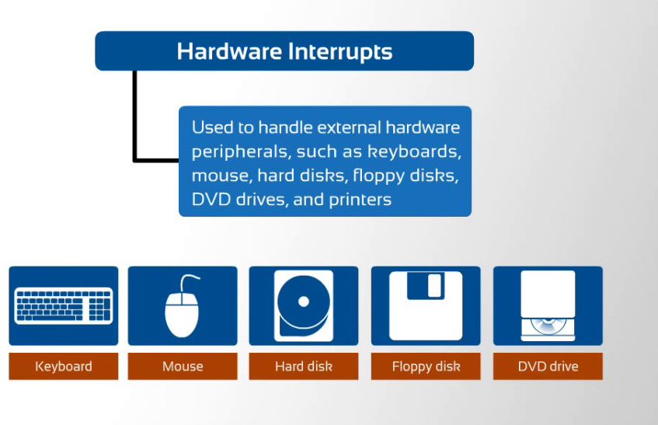

Slide 276
Maskable Interrupt: An Interrupt that can be disabled or ignored by the instructions of CPU are called as Maskable Interrupt.
Non- Maskable Interrupt: An interrupt that cannot be disabled or ignored by the instructions of CPU are called as Non- Maskable Interrupt.
Software interrupts are machine instructions that amount to a call to the designated interrupt subroutine, usually identified by interrupt number. Ex: INT0 - INT255

Slide 277
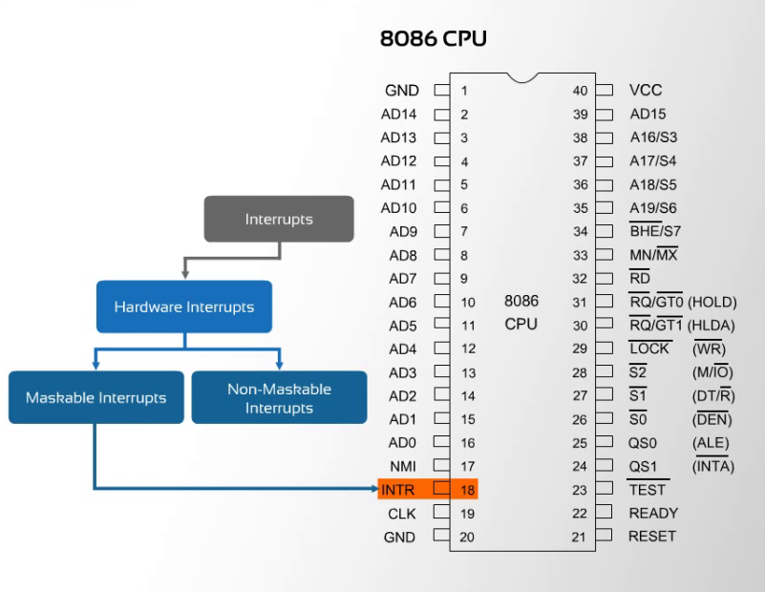

Slide 278


Slide 279
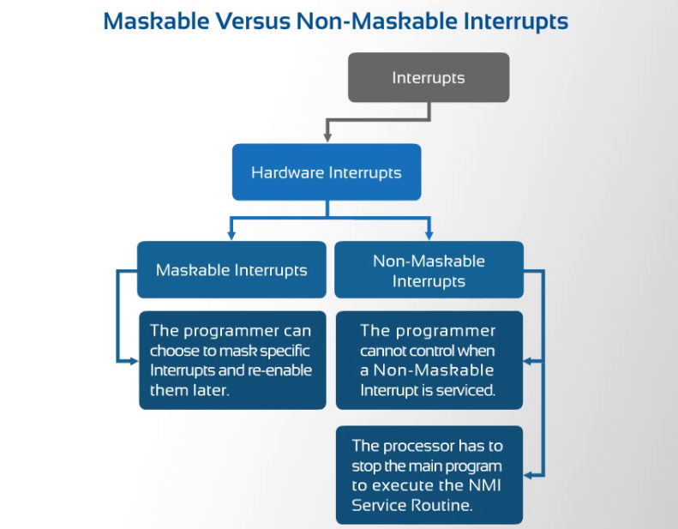

Slide 280
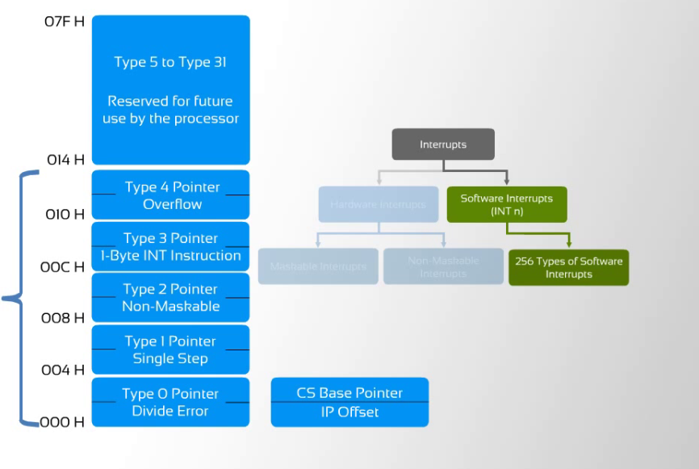

Slide 281
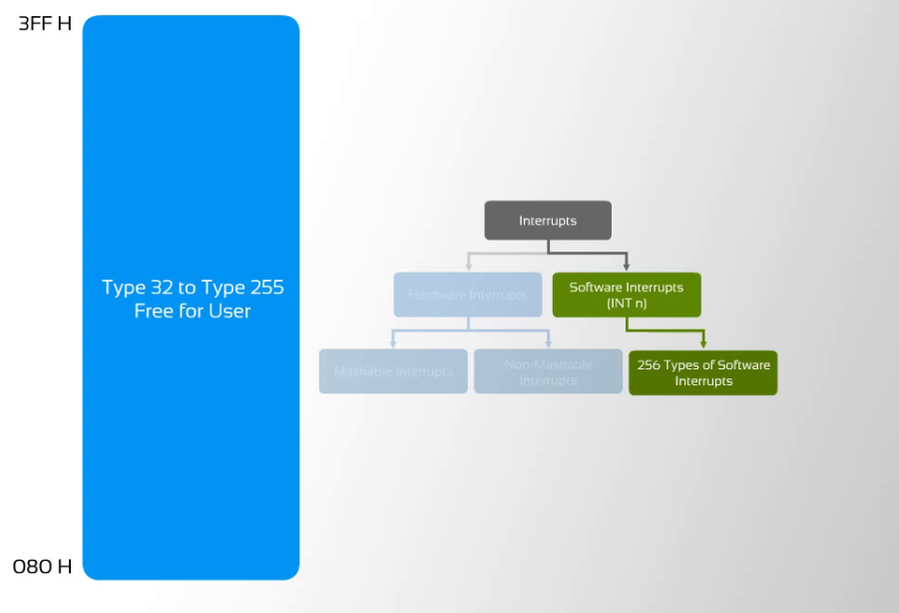

Slide 282
INTERRUPT VECTOR TABLE
256 INTERRUPTS OF 8086 ARE DIVIDED IN TO 3 GROUPS
TYPE 0 TO TYPE 4 INTERRUPTS-
These Are Used For Fixed Operations And Hence Are Called Dedicated Interrupts
TYPE 5 TO TYPE 31 INTERRUPTS
Not Used By 8086,reserved For Higher Processors Like 80286
80386 Etc
TYPE 32 TO 255 INTERRUPTS
Available For User, called User Defined Interrupts These Can Be H/W Interrupts And Activated Through Intr Line Or Can Be S/W Interrupts.

Slide 283
Type – 0 Divide Error Interrupt
Quotient is too large cant be fit in AL/AX or Divide By Zero {AX/0=∞}
Type –1 Single Step Interrupt
used for executing the program in single step mode by setting Trap Flag
To Set Trap Flag PUSHF
MOV BP,SP
OR [BP+0],0100H;SET BIT8
POPF
Type – 2 Non Maskable Interrupt
This Interrupt is used for executing ISR of NMI Pin (Positive Egde Signal). NMI cant be masked by S/W
Type – 3 Break Point Interrupt
used for providing BREAK POINTS in the program
Type – 4 Over Flow Interrupt
used to handle any Overflow Error after signed arithmetic

Slide 284
PRIORITY OF INTERRUPTS
Interrupt Type | Priority
INT0, INT3-INT 255, | Highest
NMI(INT2)
INTR
SINGLE STEP | Lowest

Slide 285
EXTRAS

Slide 286
UNIT-III 8051 MICROCONTROLLER

Slide 287
1.OVER VIEW OF 8051
MICROCONTROLLER

Slide 288
8051 CPU Operation
Features
Pin Diagram
Block Diagram

Slide 289
8051 Microcontroller
Intel introduced 8051, developed in the year 1981.
The 8051 is an 8-bit processor
The CPU can work on only 8 bits of data at a time
The 8051 became widely popular after allowing other manufactures to make and market any flavor of the 8051.

Slide 290
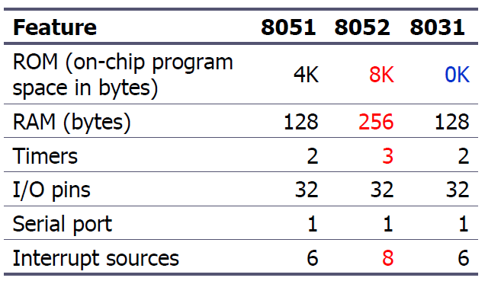
8051 Family
The 8051 is a subset of the 8052
The 8031 is a ROM-less 8051
Add external ROM to it
You lose two ports, and leave only 2 ports for I/O operations

Slide 291
8051 Features
64KB Program Memory address space
64KB Data Memory address space
4K bytes of on-chip Program Memory
128 bytes of on-chip Data RAM
32 bidirectional and individually addressable I/0 lines
Two 16-bit timer/counters
6-source/5-vector interrupt structure with two priority levels
On-chip clock oscillator

Slide 292
2.Pin Description of the 8051

Slide 293
Pin Description of the 8051
8051 family members (e.g., 8751, 89C51, 89C52, DS89C4x0)
Have 40 pins dedicated for various functions such as I/O, RD, WR, address, data, and interrupts.
DIP(dual in-line package),
Some companies provide a 20-pin version of the 8051 with a reduced number of I/O ports for less demanding applications

Slide 294
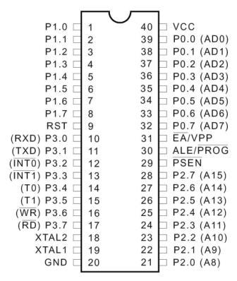
Pin Diagram of the 8051

Slide 295
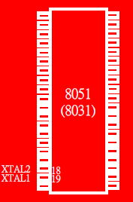
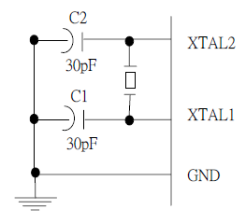
XTAL1 and XTAL2
The 8051 has an on-chip oscillator but requires an external clock to run it
A quartz crystal oscillator is connected to inputs XTAL1 (pin19) and XTAL2 (pin18)
The quartz crystal oscillator also needs two capacitors of 30 pF value

Slide 296
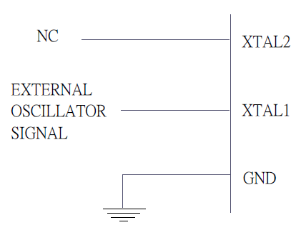
XTAL1 and XTAL2 …..
If you use a frequency source other than a crystal oscillator, such as a TTL oscillator:
It will be connected to XTAL1
XTAL2 is left unconnected

Slide 297
XTAL1 and XTAL2 …..
The speed of 8051 refers to the maximum oscillator frequency connected to XTAL.
We can observe the frequency on the XTAL2 pin using the oscilloscope.

Slide 298

RST
RESET pin is an input and is active high (normally low)
Upon applying a high pulse to this pin, the microcontroller will reset and terminate all activities

Slide 299

EA’
EA’, “external access’’, is an input pin and must be connected to Vcc or GND
Normally EA pin is connected to Vcc
EA pin must be connected to GND to indicate that the code or data is stored externally.

Slide 300

PSEN’ and ALE
PSEN, “program store enable’’, is an output pin
This pin is connected to the OE pin of the external memory.
For External Code Memory, PSEN’ = 0
For External Data Memory, PSEN’ = 1
ALE pin is used for demultiplexing the address and data.

Slide 301

I/O Port Pins
The four 8-bit I/O ports P0, P1, P2 and P3 each uses 8 pins.

Slide 302

Port 0
Port 0 is also designated as AD0-AD7.
When connecting an 8051 to an external memory, port 0 provides both address and data.
The 8051 multiplexes address and data through port 0 to save pins.
ALE indicates if P0 has address or data.
When ALE=0, it provides data D0-D7
When ALE=1, it has address A0-A7

Slide 303

Port 1 and Port 2
In 8051-based systems with no external memory connection:
Both P1 and P2 are used as simple I/O.
In 8051-based systems with external memory connections:
Port 2 must be used along with P0 to provide the 16-bit address for the external memory.
P0 provides the lower 8 bits via A0 – A7.
P2 is used for the upper 8 bits of the 16-bit address, designated as A8 – A15, and it cannot be used for I/O.

Slide 304


Port 3
Port 3 can be used as input or output.
Port 3 has the additional function of providing some extremely important signals

Slide 305
Pin Description Summary
PIN | TYPE | NAME AND FUNCTION
Vss | I | Ground: 0 V reference.
Vcc | I | Power Supply: This is the power supply voltage for normal, idle, and power-down operation.
P0.0 - P0.7 | I/O | Port 0: Port 0 is an open-drain, bi-directional I/O port. Port 0 is also the multiplexed low-order address and data bus during accesses to external program and data memory.
P1.0 - P1.7 | I/O | Port 1: Port I is an 8-bit bi-directional I/O port.
P2.0 - P2.7 | I/O | Port 2: Port 2 is an 8-bit bidirectional I/O. Port 2 emits the high order address byte during fetches from external program memory and during accesses to external data memory that use 16 bit addresses.
P3.0 - P3.7 | I/O | Port 3: Port 3 is an 8 bit bidirectional I/O port. Port 3 also serves special features as explained.

Slide 306
Pin Description Summary
PIN | TYPE | NAME AND FUNCTION
RST | I | Reset: A high on this pin for two machine cycles while the oscillator is running, resets the device.
ALE | O | Address Latch Enable: Output pulse for latching the low byte of the address during an access to external memory.
PSEN* | O | Program Store Enable: The read strobe to external program memory. When executing code from the external program memory, PSEN* is activated twice each machine cycle, except that two PSEN* activations are skipped during each access to external data memory.
EA*/VPP | I | External Access Enable/Programming Supply Voltage: Vpp pin also receives the programming supply voltage Vpp during Flash programming. (applies for 89c5x MCU's)

Slide 307
3.General Block Diagram of 8051

Slide 308
General Block Diagram of 8051
4K
ROM
Interrupt
Control
128 B
RAM
Timer 0
Timer 1
CPU
Bus
Control
4 I/O Ports
Serial
Port
OSC
TXD
RXD
P0
P1
P2
P3

Slide 309
4.ARCHITECTURE OF 8051
MICROCONTROLLER

Slide 310
MICROCONTROLLER EVOLUTION
First, microcontrollers were developed in the mid-1970s. These were basically calculator- based processors with small ROM program memories, very limited RAM data memories and a handful of input/output ports.
As silicon technology developed, more powerful, 8-bit microcontrollers were
produced. In addition to their improved instruction sets, these microcontrollers included on-chip counter/timers, interrupt facilities, and improved I/O handling. On-chip memory capacity was still small and was not adequate for many applications. One of the most significant developments at this time was the availability of on-chip ultraviolet erasable EPROM memory. This simplified the product development time
considerably and for the first time, also allowed the use of microcontrollers in low- volume applications.
The 8051 family was introduced in the early 1980s by Intel. Since its
introduction, the 8051 has been one of the most popular microcontrollers and has been second- sourced by many manufacturers. The 8051 currently has many different versions and some types include on-chip analogue-to-digital converters, a considerably large size of program and data memories.

Slide 311

Detailed Block Diagram

Slide 312
INTERNAL ARCHITECTURE OF 8051 MICROCONTROLLER
The Internal architecture is shown in Figure 4.1.4 and the various Registers and
units are described below.
Accumulator (Acc):
•Operand register
• Implicit or specified in the instruction
•Has an address in on chip SFR bank
B Register:
Used to store one of the operands for multiplication and division, otherwise,
scratch pad considered as a SFR.
Stack Pointer (SP):
8 bit wide register. Incremented before data is stored on to the stack using PUSH
or CALL instructions. Stack defined anywhere on the 128 byte RAM.
Data Pointer (DPTR):
16 bit register contains DPH and DPL Pointer to external RAM address. DPH and
DPL allotted separate addresses in SFR bank
Port 0 To 3 Latches & Drivers:
Each I/O port allotted a latch and a driver Latches allotted address in SFR. User
can communicate via these ports P0, P1, P2, and P3.
Serial Data Buffer:
Internally had TWO independent registers, TRANSMIT buffer (parallel in serial
out – PISO) and RECEIVE buffer (serial in parallel out –SIPO) identified by SBUF and
allotted an address in SFR.

Slide 313


Slide 314
Timer Registers: for Timer0 (16 bit register – TL0 & TH0) and for Timer1 (16 bit
register – TL1 & TH1) four addresses allotted in SFR
Control Registers: Control registers are IP, IE, TMOD, TCON, SCON, and PCON.
These registers contain control and status information for interrupts, timers/counters and
serial port. Allotted separate address in SFR.
Timing and Control Unit: This unit derives necessary timing and control signals for
internal circuit and external system bus.
Oscillator: generates basic timing clock signal using crystal oscillator.
Instruction Register: Decodes the opcode and gives information to timing and control
unit.
EPROM & program address Register: provide on chip EPROM and mechanism to
address it. All versions don’t have EPROM.
Ram & Ram Address Register: provide internal 128 bytes RAM and a mechanism to
address internally
ALU: Performs 8 bit arithmetic and logical operations over the operands held by TEMP1
and TEMP 2.User cannot access temporary registers.
SFR Register Bank: set of special function registers address range: 80 H to FF H.
Interrupt, serial port and timer units control and perform specific functions under the
control of timing and control unit.

Slide 315
5.8051 Memory Space

Slide 316

8051 Memory Structure
External
60K
External
64K
64K
SFR
EXT
INT
4K
128
EA = 0
EA = 1
Program Memory
Data Memory

Slide 317
Internal RAM Structure
Direct
Addressing
Only
SFR [ Special Function Registers]
Direct &
Indirect
Addressing
128 Byte Internal RAM

Slide 318
6.COMPARISION BETWEEN MICROPROCESSOR AND MICROCONTROLLER

Slide 319
 | Microprocessor | Microcontroller
1 | Microprocessor contains ALU, general purpose registers, stack pointer, program counter, clock timing circuit and interrupt circuit. | Microcontroller contains the circuitry of microprocessor and in addition it has built in ROM, RAM, I/O devices, timers and counters.
2 | It has many instructions to move data between memory and CPU. | It has one or two instructions to move data between memory and CPU.
3 | It has one or two bit handling instructions. | It has many bit handling instructions.
4 | Access times for memory and I/O devices are more | Less access time for built-in memory and I/O devices
5 | Microprocessor based system requires more hardware | Microcontroller based system requires less hardware reducing PCB size and increasing the reliability.

Slide 320
7.Special Function Register [SFR]

Slide 321












Special Function Registers [SFR]
Presented by C.GOKUL,AP/EEE , Velalar College of Engg & Tech, Erode

Slide 322
SFR Registers & their Addresses
MOV 0E0H,#55H ;is the same as
MOV A,#55H ;which means load 55H into A (A=55H)
MOV 0F0H,#25H ;is the same as
MOV B,#25H ;which means load 25H into B (B=25H)
MOV 0E0H,R2 ;is the same as
MOV A,R2 ;which means copy R2 into A
MOV 0F0H,R0 ;is the same as
MOV B,R0 ;which means copy R0 into B

Slide 323

SFR Addresses ( 1 of 2 )

Slide 324

SFR Addresses ( 2 of 2 )

Slide 325

Example

Slide 326
8.Program Status Word [PSW]

Slide 327
Program Status Word [PSW]
C AC F0 RS1 RS0 OV F1 P
Carry
Parity
Auxiliary Carry
User Flag 1
User Flag 0
Register Bank Select
Overflow

Slide 328

8051 instructions that affects flag

Slide 329
9.REGISTERS

Slide 330
128 Byte RAM
There are 128 bytes of RAM in the 8051.
Assigned addresses 00 to 7FH
The 128 bytes are divided into 3 different groups as follows:
A total of 32 bytes from locations 00 to 1F hex are set aside for register banks and the stack.
A total of 16 bytes from locations 20H to 2FH are set aside for bit-addressable read/write memory.
A total of 80 bytes from locations 30H to 7FH are used for read and write storage, called scratch pad.
128 BYTE
INTERNAL RAM
General Purpose
Area
BIT Addressable
Area
Register Banks
Reg Bank 3
Reg Bank 2
Reg Bank 1
Reg Bank 0

Slide 331

8051 RAM with addresses

Slide 332
8051 Register Bank Structure
Bank 3
R0 | R1 | R2 | R3 | R4 | R5 | R6 | R7
Bank 2
R0 | R1 | R2 | R3 | R4 | R5 | R6 | R7
Bank 1
R0 | R1 | R2 | R3 | R4 | R5 | R6 | R7
Bank 0
R0 | R1 | R2 | R3 | R4 | R5 | R6 | R7

Slide 333

8051 Register Banks with address

Slide 334


8051 Programming Model

Slide 335
8051 Stack
The stack is a section of RAM used by the CPU to store information temporarily.
This information could be data or an address
The register used to access the stack is called the SP (stack pointer) register
The stack pointer in the 8051 is only 8 bit wide, which means that it can take value of 00 to FFH

Slide 336
8051 Stack
The storing of a CPU register in the stack is called a PUSH
SP is pointing to the last used location of the stack
As we push data onto the stack, the SP is incremented by one
This is different from many microprocessors
Loading the contents of the stack back into a CPU register is called a POP
With every pop, the top byte of the stack is copied to the register specified by the instruction and the stack pointer is decremented once

Slide 337
10.INSTRUCTION SET OF 8051

Slide 338
8051 Instruction Set
The instructions are grouped into 5 groups
Arithmetic
Logic
Data Transfer
Boolean
Branching

Slide 339
1. Arithmetic Instructions
ADD
8-bit addition between the accumulator (A) and a second operand.
The result is always in the accumulator.
The CY flag is set/reset appropriately.
ADDC
8-bit addition between the accumulator, a second operand and the previous value of the CY flag.

Slide 340
ADD Instruction
ADD A, source ;ADD the source operand to
the accumulator
MOV A, #03H ;load 03H into A MOV B,#02H ;load 02H into B ADD A,B ;add B register to accumulator ;(A = A + B)= 05

Slide 341
SUBB
Subtract with Borrow.
A ← A - <operand> - CY.
The result is always saved in the accumulator.
The CY flag is set/reset appropriately.

Slide 342
SUBB Instruction
SUBB A, source ;ADD the source operand to
the accumulator
MOV A, #03H ;load 03H into A MOV B,#02H ;load 02H into B SUBB A,B ;add B register to accumulator ;(A = A - B)= 01

Slide 343
INC
Increment the operand by one. Ex: INC DPTR
The operand can be a register, a direct address, an indirect address, the data pointer.
DEC
Decrement the operand by one. Ex: DEC B
The operand can be a register, a direct address, an indirect address.
MUL AB / DIV AB
Multiply A by B and place result in A:B.
Divide A by B and place result in A:B.

Slide 344
Multiplication of Numbers
MUL AB ; A × B, place 16-bit result in B and A
MOV A,#05 ;load 05H to reg. A
MOV B,#03 ;load 03H in reg. B
MUL AB ;05 * 03 = 000F where B = 00 and A = 0F
Table 6-1:Unsigned Multiplication Summary (MUL AB)
Multiplication | Operand 1 | Operand 2 | Result
byte × byte | A | B | A=low byte, B=high byte

Slide 345
Division of Numbers
MOV A,#05 ;load 05H to reg. A
MOV B,#03 ;load 03H in reg. B
DIV AB ;05/03 =>Quotient = 01,Reminder = 02
where B = 02 and A = 01
Table 6-2:Unsigned Division Summary (DIV AB)
Division | Numerator | Denominator | Quotient | Remainder
byte / byte | A | B | A | B

Slide 346
ADD A,@Rn A = A+ memory pointed to Rn
DA A Decimal Adjust A {BCD addition}
ADDC A,@Rn
SUBB A,@Rn
INC @Ri

Slide 347
2. Logical instructions

Slide 348
ANL D,S
-Performs logical AND of destination & source
-Destination : A/memory;
-Source : data/register/memory
- Eg: ANL A,#0FH ANL A,R5
ORL D,S
-Performs logical OR of destination & source
-Destination : A/memory;
-Source : data/register/memory
- Eg: ORL A,#28H ORL A,@R0

Slide 349
XRL D,S
-Performs logical XOR of destination & source
-Destination : A/memory;
-Source : data/register/memory
- Eg: XRL A,#28H XRL A,@R0
CPL A
-Compliment accumulator
-gives 1’s compliment of accumulator data
SWAP A
-Exchange the upper & lower nibbles of accumulator

Slide 350
RL A
-Rotate data of accumulator towards left without carry
RLC A
- Rotate data of accumulator towards left with carry
RR A
-Rotate data of accumulator towards right without carry
RRC A
- Rotate data of accumulator towards right with carry

Slide 351
3. Data Transfer Instructions

Slide 352
MOV Instruction
MOV destination, source ; copy source to destination.
MOV A,#55H ;load value 55H into reg. A MOV R0,A ;copy contents of A into R0 ;(now A=R0=55H) MOV R1,A ;copy contents of A into R1 ;(now A=R0=R1=55H) MOV R2,A ;copy contents of A into R2 ;(now A=R0=R1=R2=55H) MOV R3,#95H ;load value 95H into R3 ;(now R3=95H) MOV A,R3 ;copy contents of R3 into A ;now A=R3=95H

Slide 353
MOVX
Data transfer between the accumulator and a byte from external data memory.
MOVX A, @Ri
MOVX A, @DPTR
MOVX @Ri, A
MOVX @DPTR, A
Presented by C.GOKUL,AP/EEE , Velalar College of Engg & Tech, Erode

Slide 354
PUSH / POP
Push and Pop a data byte onto the stack.
The data byte is identified by a direct address from the internal RAM locations.
PUSH DPL
POP 40H

Slide 355
XCH
Exchange accumulator and a byte variable
XCH A, Rn
XCH A, direct
XCH A, @Ri

Slide 356
4.Boolean variable instructions

Slide 357
CLR:
The operation clears the specified bit indicated in the instruction
Ex: CLR C clear the carry
SETB:
The operation sets the specified bit to 1.
CPL:
The operation complements the specified bit indicated in the instruction

Slide 358
ANL C,<Source-bit>
-Performs AND bit addressed with the carry bit.
- Eg: ANL C,P2.7 AND carry flag with bit 7 of P2
ORL C,<Source-bit>
-Performs OR bit addressed with the carry bit.
- Eg: ORL C,P2.1 OR carry flag with bit 1 of P2

Slide 359
XORL C,<Source-bit>
-Performs XOR bit addressed with the carry bit.
- Eg: XOL C,P2.1 OR carry flag with bit 1 of P2
MOV P2.3,C
MOV C,P3.3
MOV P2.0,C

Slide 360
5. Branching instructions

Slide 361
Program branching instructions are used to control the flow of actions in a program
Some instructions provide decision making capabilities and transfer control to other parts of the program.
e.g. conditional and unconditional branches

Slide 362
Jump Instructions
All conditional jumps are short jumps
Target address within -128 to +127 of PC
LJMP (long jump): 3-byte instruction
2-byte target address: 0000 to FFFFH
Original 8051 has only 4KB on-chip ROM
SJMP (short jump): 2-byte instruction
1-byte relative address: -128 to +127

Slide 363
Call Instructions
LCALL (long call): 3-byte instruction
2-byte address
Target address within 64K-byte range
ACALL (absolute call): 2-byte instruction
11-bit address
Target address within 2K-byte range

Slide 364
The 8051 provides 2 forms for the return instruction:
Return from subroutine – RET
Return from ISR – RETI

Slide 365


Slide 366
11.8051 Addressing Modes

Slide 367
8051 Addressing Modes
The CPU can access data in various ways, which are called addressing modes
Immediate
Register
Direct
Register indirect
External Direct

Slide 368

1. Immediate Addressing Mode
The source operand is a constant.
The immediate data must be preceded by the pound sign, “#”
Can load information into any registers, including 16-bit DPTR register
DPTR can also be accessed as two 8-bit registers, the high byte DPH and low byte DPL

Slide 369


2. Register Addressing Mode
Use registers to hold the data to be manipulated.
The source and destination registers must match in size.
MOV DPTR,A will give an error
The movement of data between Rn registers is not allowed
MOV R4,R7 is invalid

Slide 370

3. Direct Addressing Mode
It is most often used the direct addressing mode to access RAM locations 30 – 7FH.
The entire 128 bytes of RAM can be accessed.
Contrast this with immediate addressing mode, there is no “#” sign in the operand.

Slide 371

Stack and Direct Addressing Mode
Only direct addressing mode is allowed for pushing or popping the stack.
PUSH A is invalid.
Pushing the accumulator onto the stack must be coded as PUSH 0E0H.

Slide 372

4. Register Indirect Addressing Mode
A register is used as a pointer to the data.
Only register R0 and R1 are used for this purpose.
R2 – R7 cannot be used to hold the address of an operand located in RAM.
When R0 and R1 hold the addresses of RAM locations, they must be preceded by the “@” sign.

Slide 373

Register Indirect Addressing Mode
Write a program to copy the value 55H into RAM memory locations 40H to 41H using (a) direct addressing mode, (b) register indirect addressing mode without a loop, and (c) with a loop.

Slide 374

Register Indirect Addressing Mode
The advantage is that it makes accessing data dynamic rather than static as in direct addressing mode.
Looping is not possible in direct addressing mode.
Write a program to clear 16 RAM locations starting at RAM address 60H.

Slide 375
5. External Direct
External Memory is accessed.
There are only two commands that use External Direct addressing mode:
MOVX A, @DPTR MOVX @DPTR, A
DPTR must first be loaded with the address of external memory.

Slide 376
12.8051 Assembly Language Programming(ALP)

Slide 377
ADDITION OF TWO 8 bit Numbers
ADDRESS | LABEL | MNEMONICS
9100 | START | CLR C
 |  | MOV R0, #00
 |  | MOV A,#05
 |  | MOV B,#03
 |  | ADD A,B
 |  | MOV DPTR,#9200
 |  | JNC AHEAD
 |  | INC R0
 | AHEAD | MOV X @DPTR,A
 |  | INC DPTR
 |  | MOV A,R0
 |  | MOV X @DPTR,A
 | HERE | SJMP HERE

Slide 378
SUBTRACTION OF TWO 8 bit Numbers
ADDRESS | LABEL | MNEMONICS
9100 | START | CLR C
 |  | MOV R0, #00
 |  | MOV A,#05
 |  | MOV B,#03
 |  | SUBB A,B
 |  | MOV DPTR,#9200
 |  | JNC AHEAD
 |  | INC R0
 | AHEAD | MOV X @DPTR,A
 |  | INC DPTR
 |  | MOV A,R0
 |  | MOV X @DPTR,A
 | HERE | SJMP HERE

Slide 379
Multiplication Concept
MUL AB ; A × B, place 16-bit result in B and A
MOV A,#25H ;load 25H to reg. A
MOV B,#65H ;load 65H in reg. B
MUL AB ;25H * 65H = E99 where B = 0EH and A = 99H
Table 6-1:Unsigned Multiplication Summary (MUL AB)
Multiplication | Operand 1 | Operand 2 | Result
byte × byte | A | B | A=low byte, B=high byte

Slide 380
Division Concept
DIV AB ; divide A by B
MOV A,#95H ;load 95 into A
MOV B,#10H ;load 10 into B
DIV AB ;now A = 09 (quotient) and B = 05 (remainder)
Table 6-2:Unsigned Division Summary (DIV AB)
Division | Numerator | Denominator | Quotient | Remainder
byte / byte | A | B | A | B

Slide 381
MULTIPLICATION OF TWO 8 bit Numbers
DIVISION OF TWO 8 bit Numbers
Address | Label | Mnemonics
9000 | START | MOV A,#05
 |  | MOV F0,#03
 |  | MUL AB
 |  | MOV DPTR,#9200
 |  | MOVX @ DPTR,A
 |  | INC DPTR
 |  | MOV A,F0
 |  | MOVX @DPTR,A
 | HERE | SJMP HERE
Address | Label | Mnemonics
9000 | START | MOV A,#05
 |  | MOV F0,#03
 |  | DIV AB
 |  | MOV DPTR,#9200
 |  | MOVX @ DPTR,A
 |  | INC DPTR
 |  | MOV A,F0
 |  | MOVX @DPTR,A
 | HERE | SJMP HERE

Slide 382
Average of Five(or N) 8 bit Numbers
MOV 40H, #05H store I st number in location 40H
MOV 41H, #04H
MOV 42H, #03H
MOV 43H, #02H
MOV 44H, #01H
MOV R0, #40H store I st number address 40H in R0
MOV R5, #05H store the number 05H in R5
MOV B,R5 store the number 05H in B
CLR A Clear Acc
LOOP: ADD A,@R0
INC R0
DJNZ R5,LOOP
DIV AB
MOV 55H,A Save the quotient in location 55H
END

Slide 383

Checking an input bit
JNB (jump if no bit) ; JB (jump if bit = 1)

Slide 384

Switch Register Banks

Slide 385

Pushing onto Stack

Slide 386

Popping from Stack

Slide 387

Looping

Slide 388

Loop inside a Loop (Nested Loop)

Slide 389

Conditional Jump Example

Slide 390

Conditional Jump Example

Slide 391
8051 TIMERS

Slide 392


8051 Timer/Counter
OSC
÷12
TLx
(8 Bit)
THx
(8 Bit)
TFx
(1 Bit)
INTERRUPT

Slide 393

TMOD Register
GATE:
When set, timer/counter x is enabled, if INTx pin is high and TRx is set.
When cleared, timer/counter x is enabled, if TRx bit set.
C/T*:
When set, counter operation (input from Tx input pin).
When cleared, timer operation (input from internal clock).

Slide 394

TMOD Register
The TMOD byte is not bit addressable.

Slide 395


TCON Register

Slide 396
8051 Timer Modes
8051 TIMERS
Timer 0
Timer 1
Mode 0
Mode 0
Mode 1
Mode 1
Mode 2
Mode 2
Mode 3

Slide 397
TIMER 0
OSC
÷12
TL0
TH0
TF0
INTERRUPT

Slide 398
TIMER 0 – Mode 0
13 Bit Timer / Counter
OSC
÷12
TL0
(5 Bit)
TH0
(8 Bit)
TF0
INTERRUPT
Maximum Count = 1FFFh (0001111111111111)

Slide 399
TIMER 0 – Mode 1
16 Bit Timer / Counter
OSC
÷12
TL0
(8 Bit)
TH0
(8 Bit)
TF0
INTERRUPT
Maximum Count = FFFFh (1111111111111111)

Slide 400
TIMER 0 – Mode 2
8 Bit Timer / Counter with AUTORELOAD
OSC
÷12
TL0
(8 Bit)
TH0
(8 Bit)
TF0
INTERRUPT
Reload
TH0
(8 Bit)
Maximum Count = FFh (11111111)

Slide 401
TIMER 0 – Mode 3
Two - 8 Bit Timer / Counter
OSC
÷12
TL0
(8 Bit)
TF0
INTERRUPT
OSC
÷12
TH0
(8 Bit)
TF1
INTERRUPT

Slide 402
TIMER 1
OSC
÷12
TL1
TH1
TF1
INTERRUPT

Slide 403
TIMER 1 – Mode 0
13 Bit Timer / Counter
OSC
÷12
TL1
(5 Bit)
TH1
(8 Bit)
TF1
INTERRUPT
Maximum Count = 1FFFh (0001111111111111)

Slide 404
TIMER 1 – Mode 1
16 Bit Timer / Counter
OSC
÷12
TL1
(8 Bit)
TH1
(8 Bit)
TF1
INTERRUPT
Maximum Count = FFFFh (1111111111111111)

Slide 405
TIMER 1 – Mode 2
8 Bit Timer / Counter with AUTORELOAD
OSC
÷12
TL1
(8 Bit)
TH1
(8 Bit)
TF1
INTERRUPT
Reload
TH1
(8 Bit)
Maximum Count = FFh (11111111)

Slide 406
Programming Timers
Example: Indicate which mode and which timer are selected for each of the following.
(a) MOV TMOD, #01H (b) MOV TMOD, #20H (c) MOV TMOD, #12H
Solution: We convert the value from hex to binary.
(a) TMOD = 00000001, mode 1 of timer 0 is selected.
(b) TMOD = 00100000, mode 2 of timer 1 is selected.
(c) TMOD = 00010010, mode 2 of timer 0, and mode 1 of timer 1
are selected.

Slide 407

Programming Timers
Find the timer’s clock frequency and its period for various 8051-based system, with the crystal frequency 11.0592 MHz when C/T bit of TMOD is 0.
Solution:
1/12 × 11.0529 MHz = 921.6 MHz;
T = 1/921.6 kHz = 1.085 us

Slide 408

Presented by C.GOKUL,AP/EEE , Velalar College of Engg & Tech, Erode

Slide 409
8051 Serial Port

Slide 410

Basics of Serial Communication
Computers transfer data in two ways:
Parallel: Often 8 or more lines (wire conductors) are used to transfer data to a device that is only a few feet away.
Serial: To transfer to a device located many meters away, the serial method is used. The data is sent one bit at a time.

Slide 411
Basics of Serial Communication
Serial data communication uses two methods
Synchronous method transfers a block of data at a time
Asynchronous method transfers a single byte at a time
There are special IC’s made by many manufacturers for serial communications.
UART (universal asynchronous Receiver transmitter)
USART (universal synchronous-asynchronous Receiver-transmitter)

Slide 412
Asynchronous – Start & Stop Bit
Asynchronous serial data communication is widely used for character-oriented transmissions
Each character is placed in between start and stop bits, this is called framing.
Block-oriented data transfers use the synchronous method.
The start bit is always one bit, but the stop bit can be one or two bits
The start bit is always a 0 (low) and the stop bit(s) is 1 (high)

Slide 413

Asynchronous – Start & Stop Bit

Slide 414
Data Transfer Rate
The rate of data transfer in serial data communication is stated in bps (bits per second).
Another widely used terminology for bps is baud rate.
It is modem terminology and is defined as the number of signal changes per second
In modems, there are occasions when a single change of signal transfers several bits of data
As far as the conductor wire is concerned, the baud rate and bps are the same.

Slide 415
8051 Serial Port
Synchronous and Asynchronous
SCON Register is used to Control
Data Transfer through TXd & RXd pins
Some time - Clock through TXd Pin
Four Modes of Operation:
Mode 0 :Synchronous Serial Communication
Mode 1 :8-Bit UART with Timer Data Rate
Mode 2 :9-Bit UART with Set Data Rate
Mode 3 :9-Bit UART with Timer Data Rate

Slide 416
Registers related to Serial Communication
SBUF Register
SCON Register
PCON Register

Slide 417
SBUF Register
SBUF is an 8-bit register used solely for serial communication.
For a byte data to be transferred via the TxD line, it must be placed in the SBUF register.
The moment a byte is written into SBUF, it is framed with the start and stop bits and transferred serially via the TxD line.
SBUF holds the byte of data when it is received by 8051 RxD line.
When the bits are received serially via RxD, the 8051 deframes it by eliminating the stop and start bits, making a byte out of the data received, and then placing it in SBUF.

Slide 418

SBUF Register
Sample Program:

Slide 419

SCON Register
SM0 SM1 SM2 REN TB8 RB8 TI RI
Set when a Cha-
ractor received
Set to Enable
Serial Data
reception
Set when Stop bit Txed
Enable Multiprocessor
Communication Mode
9th Data Bit
Sent in Mode 2,3
9th Data Bit
Received in Mode 2,3

Slide 420
8051 Serial Port – Mode 0
The Serial Port in Mode-0 has the following features:
Serial data enters and exits through RXD
TXD outputs the clock
8 bits are transmitted / received
The baud rate is fixed at (1/12) of the oscillator frequency

Slide 421
8051 Serial Port – Mode 1
The Serial Port in Mode-1 has the following features:
Serial data enters through RXD
Serial data exits through TXD
On receive, the stop bit goes into RB8 in SCON
10 bits are transmitted / received
Start bit (0)
Data bits (8)
Stop Bit (1)
Baud rate is determined by the Timer 1 over flow rate.

Slide 422
8051 Serial Port – Mode 2
The Serial Port in Mode-2 has the following features:
Serial data enters through RXD
Serial data exits through TXD
9th data bit (TB8) can be assign value 0 or 1
On receive, the 9th data bit goes into RB8 in SCON
11 bits are transmitted / received
Start bit (0)
Data bits (9)
Stop Bit (1)
Baud rate is programmable

Slide 423
8051 Serial Port – Mode 3
The Serial Port in Mode-3 has the following features:
Serial data enters through RXD
Serial data exits through TXD
9th data bit (TB8) can be assign value 0 or 1
On receive, the 9th data bit goes into RB8 in SCON
11 bits are transmitted / received
Start bit (0)
Data bits (9)
Stop Bit (1)
Baud rate is determined by Timer 1 overflow rate.

Slide 424
Programming Serial Data Transmission
1. TMOD register is loaded with the value 20H, indicating the use of timer 1 in mode 2 (8-bit auto-reload) to set baud rate.
2. The TH1 is loaded with one of the values to set baud rate for serial data transfer.
3. The SCON register is loaded with the value 50H, indicating serial mode 1, where an 8- bit data is framed with start and stop bits.
4. TR1 is set to 1 to start timer 1
5. TI is cleared by CLR TI instruction
6. The character byte to be transferred serially is written into SBUF register.
7. The TI flag bit is monitored with the use of instruction JNB TI, xx to see if the character has been transferred completely.
8. To transfer the next byte, go to step 5

Slide 425
Programming Serial Data Reception
1. TMOD register is loaded with the value 20H, indicating the use of timer 1 in mode 2 (8-bit auto-reload) to set baud rate.
2. TH1 is loaded to set baud rate
3. The SCON register is loaded with the value 50H, indicating serial mode 1, where an 8- bit data is framed with start and stop bits.
4. TR1 is set to 1 to start timer 1
5. RI is cleared by CLR RI instruction
6. The RI flag bit is monitored with the use of instruction JNB RI, xx to see if an entire character has been received yet
7. When RI is raised, SBUF has the byte, its contents are moved into a safe place.
8. To receive the next character, go to step 5.

Slide 426
Doubling Baud Rate
There are two ways to increase the baud rate of data transfer
By using a higher frequency crystal
By changing a bit in the PCON register
PCON register is an 8-bit register.
When 8051 is powered up, SMOD is zero
We can set it to high by software and thereby double the baud rate.

Slide 427



Doubling Baud Rate (cont…)

Slide 428
8051 Interrupts

Slide 429
INTERRUPTS
An interrupt is an external or internal event that interrupts the microcontroller to inform it that a device needs its service
A single microcontroller can serve several devices by two ways:
Interrupt
Polling

Slide 430
Interrupt Vs Polling
Interrupts
Whenever any device needs its service, the device notifies the microcontroller by sending it an interrupt signal.
Upon receiving an interrupt signal, the microcontroller interrupts whatever it is doing and serves the device.
The program which is associated with the interrupt is called the interrupt service routine (ISR) or interrupt handler.
Polling
The microcontroller continuously monitors the status of a given device.
When the conditions met, it performs the service.
After that, it moves on to monitor the next device until every one is serviced.

Slide 431
Interrupt Vs Polling
The polling method is not efficient, since it wastes much of the microcontroller’s time by polling devices that do not need service.
The advantage of interrupts is that the microcontroller can serve many devices (not all at the same time).
Each devices can get the attention of the microcontroller based on the assigned priority.
For the polling method, it is not possible to assign priority since it checks all devices in a round-robin fashion.
The microcontroller can also ignore (mask) a device request for service in Interrupt.

Slide 432

Steps in Executing an Interrupt
It finishes the instruction it is executing and saves the address of the next instruction (PC) on the stack.
It also saves the current status of all the interrupts internally (i.e: not on the stack).
It jumps to a fixed location in memory, called the interrupt vector table, that holds the address of the ISR.
The microcontroller gets the address of the ISR from the interrupt vector table and jumps to it.
It starts to execute the interrupt service subroutine until it reaches the last instruction of the subroutine which is RETI (return from interrupt).
Upon executing the RETI instruction, the microcontroller returns to the place where it was interrupted.

Slide 433
Six Interrupts in 8051
Six interrupts are allocated as follows:
Reset – power-up reset.
Two interrupts are set aside for the timers.
one for timer 0 and one for timer 1
Two interrupts are set aside for hardware external interrupts.
P3.2 and P3.3 are for the external hardware interrupts INT0 (or EX1), and INT1 (or EX2)
Serial communication has a single interrupt that belongs to both receive and transfer.

Slide 434
What events can trigger Interrupts?
We can configure the 8051 so that any of the following events will cause an interrupt:
Timer 0 Overflow.
Timer 1 Overflow.
Reception/Transmission of Serial Character.
External Event 0.
External Event 1.
We can configure the 8051 so that when Timer 0 Overflows or when a character is sent/received, the appropriate interrupt handler routines are called.

Slide 435

8051 Interrupt Vectors
Presented by C.GOKUL,AP/EEE , Velalar College of Engg & Tech, Erode

Slide 436
8051 Interrupt related Registers
The various registers associated with the use of interrupts are:
TCON - Edge and Type bits for External Interrupts 0/1
SCON - RI and TI interrupt flags for RS232
IE - Enable interrupt sources
IP - Specify priority of interrupts

Slide 437
Enabling and Disabling an Interrupt
Upon reset, all interrupts are disabled (masked), meaning that none will be responded to by the microcontroller if they are activated.
The interrupts must be enabled by software in order for the microcontroller to respond to them.
There is a register called IE (interrupt enable) that is responsible for enabling (unmasking) and disabling (masking) the interrupts.

Slide 438

Interrupt Enable (IE) Register
--
EA : Global enable/disable.
--- : Reserved for additional interrupt hardware.
ES : Enable Serial port interrupt.
ET1 : Enable Timer 1 control bit.
EX1 : Enable External 1 interrupt.
ET0 : Enable Timer 0 control bit.
EX0 : Enable External 0 interrupt.
MOV IE,#08h or
SETB ET1

Slide 439
Enabling and Disabling an Interrupt
Example: Show the instructions to (a) enable the serial interrupt, timer 0 interrupt, and external hardware interrupt 1 and (b) disable (mask) the timer 0 interrupt, then (c) show how to disable all the interrupts with a single instruction.
Solution:
(a) MOV IE,#10010110B ;enable serial, timer 0, EX1
Another way to perform the same manipulation is:
SETB IE.7 ;EA=1, global enable
SETB IE.4 ;enable serial interrupt
SETB IE.1 ;enable Timer 0 interrupt
SETB IE.2 ;enable EX1
(b) CLR IE.1 ;mask (disable) timer 0 interrupt only
(c) CLR IE.7 ;disable all interrupts

Slide 440

Interrupt Priority
When the 8051 is powered up, the priorities are assigned according to the following.
In reality, the priority scheme is nothing but an internal polling sequence in which the 8051 polls the interrupts in the sequence listed and responds accordingly.

Slide 441
Interrupt Priority
We can alter the sequence of interrupt priority by assigning a higher priority to any one of the interrupts by programming a register called IP (interrupt priority).
To give a higher priority to any of the interrupts, we make the corresponding bit in the IP register high.

Slide 442
Interrupt Priority (IP) Register
PS PT1 PX1 PT0 PX0
Reserved
Serial Port
INT 0 Pin
Timer 1 Pin
INT 1 Pin
Timer 0 Pin
Priority bit=1 assigns high priority
Priority bit=0 assigns low priority

Slide 444
UNIT IV

Slide 446

Serial communication interface INTEL 8251 USART

Slide 447
UNIVERSAL SYNCHRONOUS ASYNCHRONOUS RECEIVER TRANSMITTER (USART)
Programmable chip designed for synchronous and asynchronous serial data transmission
28 pin DIP
Coverts the parallel data into a serial stream of bits suitable for serial transmission.
Receives a serial stream of bits and convert it into parallel data bytes to be read by a microprocessor.

Slide 448


Slide 449

BLOCK DIAGRAM

Slide 450
Five Sections
Read/Write Control Logic
Interfaces the chip with MPU
Determine the functions according to the control word
Monitors data flow
Transmitter
Converts parallel word received from MPU into serial bits
Transmits serial bits over TXD line to a peripheral.
Receiver
Receives serial bits from peripheral
Converts serial bits into parallel word
Transfers the parallel word to the MPU
Data Bus Buffer- 8 bit Bidirectional bus.
Modem Controller
Used to establish data communication modems over telephone line

Slide 451
Input Signals
CS – Chip Select
When this signal goes low, 8251 is selected by MPU for communication
C/D – Control/Data
When this signal is high, the control register or status register is addressed
When it is low, the data buffer is addressed
Control and Status register is differentiated by WR and RD signals, respectively

Slide 452
WR – Write
writes in the control register or sends outputs to the data buffer.
This connected to IOW or MEMW
RD – Read
Either reads a status from status register or accepts data from the data buffer
This is connected to either IOR or MEMR
RESET - Reset
CLK - Clock
Connected to system clock
Necessary for communication with microprocessor.

Slide 453
CS | C/D | RD | WR | Function
0 | 1 | 1 | 0 | MPU writes instruction in the control register
0 | 1 | 0 | 1 | MPU reads status from the status register
0 | 0 | 1 | 0 | MPU outputs the data to the Data Buffer
0 | 0 | 0 | 1 | MPU accepts data from the Data Buffer
1 | X | X | X | USART is not Selected

Slide 454
Control Register
16-bit register
This register can be accessed an output port when the C/D pin is high
Status Register
Checks ready status of a peripheral
Data Buffer

Slide 455
Transmitter Section
Accepts parallel data and converts it into serial data
Two registers
Buffer Register
To hold eight bits
Output Register
Converts eight bits into a stream of serial bits
Transmits data on TxD pin with appropriate framing bits(Start and Stop)

Slide 456
Signals Associated with Transmitter Section
TxD – Transmit Data
Serial bits are transmitted on this line
TxC – Transmitter Clock
Controls the rate at which bits are transmitted
TxRDY – Transmitter Ready
Can be used either to interrupt the MPU or indicate the status
TxE – Transmitter Empty
Logic 1 on this line indicate that the output register is empty

Slide 457
Receiver Section
Accepts serial data from peripheral and converts it into parallel data
The section has two registers
Input Register
Buffer Register

Slide 458
Signals Associated with Receiver Section
RxD – Receive Data
Bits are received serially on this line and converted into parallel byte in the receiver input
RxC – Receiver Clock
RxRDY – Receiver Ready
It goes high when the USART has a character in the buffer register and is ready to transfer it to the MPU

Slide 459
Signals Associated with Modem Control
DSR- Data Set Ready
Normally used to check if the Data Set is ready when communicating with a modem
DTR – Data Terminal Ready
device is ready to accept data when the 8251 is communicating with a modem.
RTS – Request to send Data
the receiver is ready to receive a data byte from modem
CTS – Clear to Send

Slide 460

Interfacing of 8255(PPI) with 8085 processor:

Slide 462
8257 DMA Controller

Slide 463


Slide 464
Pin No. Name Function
1–4 D0–D3 Lower 4 bits of bidirectional data bus.
5–7 D4–D6 Upper 3 bits of the data bus.
8 A0 Address line to select internal registers.
9–12 DRQ0–DRQ3 DMA Request Inputs for channels 0 to 3.
13–16 DACK0–DACK3 DMA Acknowledge Outputs for channels 0 to 3.
17 IOR̅ I/O Read signal (Active Low). Reads data from an I/O device.
18 IOW̅ I/O Write signal (Active Low). Writes data to an I/O device.
19 MEMR̅ Memory Read signal (Active Low). Reads data from memory.
20 MEMW̅ Memory Write signal (Active Low). Writes data to memory.
21 READY Waits for the slower devices during data transfer.
22 HRQ Hold Request — sent to CPU for bus access.
23 HLDA Hold Acknowledge — indicates CPU has granted bus access.

Slide 465
24 AEN Address Enable — disables system address/data buses during DMA
operation.
25 TC Terminal Count — indicates the end of DMA transfer.
26 MARK Marks end of each 128 bytes transfer. Used for floppy disk operations.
27 ADSTB Address Strobe — latches the MSB of address from the data bus.
28 A4–A7 High-order 4 bits of address bus.
29 RESET Resets the 8257.
30 CS̅ Chip Select — enables communication with CPU.
31 CLK Clock Input.
32 Vcc +5V Supply.
33–40 GND (and others) Ground and internal connections depending on package.

Slide 466


Slide 467


Slide 468
DRQ0DRQ3
These are the four individual channel DMA request inputs, which are used by the peripheral devices for using DMA services. When the fixed priority mode is selected, then DRQ0 has the highest priority and DRQ3 has the lowest priority among them.
DACKo DACK3
These are the active-low DMA acknowledge lines, which updates the requesting peripheral about the status of their request by the CPU. These lines can also act as strobe lines for the requesting devices.
Do D7
These are bidirectional, data lines which are used to interface the system bus with the internal data bus of DMA controller. In the Slave mode, it carries command words to 8257 and status word from 8257. In the master mode, these lines are used to send higher byte of the generated address to the latch. This address is further latched using ADSTB signal.

Slide 469
IOR
It is an active-low bidirectional tri-state input line, which is used by the CPU to read internal registers of 8257 in the Slave mode. In the master mode, it is used to read data from the peripheral devices during a memory write cycle.
IOW
It is an active low bi-direction tri-state line, which is used to load the contents of the data bus to the 8-bit mode register or upper/lower byte of a 16-bit DMA address register or terminal count register. In the master mode, it is used to load the data to the peripheral devices during DMA memory read cycle.
CLK
It is a clock frequency signal which is required for the internal operation of 8257.
RESET
This signal is used to RESET the DMA controller by disabling all the DMA channels.

Slide 470
Ao - A3
These are the four least significant address lines. In the slave mode, they act as an input, which selects one of the registers to be read or written. In the master mode, they are the four least significant memory address output lines generated by 8257.
CS
It is an active-low chip select line. In the Slave mode, it enables the read/write operations to/from 8257. In the master mode, it disables the read/write operations to/from 8257.
A4 - A7
These are the higher nibble of the lower byte address generated by DMA in the master mode.
READY
It is an active-high asynchronous input signal, which makes DMA ready by inserting wait states.
HRQ
This signal is used to receive the hold request signal from the output device. In the slave mode, it is connected with a DRQ input line 8257. In Master mode, it is connected with HOLD input of the CPU.

Slide 471
HLDA
It is the hold acknowledgement signal which indicates the DMA controller that the bus has been granted to the requesting peripheral by the CPU when it is set to 1.
MEMR
It is the low memory read signal, which is used to read the data from the addressed memory locations during DMA read cycles.
MEMW
It is the active-low three state signal which is used to write the data to the addressed memory location during DMA write operation.
ADST
This signal is used to convert the higher byte of the memory address generated by the DMA controller into the latches.
AEN
This signal is used to disable the address bus/data bus.

Slide 472
TC
It stands for Terminal Count, which indicates the present DMA cycle to the present peripheral devices.
MARK
The mark will be activated after each 128 cycles or integral multiples of it from the beginning. It indicates the current DMA cycle is the 128th cycle since the previous MARK output to the selected peripheral device.
Vcc
It is the power signal which is required for the operation of the circuit.

Slide 473
INTERRUPT CONTROLLER INTEL 8259

Slide 474
If we are working with an 8086, we have a problem here because the 8086 has only two interrupt inputs, NMI and INTR.
If we save NMI for a power failure interrupt, this leaves only one interrupt for all the other applications. For applications where we have interrupts from multiple source, we use an external device called a priority interrupt controller ( PIC ) to the interrupt signals into a single interrupt input on the processor.

Slide 475


Slide 476
Architecture and Signal Descriptions of 8259
Interrupt Request Register (RR): The interrupts at IRQ input lines are handled by Interrupt Request internally. IRR stores all the interrupt request in it in order to serve them one by one on the priority basis.
In-Service Register (ISR): This stores all the interrupt requests those are being served, i.e. ISR keeps a track of the requests being served.

Slide 477
Priority Resolver : This unit determines the priorities of the interrupt requests appearing simultaneously. The highest priority is selected and stored into the corresponding bit of ISR during INTA pulse. The IR0 has the highest priority while the IR7 has the lowest one, normally in fixed priority mode. The priorities however may be altered by programming the 8259A in rotating priority mode.
Interrupt Mask Register (IMR) : This register stores the bits required to mask the interrupt inputs. IMR operates on IRR at the direction of the Priority Resolver.

Slide 478
Interrupt Control Logic: This block manages the interrupt and interrupt acknowledge signals to be sent to the CPU for serving one of the eight interrupt requests. This also accepts the interrupt acknowledge (INTA) signal from CPU that causes the 8259A to release vector address on to the data bus.
Data Bus Buffer : This tristate bidirectional buffer interfaces internal 8259A bus to the microprocessor system data bus. Control words, status and vector information pass
through data buffer during read or write operations.

Slide 479
Read/Write Control Logic: This circuit accepts and decodes commands from the CPU. This block also allows the status of the 8259A to be transferred on to the data bus.
Cascade Buffer/Comparator: This block stores and compares the ID’s all the 8259A used in system. The three I/O pins CASO-2 are outputs when the 8259A is used as a master. The same pins act as inputs when the 8259A is in slave mode. The 8259A in master mode sends the ID of the interrupting slave device on these lines. The slave thus selected, will send its preprogrammed vector address on
the data bus during the next INTA pulse.

Slide 482
Keyboard/Display Controller INTEL 8279

Slide 483

Introduction
The INTEL 8279 is specially developed for interfacing keyboard and display devices to 8085/8086 microprocessor based system

Slide 484
Features of 8279
Simultaneous keyboard and display operations
Scanned keyboard mode
Scanned sensor mode
8-character keyboard FIFO
1 6-character display

Slide 485

Pin Diagram

Slide 486
4 sections
Keyboard section
Display section
Scan section
CPU interface section

Slide 487


Slide 488


Slide 489
Keyboard section
The keyboard section consists of 8 return lines RL0 - RL7 that can be used to form the columns of a keyboard matrix.
It has two additional input : shift and control/strobe. The keys are automatically debounced.
The two operating modes of keyboard section are 2-key lockout and N-key rollover.

Slide 490
In the 2-key lockout mode, if two keys are pressed simultaneously, only the first key is recognized.
In the N-key rollover mode simultaneous keys are recognized and their codes are stored in FIFO.
The keyboard section also have an 8 x 8 FIFO (First In First Out) RAM.
The FIFO can store eight key codes in the scan keyboard mode. The status of the shift key and control key are also stored along with key code. The 8279 generate an interrupt signal (IRQ)when there is an entry in FIFO.

Slide 491
Display section
The display section has eight output lines divided into two groups A0-A3 and B0-B3.
The output lines can be used either as a single group of eight lines or as two groups of four lines, in conjunction with the scan lines for a multiplexed display.
The output lines are connected to the anodes through driver transistor in case of common cathode 7-segment LEDs.

Slide 492
The cathodes are connected to scan lines through driver transistors.
The display can be blanked by BD (low) line.
The display section consists of 16 x 8 display RAM. The CPU can read from or write into any location of the display RAM.

Slide 493
Scan section
The scan section has a scan counter and four scan lines, SL0 to SL3.
In decoded scan mode, the output of scan lines will be similar to a 2-to-4 decoder.
In encoded scan mode, the output of scan lines will be binary count, and so an external decoder should be used to convert the binary count to decoded output.
The scan lines are common for keyboard and display.

Slide 494
CPU interface section
The CPU interface section takes care of data transfer between 8279 and the processor.
This section has eight bidirectional data lines DB0 to DB7 for data transfer between 8279 and CPU.
It requires two internal address A =0 for selecting data buffer and A = 1 for selecting control register of8279.

Slide 495
The control signals WR (low), RD (low), CS (low) and A0 are used for read/write to 8279.
It has an interrupt request line IRQ, for interrupt driven data transfer with processor.
The 8279 require an internal clock frequency of 100 kHz. This can be obtained by dividing the input clock by an internal prescaler.

Slide 496

Command Words of 8279
All the command words or status words are written or
read with A0 = 1 and CS = 0 to or from 8279.
Keyboard Display Mode Set : The format of the command word to select different modes of operation of 8279 is given below with its bit definitions.
D7 | D6 | D5 | D4 | D3 | D2 | D1 | D0
0 | 0 | 0 | D | D | K | K | K

Slide 497

SENSOR MATRIX
SENSOR MATRIX

Slide 498
B) Programmable clock :
The clock for operation of 8279 is obtained by dividing the external clock input signal by a programmable constant called prescaler.
PPPPP is a 5-bit binary constant.
The input frequency is divided by a decimal constant ranging from 2 to 31, decided by the bits of an internal prescaler, PPPPP.
D7 | D6 | D5 | D4 | D3 | D2 | D1 | D0
0 | 0 | 1 | P | P | P | P | P

Slide 499
c) Read FIFO / Sensor RAM : The format of this command is given below.
AI – Auto Increment Flag
AAA – Address pointer to 8 bit FIFO RAM
X- Don’t care
This word is written to set up 8279 for reading FIFO/ sensor RAM.
In scanned keyboard mode, AI and AAA bits are of no use. The 8279 will automatically drive data bus for each subsequent read, in the same sequence, in which the data was entered.
In sensor matrix mode, the bits AAA select one of the 8 rows of RAM.
If AI flag is set, each successive read will be from the subsequent RAM location.
D7 | D6 | D5 | D4 | D3 | D2 | D1 | D0
0 | 1 | 0 | AI | X | A | A | A

Slide 500
d) Read Display RAM :
This command enables a programmer to read the display RAM data.
The CPU writes this command word to 8279 to prepare it for display RAM read operation.
AI is auto increment flag and AAAA, the 4-bit address points to the 16-byte display RAM that is to be read.
If AI=1, the address will be automatically, incremented after each read or write to the Display RAM.
The same address counter is used for reading and writing.
D7 | D6 | D5 | D4 | D3 | D2 | D1 | D0
0 | 1 | 1 | AI | A | A | A | A

Slide 501
d) Write Display RAM :
This command enables a programmer to write the display RAM data.
AI – Auto increment Flag.
AAAA – 4 bit address for 16-bit display RAM to be
written.
e) Display Write Inhibit/Blanking :
D7 | D6 | D5 | D4 | D3 | D2 | D1 | D0
1 | 0 | 0 | AI | A | A | A | A
D7 | D6 | D5 | D4 | D3 | D2 | D1 | D0
1 | 0 | 1 | X | IW | IW | BL | BL
IW - inhibit write flag
BL - blank display bit flags

Slide 502
g) Clear Display RAM :
ENABLES CLEAR DISPLAY
WHEN CD2=1
CD2 must be 1 for enabling the clear display command.
If CD2 = 0, the clear display command is invoked by setting CA(CLEAR ALL) =1 and maintaining CD1, CD0 bits exactly same as above.
If CF(CLEAR FIFO RAM STATUS) =1, FIFO status is cleared and IRQ line is pulled down and the sensor RAM pointer is set to row 0.
If CA=1, this combines the effect of CD and CF bits.
D7 | D6 | D5 | D4 | D3 | D2 | D1 | D0
1 | 1 | 0 | CD2 | CD1 | CD0 | CF | CA
CD2 | CD1 | CD0
0X - All zeros ( x don’t care ) AB=00
10 - A3-A0 =2 (0010) and B3-B0=00 (0000)
11 - All ones (AB =FF), i.e. clear RAM

Slide 503
h) End Interrupt / Error mode Set :
E- Error mode
X- don’t care
For the sensor matrix mode, this command lowers the IRQ line and enables further writing into the RAM.
Otherwise, if a change in sensor value is detected, IRQ goes high that inhibits writing in the sensor RAM.
For N-Key roll over mode, if the E bit is programmed to be ‘1’, the 8279 operates in special Error mode
D7 | D6 | D5 | D4 | D3 | D2 | D1 | D0
1 | 1 | 1 | E | X | X | X | 1

Slide 505
A/D Interfacing

Slide 506

Interfacing ADC to 8051
ADC0804 is an 8 bit successive approximation analogue to digital converter from National semiconductors. The features of ADC0804 are differential analogue voltage inputs, 0-5V input voltage range, no zero adjustment, built in clock generator, reference voltage can be externally adjusted to convert smaller analogue voltage span to 8 bit resolution etc.

Slide 507
Steps for converting the analogue input and reading the output from ADC0804
Make CS=0 and send a low to high pulse to WR pin to start the conversion.
Now keep checking the INTR pin. INTR will be 1 if conversion is not finished and INTR will be 0 if conversion is finished.
If conversion is not finished (INTR=1) , poll until it is finished.
If conversion is finished (INTR=0), go to the next step.
Make CS=0 and send a high to low pulse to RD pin to read the data from the ADC.

Slide 508


Slide 509
The circuit initiates the ADC to convert a given analogue input , then accepts the corresponding digital data and displays it on the LED array connected at P0. For example, if the analogue input voltage Vin is 5V then all LEDs will glow indicating 11111111 in binary which is the equivalent of 255 in decimal. AT89s51 is the microcontroller used here. Data out pins (D0 to D7) of the ADC0804 are connected to the port pins P1.0 to P1.7 respectively. LEDs D1 to D8 are connected to the port pins P0.0 to P0.7 respectively. Resistors R1 to R8 are current limiting resistors. In simple words P1 of the microcontroller is the input port and P0 is the output port. Control signals for the ADC (INTR, WR, RD and CS) are available at port pins P3.4 to P3.7 respectively. Resistor R9 and capacitor C1 are associated with the internal clock circuitry of the ADC. Preset resistor R10 forms a voltage divider which can be used to apply a particular input analogue voltage to the ADC. Push button S1, resistor R11 and capacitor C4 forms a debouncing reset mechanism. Crystal X1 and capacitors C2,C3 are associated with the clock circuitry of the microcontroller.

Slide 510
Program:
MOV P1,#11111111B // initiates P1 as the input port
MAIN: CLR P3.7 // makes CS=0
SETB P3.6 // makes RD high
CLR P3.5 // makes WR low
SETB P3.5 // low to high pulse to WR for starting
conversion
WAIT: JB P3.4,WAIT // polls until INTR=0
CLR P3.7 // ensures CS=0
CLR P3.6 // high to low pulse to RD for reading the
data from ADC
MOV A,P1 // moves the digital data to accumulator CPL A // complements the digital data
MOV P0,A // outputs the data to P0 for the LEDs SJMP MAIN // jumps back to the MAIN program END
Presented by C.GOKUL,AP/EEE , Velalar College of Engg & Tech, Erode

Slide 511
D/A Interfacing

Slide 512
Digital-to-analog (DAC) converter
The digital-to-analog converter (DAC) is a device widely used to convert digital pulses to analog signals.
Two methods of creating a DAC:
Binary weighted and R/2R ladder.
The vast majority of integrated circuit DACs, including the MC1408 (DAC0808) used in this section, use the R/2R method since it can achieve a much higher degree of precision. The first criterion for judging a DAC is its resolution, which is a function of the number of binary inputs. The common ones are 8, 10, and 12 bits. The number of data bit inputs decides the resolution of the DAC since the number of analog output levels is equal to 2″, where n is the number of data bit inputs. Therefore, an 8-input DAC such as the DAC0808 provides 256 discrete voltage (or current) levels of output. Similarly, the 12-bit DAC provides 4096 discrete voltage levels. There are also 16-bit DACs, but they are more expensive.

Slide 513

8051 Connection to DAC808

Slide 514


program to send data to the DAC to generate a stair-step ramp

Slide 517
LCD Interfacing {before discussed in Unit 3 LCD interfacing using 8086}
Slide number 127,128 in
Unit 3

Slide 518



Slide 519
LCD display is an inevitable part in almost all embedded projects and this article is about interfacing16×2 LCD with 8051 microcontroller. Many guys find it hard to interface LCD module with the 8051 but the fact is that if you learn it properly, its a very easy job and by knowing it you can easily design embedded projects like digital voltmeter / ammeter, digital clock, home automation displays, status indicator display, digital code locks, digital speedometer/ odometer, display for music players etc etc. Thoroughly going through this article will make you able to display any text (including the extended characters) on any part of the 16×2 display screen. In order to understand the interfacing first you have to know about the 16×2 LCD module.

Slide 520
16×2 LCD module.
16×2 LCD module is a very common type of LCD module that is used in 8051 based embedded projects. It consists of 16 rows and 2 columns of 5×7 or 5×8 LCD dot matrices. The module were are talking about here is type number JHD162A which is a very popular one . It is available in a 16 pin package with back light ,contrast adjustment function and each dot matrix has 5×8 dot resolution. The pin numbers, their name and corresponding functions are shown in the table below.

Slide 521



Already discussed in UNIT 3 also

Slide 522

HARDWARE CONFIGURATION OF LCD WITH 8051/8086/8085

Slide 523
LCD initialization.
The steps that has to be done for initializing the LCD display is given below and these steps are common for almost all applications.
▪ Send 38H to the 8 bit data line for initialization
▪ Send 0FH for making LCD ON, cursor ON and cursor blinking ON.
▪ Send 06H for incrementing cursor position.
▪ Send 01H for clearing the display and return the cursor.
Sending data to the LCD.
The steps for sending data to the LCD module is given below. I have already said that the LCD module has pins namely RS, R/W and E. It is the logic state of these pins that make the module to determine whether a given data input is a command or data to be displayed.
▪ Make R/W low.
▪ Make RS=0 if data byte is a command and make
RS=1 if the data byte is a data to be displayed.
▪ Place data byte on the data register.
▪ Pulse E from high to low.
▪ Repeat above steps for sending another data.

Slide 524
Sending data to the LCD.
The steps for sending data to the LCD module is given below. I have already said that the LCD module has pins namely RS, R/W and E. It is the logic state of these pins that make the module to determine whether a given data input is a command or data to be displayed.
▪ Make R/W low.
▪ Make RS=0 if data byte is a command and make
RS=1 if the data byte is a data to be displayed.
▪ Place data byte on the data register.
▪ Pulse E from high to low.
▪ Repeat above steps for sending another data.

Slide 525


Slide 526


Slide 527
The circuit diagram given above shows how to interface a 16×2 LCD module with AT89S1 microcontroller. Capacitor C3, resistor R3 and push button switch S1 forms the reset circuitry. Ceramic capacitors C1,C2 and crystal X1 is related to the clock circuitry which produces the system clock frequency. P1.0 to P1.7 pins of the microcontroller is connected to the DB0 to DB7 pins of the module respectively and through this route the data goes to the LCD module. P3.3, P3.4 and P3.5 are connected to the E, R/W, RS pins of the microcontroller and through this route the control signals are transffered to the LCD module. Resistor R1 limits the current through the back light LED and so do the back light intensity. POT R2 is used for adjusting the contrast of the display.

Slide 528

LCD INTERFACING WITH 8051 TRAINER KIT
GPIO- I (8255) J1 Connector
PORTS ADDRESS
Control port 4003
PORT A 4000
PORT B 4001
PORT C 4002

Slide 529



Slide 530
SENSOR INTERFACING
take temperature sensor for example

Slide 531

8051 WITH TEMPERATURE SENSOR

Slide 532


Slide 533
EXTERNAL MEMORY INTERFACING

Slide 534
Access to External Memory
Port 0 acts as a multiplexed address/data bus. Sending the low byte of the program counter (PCL) as an address.
Port 2 sends the program counter high byte (PCH) directly to the external memory.
The signal ALE operates as in the 8051 to allow an external latch to store the PCL byte while the multiplexed bus is made ready to receive the code byte from the external memory.
Port 0 then switches function and becomes the data bus receiving the byte from memory.

Slide 535

Presented by C.GOKUL,AP/EEE , Velalar College of Engg & Tech, Erode

Slide 536
SERIAL COMMUNICATION

Slide 537
a) serial communication
Serial communication is a method of data transfer where bits are sent one after another over a single line or pair of lines, rather than multiple bits simultaneously as in parallel communication.
b) Two common serial communication standards:
1. UART (Universal Asynchronous Receiver Transmitter):
It is an asynchronous serial communication protocol used for full-duplex communication.
Data is transmitted without a clock signal, using start and stop bits to frame data.
2.SPI (Serial Peripheral Interface):
It is a synchronous serial protocol that uses a clock signal for synchronization.
It uses four lines (SCLK, MOSI, MISO, SS) and supports full-duplex data transfer between master and slave devices.
c) One advantage of serial communication over parallel communication:
Serial communication requires fewer wires, reducing the complexity and cost of the connection, especially for long-distance communication.1.

Slide 538
I²C Bus
I²C (Inter-Integrated Circuit) is a two-wire, synchronous serial communication bus used to connect multiple low-speed peripherals to a microcontroller or microprocessor..

Slide 539
LCD display
An LCD (Liquid Crystal Display) is a flat-panel display device that uses liquid crystals to display characters or graphics. It is commonly used as an output device in microprocessor systems to show information.
Two advantages of using an LCD display with a microprocessor are:
Low power consumption compared to LEDs or CRT displays.
Can display both characters and graphics clearly in a compact size..

Slide 540
SPI bus
a) SPI purpose
SPI (Serial Peripheral Interface) is a synchronous serial communication protocol used to transfer data between a microprocessor (master) and peripheral devices (slaves). It allows fast, full-duplex data transfer over short distances.
b) Four main signal lines in SPI:
SCLK (Serial Clock): Clock signal generated by the master to synchronize data transfer.
MOSI (Master Out Slave In): Line for data sent from master to slave.
MISO (Master In Slave Out): Line for data sent from slave to master.
SS (Slave Select): Used by the master to select the slave device for communication.
c) Two advantages of SPI over I²C:
Faster data transfer speeds due to full-duplex communication.
Simple hardware implementation without addressing, reducing complexity

Slide 541
EXTERNAL COMMUNICATION INTERFACE RS232

Slide 542
RS-232 stands for Recommended Standard 232. It is a standard for serial communication that allows the exchange of data between a computer (DTE – Data Terminal Equipment) and a peripheral device (DCE – Data Communication Equipment) like a modem or printer. RS-232 is a standard communication protocol for connecting computers and their peripheral devices to enable serial data exchange. In simple terms, RS232 represents the voltage for the path used for data exchange between the devices. It determines the common voltage and signal level, common pin wire configuration and minimum, amount of control signals. RS232 represents the signals connecting between DTE and DCE. Therefore, DTE represents Data Terminal Equipment and an example for DTE is a computer. DCE represents Data Communication Equipment or Data Circuit Terminating Equipment and an example for DCE is a modem. RS232 was introduced in the 1960s and was initially referred to as EIA Recommended Standard 232. RS232 is one of the first serial communication standards with provided simple connectivity and compatibility across multiple manufacturers. The DTEs in RS32 are electromechanical typewriters and DCEs are modems.

Slide 543


Slide 544
The RS-232 interface works in a mixture with UART (universal asynchronous receiver/transmitter). It is a part of an integrated circuit integrated within the processor or controller. It creates bytes and sequentially sends the single bits in a frame. A frame is a defined structure, carrying a meaningful sequence of bits or bytes of data. It has a start bit followed by 8 data bits, a parity bit, and a stop bit. Once data is modified into bits separate line drivers are used to changing the logic level of UART to RS-232 logic. Finally, the signals are shared along the interface cable at the particular voltage level of RS-232. The data is transmitted serially on RS232. Each bit is transmitted one after the other. This mode of transmission needed that the receiver is aware of when the actual data bits are appearing to synchronize itself with arriving data. Therefore, logic 0 is sent as a start bit. The start bit in the frame signals the receiver that a new character is arriving. Once the receiver acknowledges the next five to eight bits are sent which defines the character. This is followed by the parity bit used for error detection. The parity bit can determine an even or an odd number of ones in the set of bits. For error detection, it can add a more bit to the data word.

Slide 545
The transmitter evaluates the value of the bit based on the data sent and the receiver also implements the same computation. It tests the parity value to the computed value. The stop bit supports the receiver to recognize the end of the message. The start bit continually has space value and the stop bit has mark value. This generates a framing error condition in the receiving UART. The device then attempts to resynchronize on more incoming bits. At the other end again the line driver interface changes it into UART compatible logic levels. At the destination, a second UART re-assembles the bits into bytes. This is how RS232 creates the data exchange compatible and reliable.

Slide 546

RS232 INTERFACING DIAGRAM

Slide 547
EXTERNAL COMMUNICATION INTERFACE USB

Slide 548


Slide 549


Slide 550
Universal Serial Bus (USB)
USB was designed to standardize the connection of peripherals like pointing devices, keyboards, digital images and video cameras. But some devices such as printers, portable media players, disk drives, and network adaptors to personal computers used USB to communicate and to supply electric power.
It is commonplace to many devices and has largely replaced interfaces such as serial ports and parallel ports. USB connectors have replaced other types of battery chargers for portable devices with themselves.

Slide 551
What is a Universal Serial Bus(USB)?
Universal Serial Bus (USB) is an industry standard that establishes specifications for connectors, cables, and protocols for communication, connection, and power supply between personal computers and their peripheral devices. There have been 3 generations of USB specifications:
USB 1.x
USB 2.0
USB 3.x
The first USB was formulated in the mid-1990s. USB 1.1 was announced in 1995 and released in 1996. It was too popular and grab the market till about the year 2000. In the duration of USB 1.1 Intel announced a USB host controller and Philips announced USB audio for isochronous communication with consumer electronics devices.
In April of 2000, USB 2.0 was announced. USB 2.0 has multiple updates and additions. The USB Implementer Forum (USB IF) currently maintains the USB standard and it was released in 1996.

Slide 552
TYPES OF USB
Mini USB
Micro USB
USB Type-C

Slide 553
USB Connector Types
Mini USB
Mini USB is available in three different types A type, B type, and AB type. It is used with computer peripherals and digital cameras. The most common kind of interface is this one, that is referred to as mini B. Micro USB and USB-C cables basically take the place of mini USB on the latest devices. It uses coaxial cable to transmit data and power between two devices. it applies to mobile hard drives, digital cameras, and MP3 players. One end of a micro USB cable has a much smaller quadrilateral hub, and the other end has a regular USB hub with a flat head. It can be easily plugged into mobile devices. Although the tiny USB is mainly designed for, it can also be used to transfer data between computers having at least one USB port for charging device.

Slide 554
USB Connector Types
Micro USB
A reduced version of the USB (Universal Serial Bus), the micro-USB. It was created for connecting small and mobile devices including digital cameras, smartphones, GPS, components, MP3 players, and photo printers and was first announced in 2007 as a replacement for mini USB.
The three different types of Micro-USB are Micro A, Micro B, and Micro USB 3. The connector size for the type Micro-A and Micro-B is 6.85 x 1.8 mm, while the Micro-A connector has a larger maximum overmild size. Because it has more pins on the side for twice as many wires than micro B, USB 3 micro is more comparable to micro B yet has faster speed. Micro USB and normal USB versions are both plug-and-play and hot-swappable is still widely used with electronic devices

Slide 555
USB Connector Types
USB Type-C
A USB Type-C port is a relatively new type of connector that may be found on the majority of contemporary newer Android smartphones and other USB-connected devices. Data and power are delivered to computing machines using it. In contrast to traditional USB connections, USB-C cables can be connected into devices in either direction, including upside down.

Slide 556
Advantages of USB
The Universal Serial Bus was designed to simplify and improve the interface between personal computers and peripheral devices when compared with previously existing standard or ad-hoc proprietary interfaces.
The USB interface is self-configuring. This means that the user need not adjust settings on the device and interface for speed or data format, or configure interrupts, input/output addresses, or direct memory access channels.
USB connectors are standardized at the host, so any peripheral can use any available receptacle. USB takes full advantage of the additional processing power that can be economically put into peripheral devices so that they can manage themselves. USB devices mostly do not have user-adjustable interface settings.
The USB interface is hot pluggable or plug and plays, meaning devices can be exchanged without rebooting the host computer. Small devices can be powered directly from the USB interface thus removing extra power supply cables.
The USB interface defines protocols for improving reliability over previous interfaces and recovery from common errors.
Installation of a device relying on the USB standard minimal operator action is required.

Slide 557
Disadvantages of USB
USB cables are limited in length.
USB has a strict tree topology and master-slave protocol for addressing peripheral devices. Peripheral devices cannot interact with one another except via the host, and two hosts cannot communicate over their USB ports directly.
Some very high-speed peripheral devices require sustained speeds not available in the USB standard.
For a product developer, the use of USB requires the implementation of a complex protocol and implies an intelligent controller in the peripheral device.
Use of the USB logos on the product requires annual fees and membership in the organization.

Slide 558
COMPARE RS-232 AND USB COMMUNICATION STANDARDS IN DETAIL. EXPLAIN THEIR ARCHITECTURE, WORKING PRINCIPLES, ADVANTAGES, DISADVANTAGES, AND APPLICATIONS.

Slide 559
1. Introduction: RS-232 and USB are two widely used communication standards for connecting electronic devices and transferring data. RS-232 (Recommended Standard 232) is an older serial communication standard used for short-distance data exchange between two devices. USB (Universal Serial Bus) is a modern communication protocol used to connect multiple devices to a computer with high data transfer speed. 2. Architecture and Working Principle: RS-232: RS-232 uses asynchronous serial communication with no clock signal. Data is transmitted bit by bit over a single channel using start and stop bits. Uses voltage levels: Logic 1 = –3V to –15V Logic 0 = +3V to +15V Uses DB9 or DB25 connectors. USB: USB is a synchronous protocol that uses a host-controller architecture. It supports multiple devices via hubs using a tiered star topology. Uses differential signaling (D+ and D– lines). Supports plug-and-play and hot-swapping. Transfers data in packets with built-in error checking and retry mechanisms.

Slide 560
Differences Between RS-232 and USB:
Feature | RS-232 | USB
Type | Serial (asynchronous) | Serial (synchronous, packet-based)
Voltage Levels | ±3V to ±15V | 0V to 5V (TTL)
Speed | Up to 115.2 kbps | Up to 10 Gbps (USB 3.1/3.2)
Distance | Up to 15 meters | Up to 5 meters (standard USB)
Number of Devices | 1-to-1 connection | Supports up to 127 devices
Connector Type | DB9, DB25 | USB-A, USB-B, USB-C
Plug and Play | Not supported | Supported
Power Supply | Not provided | Provides power to devices

Slide 561
Advantages and Disadvantages
RS-232:
Advantages:
Simple and easy to implement.
Good for short-distance point-to-point communication.
Disadvantages:
Slow data transfer rate.
Limited to one device.
Large and bulky connectors.
USB:
Advantages:
High-speed data transfer.
Supports multiple devices.
Provides power supply to devices.
Easy to use with plug-and-play.
Disadvantages:
More complex protocol.
Requires driver support in the operating system.

Slide 562
Applications
RS-232 Applications:
Modems
Old printers
CNC machines
Industrial controllers
USB Applications:
Keyboards, mice, printers
Flash drives, hard drives
Cameras, mobile phones
Microcontroller-based development boards

Slide 563
UNIT V

Slide 564
ARM PROCESSOR

Slide 565
ARM Architecture Versions:
• ARM means Advanced RISC Machines. ARM machines have a 32-bit Reduced Instruction Set Computer (RISC) Load Store Architecture. It is first RISC microprocessor for commercial use and market-leader for low- power and cost-sensitive embedded applications.
• The processor originated in England in 1984. At its inception ARM stood for Acorn RISC Machine. The first ARM reliant systems include the Acorn : BBC Micro, Masters and the Archimedes. During this early period they were used mostly for British educational systems and therefore, were not widely available or known outside England. However in 1987 the ARM became the first commercial RISC processor.
• The ARM is a Von Neumann, load/store architecture i.e. only 32-bit data bus for both instruction and data. Also for the load/store instruction access memory.
• Licenses ARM core designs to semiconductor partners who fabricate and sell to their customers. ARM does not fabricate silicon itself.
• First models had only a 26-bit program counter, limiting the memory space to 64 MB.

Slide 566
• In 1990, the research section of Acorn separated from the parent company and formed : Advanced RISC Machines Limited.
• The ARM is a 32-bit architecture. When used in relation to the ARM :
1. Byte means 8 bits
2. Halfword means 16 bits.
3. Word means 32 bits.
• Most ARM's implement two instruction sets
1. 32-bit ARM Instruction Set
2. 16-bit Thumb Instruction Set
• Memory is addressed as a 32 bit address space. Data type can be 8 bit
bytes, 16 bit half-words or 32 bit words and may be seen as a byte line
folded into 4-byte words.
ARM1 processor was the first commercialized RiSC processor and it
contained 25,000 transistors.

Slide 567
ARM Features:
1. Thumb Set designed for 16-bit word lengths and instructions, which internally executes by same 32-bit core.
2. ARM views memory as a linear collection of bytes numbered upwards from zero. it contains memory management unit and memory protection unit.
3. Most operations are executed over registers.
4. All instructions can be conditional.
5. it uses Big-endian and Little-endian method.
6. The ARM processor supports 25 different instruction.
7. ARM provides no explicit return instruction.
8. The Software Interrupt (SWI) instruction is the only way an ARM
processor can access resources controlled by the operating system.
9. Many Thumb data processing instructions use a 2-address format.
10. Jazelle Instruction Set : Introduces technological infrastructure for
running Java code.
11. The ARM architecture has a large variety of addressing modes

Slide 568
ARM Architecture

Slide 569
ARM Architecture
• The ARM architecture processor is an advanced reduced instruction set computing [RISC] machine and it's a 32 bit RISC microcontroller.
• The ARM cortex is a complicated microcontroller within the ARM family that has ARMv7 design. There are 3 subfamilies within the ARM cortex family:
a) ARM Cortex Ax-series
b) ARM Cortex Rx-series
c) ARM Cortex Mx-series
• The ARM Architecture consists of following:
a) Arithmetic Logic Unit
b) Booth multiplier
c) Barrel shifter
d) Control unit
e) Register file

Slide 570
a) Arithmetic Logic Unit → Performs math and logic operations.
b) Booth Multiplier → Fast binary multiplication unit.
c) Barrel Shifter → Shifts bits in one cycle.
d) Control Unit → Directs instruction execution flow.
e) Register File → Holds temporary processor data.

Slide 571


Slide 572
• The ARM processor conjointly has other components like the Program status register, which contains the processor flags (Z, S, V and C).
• The modes bits conjointly exist within the program standing register, in addition to the interrupt and quick interrupt disable bits; Some special registers: Some registers are used like the instruction, memory data read and write registers and memory address register

Slide 573
1. Priority encoder : The encoder is used in the multiple load and store instruction to point which register within the register file to be loaded or kept.
2. Multiplexers : Several multiplexers are accustomed to the management operation of the processor buses.
3. Arithmetic Logic Unit (ALU) : The ALU has two 32-bits inputs. The primary comes from the register file, whereas the other comes from the shifter. Status registers flags modified by the ALU outputs. The V-bit output goes to the V flag as well as the Count goes to the C flag. Whereas the foremost significant bit really represents the S flag, the ALU output operation is done by NORed to get the Z flag. The ALU has a 4-bit function bus that permits up to 16 opcode to be implemented.
4. Booth multiplier factor : The multiplier factor has 3 32-bit inputs and the inputs return from the register file. The multiplier output is barely 32-Least Significant Bits of the merchandise. The entity representation of the
multiplier factor is shown in the above block diagram. The multiplication
starts whenever the beginning 04 input goes active. Fin of the output goes high when finishing

Slide 574
5. Barrel shifter : The barrel shifter features a 32-bit input to be shifted. input is coming back from the register file or it might be immediate data. The shifter has different control inputs coming back from the instruction register. The Shift field within the instruction controls the operation of the barrel shifter. This field indicates the kind of shift to be performed. The quantity by which the register thought to be shifted is contained in animmediate field within the instruction or it might be the lower 6 bits of a register within the register file.
6. Control unit : The control unit is sometimes a pure combinational circuit design. Here, the control unit is implemented by easy state machine. The processor timing is additionally included within the control unit. Signals from the control unit are connected to each component within the processor to supervise its operation.
7. Incremented :
• For load and store instructions, the incremented updates the contents of the address register before the processor core reads or writes the next register value from or to the consecutive memory location.
• The processor core continues the execution of instruction. Only when
an exception or interrupt occurs, the normal execution flow is changed
8. Address Register : This holds the address generated by the load and store instructions and places it on the address bus.
9. Instruction decoder : It decodes the instruction opcode read from the
memory and then the instruction is executed.
10. Register file : This is a bank of 32-bit registers used for storing data items.

Slide 575
Pipeline

Slide 576
Pipeline Concept in ARM Processor
Pipelining is a technique used in ARM processors to improve instruction execution speed by overlapping different stages of instruction processing.
Basic 3-Stage Pipeline in ARM:
Fetch – The instruction is fetched from memory.
Decode – The fetched instruction is decoded to understand what it should do.
Execute – The instruction is executed, and the result is written back if needed
How It Works:
In pipelining, while one instruction is being decoded, the next one is being fetched, and a previous one might be in the execution stage.
This overlap increases the throughput — more instructions are completed in less time
Advantages:
Improves CPU performance and efficiency.
Makes better use of processor resources.
Advanced Pipelining:
Later ARM cores (like ARM7, ARM9, Cortex series) have 5-stage or even deeper pipelines to further increase speed

Slide 577
Interrupt

Slide 578
Software Interrupt (SWI) in ARM ProcessoR
Definition: A Software Interrupt (SWI) is an instruction used in ARM processors to generate a software interrupt, allowing the processor to switch to Supervisor mode and execute a specific service routine
Interupt is a signal generated by software to request a service from the operating system or to handle specific events.
SWI <immediate_value>
The < immediate_value> can be used to identify different system service routines (like system calls in operating systems).
Function:
It is typically used to request a system-level service (e.g., file I/O, memory allocation).
When SWI is executed:
The processor saves the current state (e.g., PC and CPSR).
Switches to Supervisor mode.
Jumps to the SWI vector address to execute the interrupt handler.

Slide 579
ARM Instruction Set

Slide 580
Introduction to ARM Instruction Set:
The ARM processor uses a RISC (Reduced Instruction Set Computing) architecture, meaning it has a small number of simple and efficient instructions.
Each instruction is 32-bits long (in ARM mode) or 16-bits (in Thumb mode). ARM instructions are designed to execute in one clock cycle, making them very fast and efficient for embedded and mobile systems
The ARM instruction set is a set of commands that a microprocessor understands and executes, defining how software interacts with the ARM processor.

Slide 581
1. Data Processing Instructions
These instructions perform arithmetic and logical operations on registers.
Example
ADD R0, R1, R2 → R0 = R1 + R2
SUB R4, R5, #10 → R4 = R5 - 10
MOV R2, #0 → Move 0 into R2
CMP R1, R3 → Compare R1 and R3 (sets condition flags)
Use:
Used for addition, subtraction, logical operations like AND, OR, XOR, comparison, etc

Slide 582
2. Load and Store Instructions
These instructions are used to move data between registers and memory.
EXAMPLE
LDR R0, [R1] → Load data from memory address in R1 to R0
STR R2, [R3, #4] → Store R2 to memory at address R3 + 4
Use:
Accessing memory to read or write data

Slide 583
3. Branch Instructions
These instructions are used for changing the flow of execution.
Examples:
B LOOP → Unconditional branch to label LOOP
BL FUNCTION → Branch to subroutine FUNCTION and store return address in LR
BX LR → Return from subroutine using Link Register
Use:
Used for loops, function calls, conditional branching.

Slide 584
4. Software Interrupt Instructions (SWI)
This is used to make a system call or trap to the operating system.
Example:
SWI 0x01 → Request system service with code 0x01
Use:
Used in OS-based systems for user-to-kernel mode switching.

Slide 585
5. Program Status Register Access
These instructions are used to access or modify the CPSR (Current Program Status Register) and SPSR (Saved Program Status Register).
👉 Examples:
MRS R0, CPSR → Move value of CPSR to R0
MSR CPSR_c, R1 → Modify condition flags of CPSR with R1
✅ Use:
Control processor state, enable/disable interrupts, change processor modes.

Slide 586
6. Multiply and Multiply-Accumulate Instructions
These instructions perform multiplication of register values, optionally adding a third register.
👉 Examples:
MUL R4, R2, R3 → R4 = R2 × R3
MLA R5, R1, R2, R3 → R5 = (R1 × R2) + R3
✅ Use:
Useful for DSP and multimedia applications

Slide 587
7. Conditional Execution
Most ARM instructions can be conditionally executed based on the flags in CPSR.
Executes instructions if condition true.
👉 Examples:
ADDEQ R1, R2, R3 → Add if Equal (Z flag set)
SUBNE R4, R5, R6 → Subtract if Not Equal
✅ Use:
Reduces need for branching, improving pipeline performance

Slide 588
OMAP BLOCK DIAGRAM

Slide 589


Slide 590
ARM Cortex-M3 Processor

Slide 591
The ARM Cortex™-M3 processor, the first of the Cortex generation of processors released by ARM in 2006, was primarily designed to target the 32-bit microcontroller market.
The Cortex-M3 processor provides excellent performance at low gate count and comes with many new features previously available only in high-end processors.
The Cortex-M3 addresses the requirements for the 32-bit embedded processor market in the following ways:
Greater performance efficiency: allowing more work to be done without increasing the frequency or power requirements

Slide 592
Low power consumption: enabling longer battery life, especially critical in portable products including wireless networking applications
Enhanced determinism: guaranteeing that critical tasks and interrupts are serviced as quickly as possible and in a known number of cycles
Improved code density: ensuring that code fits in even the smallest memory footprints
Ease of use: providing easier programmability and debugging for the growing number of 8-bit and 16-bit users migrating to 32 bits
Lower cost solutions: reducing 32-bit-based system costs close to those of legacy 8-bit and 16-bit devices and enabling low-end, 32-bit microcontrollers to be priced at less than US$1 for the first time
Wide choice of development tools: from low-cost or free compilers to full- featured development suites from many development tool vendors.

Slide 593
Cortex-M3 processor-based microcontrollers can be easily programmed using the C language and are based on a well-established architecture, application code can be ported and reused easily, reducing development time and testing costs. Additionally, the Cortex-M3 processor introduces a number of features and technologies that meet the specific requirements of the microcontroller applications, such as nonmaskable interrupts for critical tasks, highly deterministic nested vector interrupts, atomic bit manipulation, and an optional Memory Protection Unit (MPU). These factors make the Cortex-M3 processor attractive to existing ARM processor users as well as many new users considering use of 32-bit MCUs in their products.

Slide 594
Cortex-M3 Processor Applications
Low-cost microcontrollers: The Cortex-M3 processor is ideally suited for low-cost microcontrollers, which are commonly used in consumer products, from toys to electrical appliances. Its lower power, high performance, and ease-of-use advantages enable embedded developers to migrate to 32-bit systems and develop products with the ARM architecture.
Automotive: Another ideal application for the Cortex-M3 processor is in the automotive industry. The Cortex-M3 processor has very high-performance efficiency and low interrupt latency, allowing it to be used in real-time systems. The Cortex-M3 processor supports up to 240 external vectored interrupts, with a built-in interrupt controller with nested interrupt supports and an optional MPU, making it ideal for highly integrated and cost-sensitive automotive applications.
Data communications: The processor’s low power and high efficiency, coupled with instructions in Thumb-2 for bit-field manipulation, make the Cortex-M3 ideal for many communications applications, such as Bluetooth and ZigBee.
Industrial control: In industrial control applications, simplicity, fast response, and reliability are key factors. Again, the Cortex-M3 processor’s interrupt feature, low interrupt latency, and enhanced fault-handling features make it a strong candidate in this area.
Consumer products: In many consumer products, a high-performance microprocessor (or several of them) is used. The Cortex-M3 processor, being a small processor, is highly efficient and low in power and supports an MPU enabling complex software to execute while providing robust memory protection.

Slide 595
ARCHITECTURE OF ARM Cortex-M3 Processor

Slide 596


Slide 597


Slide 598


Slide 599


Slide 600
EXPLAIN ARM ARCHITECTURE

Slide 601
The ARM Cortex is a family of processors developed by ARM Holdings based on the ARMv7 and ARMv8 architectures. These processors are designed to provide high performance, low power consumption, and scalability. ARM Cortex processors are widely used in mobile phones, embedded systems, IoT devices, automotive, and real-time applications.
ARM Cortex processors are divided into three main series:
Cortex-A (Application processors – for smartphones, tablets)
Cortex-R (Real-time processors – for automotive and industrial)
Cortex-M (Microcontroller processors – for low-power embedded systems)

Slide 602
Features of ARM Cortex Processors:
RISC Architecture – Uses simple and efficient instructions.
High Performance – Capable of running modern operating systems (e.g., Android, Linux).
Low Power Consumption – Ideal for battery-operated devices.
Scalability – Supports single-core to multi-core systems.
Interrupt Handling – Efficient support for real-time operations.
Thumb-2 Instruction Set – Mix of 16-bit and 32-bit instructions to reduce memory usage.
Support for Floating Point Unit (FPU) – For arithmetic and DSP operations.
Debug and Trace – Built-in support for debugging tools like JTAG, ETM

Slide 603
Architecture of ARM Cortex Processor:
While the architecture can vary slightly across Cortex-A, M, and R series, here is a generalized architecture description based on ARM Cortex-A series

Slide 605
🔷 1. Core (Execution Engine):
Executes instructions from memory.
Supports pipelining (usually 5-stage or 8-stage pipelines).
Can be scalar or superscalar (depending on Cortex model).
Includes ALU, MAC unit, FPU.
🔷 2. Register File:
Includes general-purpose registers (R0–R15).
Special registers: Program Counter (PC), Stack Pointer (SP), Link Register (LR), and Program Status Register (CPSR).
Registers support banking in exception modes for faster context switching.
🔷 3. Instruction and Data Caches:
Cortex-A processors support separate instruction and data caches (Harvard architecture).
Improves performance by reducing memory latency.
🔷 4. Memory Management Unit (MMU):
Handles virtual memory and address translation.
Provides memory protection, access control, and caching policies.
Essential for running operating systems like Linux or Android.
Enables communication with memory and peripherals.

Slide 606
🔷 5. Bus Interface Unit:
Connects processor core with system bus (like AMBA – Advanced Microcontroller Bus Architecture).
🔷 6. NEON SIMD Engine (optional):
Used in Cortex-A processors.
Enables parallel processing for multimedia, image, and signal processing.
🔷 7. Interrupt Controller:
Cortex processors include Nested Vectored Interrupt Controller (NVIC) in Cortex-M.
In Cortex-A, it uses Generic Interrupt Controller (GIC).
Supports priority-based and nested interrupts.
🔷 8. Debug and Trace Logic:
Supports real-time debugging with JTAG, CoreSight, and ETM (Embedded Trace Macrocell).
Allows non-intrusive observation and debugging of code.

Slide 607
🔷 9. Pipeline:
ARM Cortex-A cores use superscalar, out-of-order pipelines for high performance.
Example: Cortex-A9 has dual-issue pipeline, while Cortex-A15 has out-of-order execution.
🔷 10. Power Management Unit:
Supports features like Dynamic Voltage and Frequency Scaling (DVFS) and Sleep Modes.
Important for power-sensitive applications like smartphones.

Slide 608
OMAP PROCESSOR

Slide 609
🧠 What is an OMAP Processor?
OMAP stands for Open Multimedia Application Platform. It is a series of advanced system-on-chip (SoC) processors developed by Texas Instruments (TI).
Refer to the ARM-based multimedia application processor.
OMAP processors are designed for mobile phones, tablets, multimedia devices, and embedded systems. They are built on the ARM architecture and include ARM cores, along with additional processing units like DSPs (Digital Signal Processors) and Graphics Processing Units (GPUs).
👉 OMAP is an advanced processor based on ARM, combining the efficiency of ARM CPUs with powerful multimedia co-processors. It is highly optimized for low power consumption, high performance, and real-time multimedia processing.

Slide 610
🌟 Key Features and Functions of OMAP Processor (6 Marks):
1. ARM Core:
Uses ARM Cortex-A8, Cortex-A9 or Cortex-A15 cores.
Supports high-performance, low-power computing.
2.Heterogeneous Architecture:
Includes a combination of:
ARM CPU (for general processing),
DSP (for signal and audio processing),
GPU (for graphics and video),
ISP (Image Signal Processor for camera functions).
3. Multimedia Support:
Supports 1080p HD video playback and recording.
Hardware acceleration for audio, video, and image processing.
4. Low Power Consumption:
Designed using power optimization techniques like dynamic voltage and frequency scaling (DVFS).
Suitable for battery-operated devices.

Slide 611
5. High Integration:
Combines memory controllers, peripheral interfaces (USB, I2C, SPI), and wireless communication blocks (Wi-Fi, Bluetooth) in a single chip.
6. Real-Time Operating System Support:
Supports operating systems like Android, Linux, and Windows Embedded.

Slide 612
Register Bank in OMAP Processor
The register bank is a core part of the ARM CPU used inside the OMAP processor. It stores temporary data, control flags, return addresses, and status information required during execution.
🔸 General Purpose Registers (R0 to R15):
R0 to R12: Used for general operations.
R13 (SP): Stack Pointer.
R14 (LR): Link Register (used to store return address after function call).
R15 (PC): Program Counter (holds the address of the next instruction).
🔸 Program Status Registers:
CPSR (Current Program Status Register): Stores condition flags (Zero, Carry, Negative, Overflow), interrupt status, processor mode.
SPSR (Saved Program Status Register): Used to store the CPSR during exception handling.

Slide 613


Slide 614
🔸 Register Banking (for fast context switching):
ARM architecture supports register banking, where certain registers (SP, LR, SPSR) have multiple copies for different processor modes:
. User/System Mode
. FIQ (Fast Interrupt) Mode
. IRQ (Interrupt Request) Mode
.Supervisor, Abort, and Undefined Modes
This speeds up interrupt handling, as there is no need to save/restore registers to memory manually during mode switching.
🔸 Importance in Processing:
Fast data access and temporary storage.
Context switching for interrupts and multitasking.
Efficient function call handling (via LR and SP).
Enables fast execution of instructions by reducing memory access.

Slide 615
DIFFERENT CONDITIONAL FLAGS USED IN THE ARM PROCESSOR

Slide 616
1. N – Negative Flag
Set to 1 if the result of an operation is negative (i.e., the most significant bit is 1).
Used for signed number comparisons.
2. Z – Zero Flag
Set to 1 if the result of an operation is zero.
Used to check for equality or successful completion.
3. C – Carry Flag
Set if an operation results in a carry out or borrow (e.g., unsigned overflow in addition).
Useful in multi-word arithmetic and logical operations.
4. V – Overflow Flag
Set when there is a signed overflow — that is, the result is too large to be represented with the available number of bits

Slide 617
THUMB INSTRUCTION SET

Slide 618
The Thumb instruction set is a compressed 16-bit instruction format used in ARM processors. It provides better code density compared to standard 32-bit ARM instructions.
Thumb instructions are designed to execute the same operations as ARM instructions but with smaller size, making them ideal for memory-constrained systems.
Advantages of Thumb Instructions:
1.Reduces code size – Efficient for embedded systems with limited memory.
2.Improves performance – More instructions can be fetched per memory access.
3.Saves power – Smaller code results in lower power consumption.
4.Compatibility – ARM cores can switch between ARM and Thumb modes.

Slide 619
CURRENT PROGRAM STATUS REGISTER (CPSR)

Slide 620

Purpose of CPSR:
Holds condition flags (N, Z, C, V) used for decision making in conditional instructions.
Stores interrupt disable bits to enable/disable IRQ and FIQ interrupts.
Indicates the current operating mode of the processor (User, Supervisor, IRQ, etc.).
Supports instruction set state (ARM/Thumb) control

Slide 621
S.No. | RISC | CISC
1. | It stands for Reduced Instruction Set Computer. | It stands for Complex Instruction Set Computer.
2. | It is a microprocessor architecture that uses small instruction set of uniform length. | This offers hundreds of instructions of different sizes to the users.
3. | These simple instructions are executed in one clock cycle. | This architecture has a set of special purpose circuits which help execute the instructions at a high speed.
4. | These chips are relatively simple to design. | These chips are complex to design.
5. | They are inexpensive. | They are relatively expensive.
6. | Examples of RISC chips include SPARC, POWER PC. | Examples of CISC include Intel architecture, AMD.
7. | It has less number of instructions. | It has more number of instructions.
8. | It has fixed-length encodings for instructions. | It has variable-length encodings of instructions.
9. | Simple addressing formats are supported. | The instructions interact with memory using complex addressing modes.
10. | It doesn't support arrays. | It has a large number of instructions. It supports arrays.
11. | It doesn't use condition codes. | Condition codes are used.
12. | Registers are used for procedure arguments and return addresses. | The stack is used for procedure arguments and return addresses.

